Slide 1
Presenter:
Date:

Slide 2
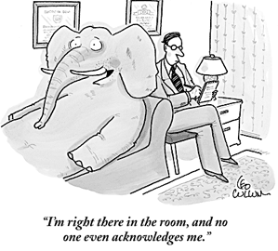

Slide 3
Today’s Agenda: Steps in Advance Care Planning
Educate
Prepare
Communicate
Document
Act
Empower

Slide 4
Educate
Advance care planning is a PROCESS of making and communicating future healthcare decisions.
It is a valuable tool to reduce stress and anxiety for patients and families and can lead to improved quality of care.
It helps ensure your choices are honored and is a gift to your family.

Slide 5
Educate
Learn from Terri Schiavo and her family
Adults in all stages of life
Life can change in an instant
End of life decision-making is difficult
Conflict is an unfortunate possibility
No decision is a decision

Slide 6
Prepare
What is important to YOU?
Affairs in order?
Free from pain?
Not a burden to family?
Maintain quality of life?
Be connected to my faith?
Share my story?
Be at home?

Slide 7
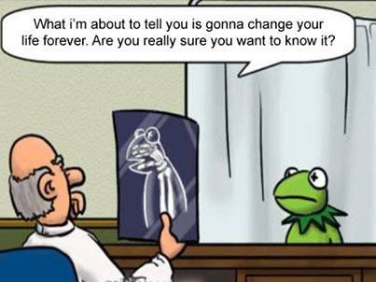
Communicate
It won’t be easy…

Slide 8
Communicate
Who needs to know?
Family members
Friends, neighbors, church members
Caregivers
Physicians
Clergy
Attorneys

Slide 9
Communicate
Remember:
Don’t rush
Include everyone involved
Not everyone has to agree initially
Use a reference point or trigger event
Use two-way communication
Use available resources

Slide 10
Document
Living Will
Use or removal of life-prolonging measures
When terminal or incurable
When you cannot communicate
Gives foundation for allowing natural death

Slide 11
Document
Limitations of the Living Will
Doesn’t give detail for all possible healthcare scenarios
May be disputed by medical personnel and/or family

Slide 12
Document
Healthcare Power of Attorney
Appoints a person to make decisions
Agent should be willing and able
You may appoint more than one – in order
Can make the decision of the Living Will
Healthcare-related decisions only

Slide 13
Document
Both Documents
Requires notarization and witnesses
Not used in traumatic situations
Photocopies are encouraged
Does not expire
Keep forms accessible
Forms are state specific

Slide 14
Document
Other documentation
DNR
Organ, eye, and tissue donation
Disposition of remains
Funeral planning, memorial service
Legacy – what do you want to be remembered from?
Legal and financial matters

Slide 15
Act
Now What?
Share documents
Continue conversations
Review choices at least annually

Slide 16
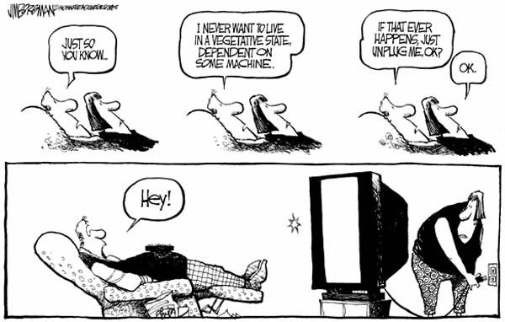
Act

Slide 17
Empower
All good gifts should be shared.
Tell family and friends about your experience
Seek out opportunities to learn more
Encourage others to practice Advance Care Planning
Do something on your bucket list
Be proud

Slide 18
Questions?

Slide 19
Presenter:
Date:

