Slide 1
Oncotype DX Genomic Prostate Score – “Fit for Purpose” Development, Validation, and Utility
Phil Febbo, MD
Chief Medical Officer
Genomic Health, Inc.

Slide 2




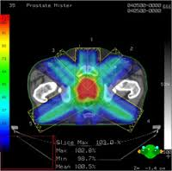
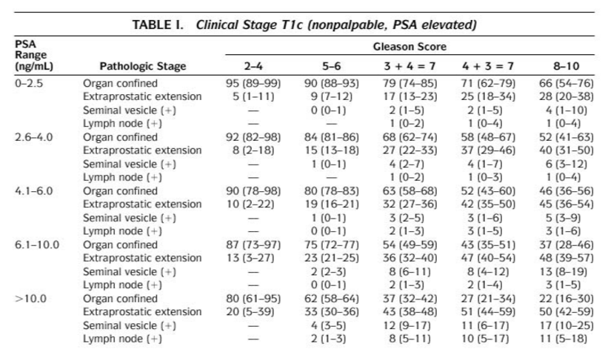
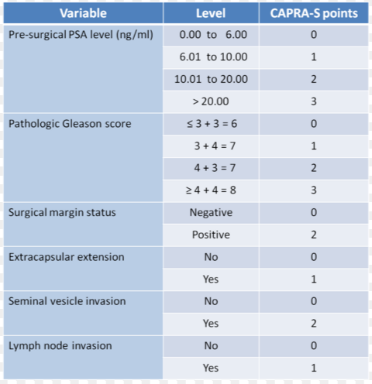
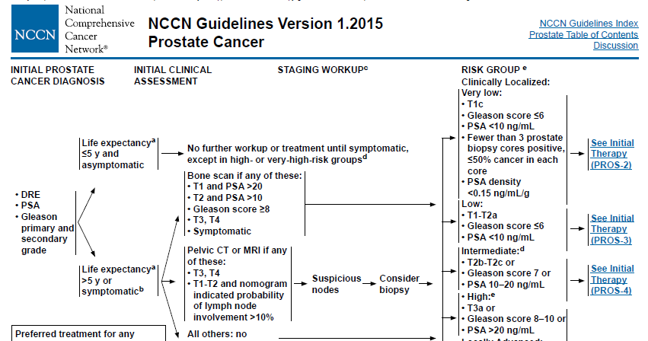
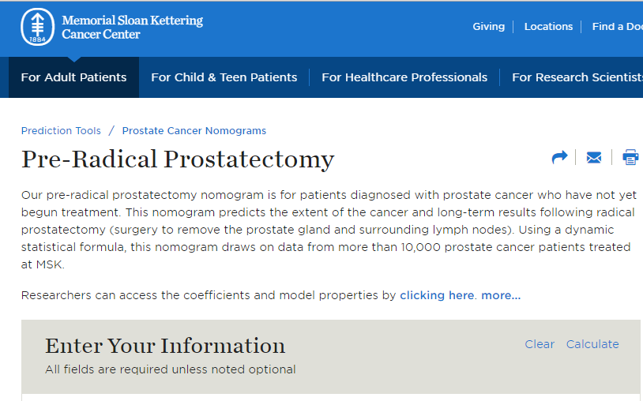
Now that Active Surveillance is part of Urology Practice – How do you identify appropriate patients?
AS
Rx
Lower Risk
Higher Risk

Slide 3
GPS Case Study
59 year-old patient
PSA: 5.8
Gleason Score: 3+3=6
Number of cores positive/collected: 3/12
>50% tumor involvement in any core: No
Stage: T1c
PSA Density: 0.13
Life Expectancy: 25 yrs.
_____________________________________
CASE SUBMITTED BY:
Peter Scardino, M.D.
MSKCC, NY
  What is this patient’s risk due to prostate cancer?
  What would your guidance be for this patient?
  What additional information would you encourage the man to obtain to confidently make a treatment decision?

Slide 4
Prostate Cancer Timeline
Diagnosis ^{1,2,3,4}
Gleason Score
~2-30 Yr. Window^{5,6,7,8,9}
Gleason 6/3+4 and
Organ Confined
Minimal Risk
of BCR
Minimal Risk of Metastatic Disease
Minimal Risk of
PCa Death
Biopsy
Result
Gleason ≥4+3 and/or pT3
Increased Risk
of BCR
Increased Risk Metastatic Disease
Death Due
to PCa
Most important decision is made at this time
  To treat or not to treat?
Understanding adverse pathology is pivotal in the assessment of prostate cancer and will impact the road ahead
1. Amin A, Partin A, Epstein JI. Gleason score 7 prostate cancer on needle biopsy: relation of primary pattern 3 or 4 to pathological stage and progression after radical prostatectomy. J Urol. 2011;186(4):1286-90.
2. Boorjian SA, Karnes RJ, Crispen PL, et al. The impact of discordance between biopsy and pathological Gleason scores on survival after radical prostatectomy. J Urol. 2009;181(1):95-104
3. Pinthus JH, Witkos M, Fleshner NE, et al. Prostate cancers scored as Gleason 6 on prostate biopsy are frequently Gleason 7 tumors at radical prostatectomy: implication on outcome. Journal of Urology. 2006;176(3):979-84.
4. Shariat SF, Kattan MW, Vickers AJ, et al. Critical review of prostate cancer predictive tools. Future Oncol. 2009;5(10):1555-84.
5. Ross HM, Kryvenki ON, Cowan JE, et al. Do adenocarcinomas of the prostate with Gleason score ≤6 have the potential to metastasize to lymph nodes? Am J Surg Pathol. 2012 September ; 36(9): 1346–1352. doi:10.1097/PAS.0b013e3182556dcd.
6. Klotz L, Vesprini D, Sethukavalan P, et al. Long-term follow up of a large active surveillance cohort of patients with prostate cancer. Journal of Clin. Onc. 15 December 2014. 10.1200/JCO.2014.55.1192
7. Freedland SJ, Humphreys EB, Mangold LA, et al. Risk of prostate cancer specific mortality following biochemical recurrence after radical prostatectomy. JAMA. 2005; 294(4):433-439. doi:10.1001/jama.294.4.433.
8. Pound CR, Partin AW, Epstein JL, et al. Prostate-specific antigen after anatomic radical retropubic prostatectomy. Patterns of recurrence and cancer control. Uro Clin North Am. 1997 May; 24(2):395-406
9. Han M, Snow PB, Epstein JL, et al. A neural network predicts progression for men with Gleason score 3+4 versus 4+3 tumors after radical prostatectomy. Urology. 2000 Dec 20;56(6):994-9.

Slide 5
Random Biopsies are Random
The heterogeneity and multifocality of prostate cancer leads to grading and staging errors in over a third of all TRUS guided biopsies.
Final Pathology – GS 7 (3 + 4)
4
+
4
3
+
3
3
+
3
3
+
4
(-)

Slide 6
Needle Bx GS ≤6:
Limited Concordance With RP
Publication | Time Period (Institution) | n | % Concordant with RP | % Upgraded | % Downgraded
Chun 2006 | (Hamburg, UTSW, Montreal, Milan) | 3296 | 61% | 39% | 0%
Fine 2007 | 2002-2003 (JHH) | 1117 | 80% | 20% | 0%
Rajinikanth 2007 | 1992-2006 (Miami) | 910 | 65% | 35% | 0%
Muntener 2008 | 1982-2005 (JHH) | 5209 | 75% | 25% | 0%
Cohen 2008 | 1982-2007 (Lahey Clinic) | 1168 | 54% | 46% | 0%
Boorjian 2009 | 1987-2003 (Mayo) | 5908 | 79% | 21% | 0%
Corcoran 2010 | 1995-2003 (AUS/CA) | 670 | 41% | 57% | 2%
Kuroiwa 2010 | 1997-2005 (Kyushu U.) | 545 | 62% | 39% | 0%
Corcoran 2011 | 2003-2008 (AUS/CA) | 298 | 33% | 67% | 0%
 |  | 19,121 | 70% Weighted | 30% Weighted | 0% Weighted

Slide 7
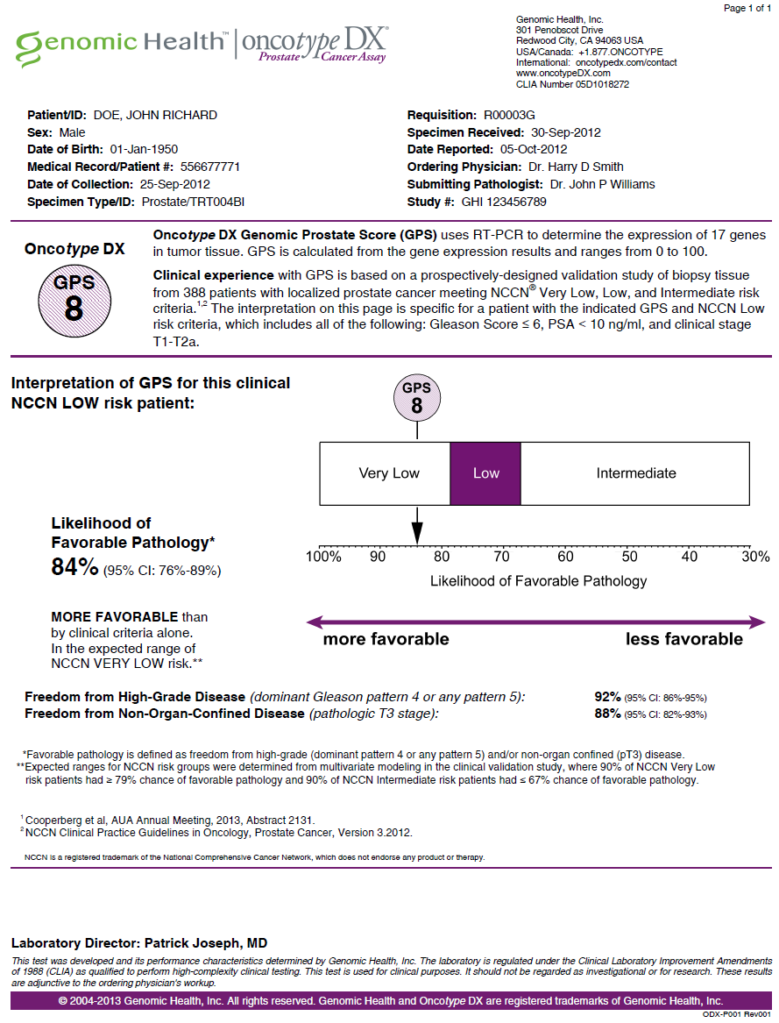
The Oncotype DX® Prostate Cancer Assay
WHAT is the test?
  A tumor gene expression assay which produces a Genomic Prostate Score (GPS) to help guide initial treatment decisions at the time of biopsy
WHO is the test for?
  Men with low to intermediate risk prostate cancer (GS 3+3 and 3+4)
WHY do the test?
  To improve risk stratification by incorporating individual underlying tumor biology
  To identify appropriate patients for active surveillance (AS) or immediate treatment
HOW are the results reported?
  Favorable Pathology: freedom from high-grade (dominant pattern 4 or any pattern 5) and/or non-organ-confined disease

Slide 8


Driving the transition to Precision Medicine by Addressing Critical Questions

Slide 9
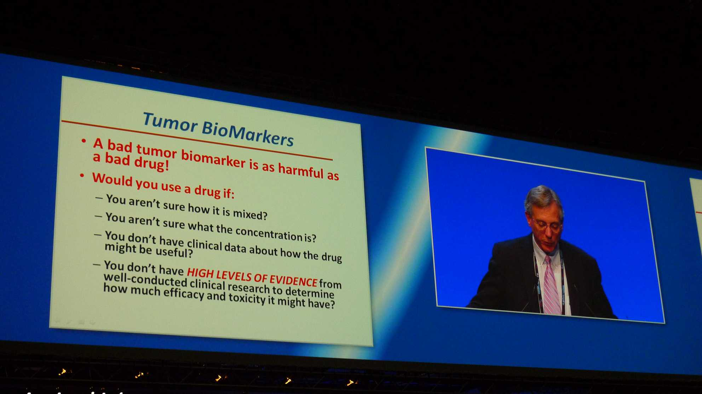
“A bad tumor biomarker is as harmful as a bad drug! ” – Dan Hayes, University of Michigan
St Gallen Breast Cancer Symposium 2013

Slide 10
Program Overview
Development of the Oncotype DX® Genomic Prostate Score
Validation of the Oncotype DX® Genomic Prostate Score
Utility of the Oncotype DX® Genomic Prostate Score

Slide 11
Fit-For-Purpose Development, Validation and Utility Using the GHI Playbook
Prostatectomy Cancer Feasibility Studies (n=104)
Development
Prostatectomy Study (n=441)
Endpoints: Clinical Recurrence, Biochemical Recurrence,
Prostate Cancer Death, Adverse Pathology at RP
Biopsy Development Study #1 (n=167)
Endpoint: Prediction of Adverse Pathology at RP
Selection of Final Gene List & Algorithm
Analytic Validation
Standardization and Validation of Analytical Methods
Clinical
Validation
Clinical Validation Study #1 (n=395)
Endpoint: Prediction of Adverse Pathology at RP
Clinical Validation Study #2 (n=402)
Endpoints: Biochemical Recurrence (n=402),
Prediction of Adverse Pathology at RP (n=382),
Metastasis (n=402)
Clinical
Utility
Clinical Utility Study #1: Decision Impact (n=158)
Clinical Utility Study #2: Chart Pull (n=200)

Slide 12
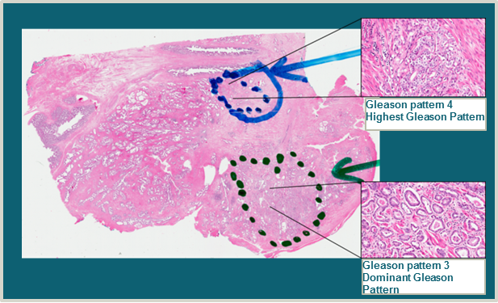
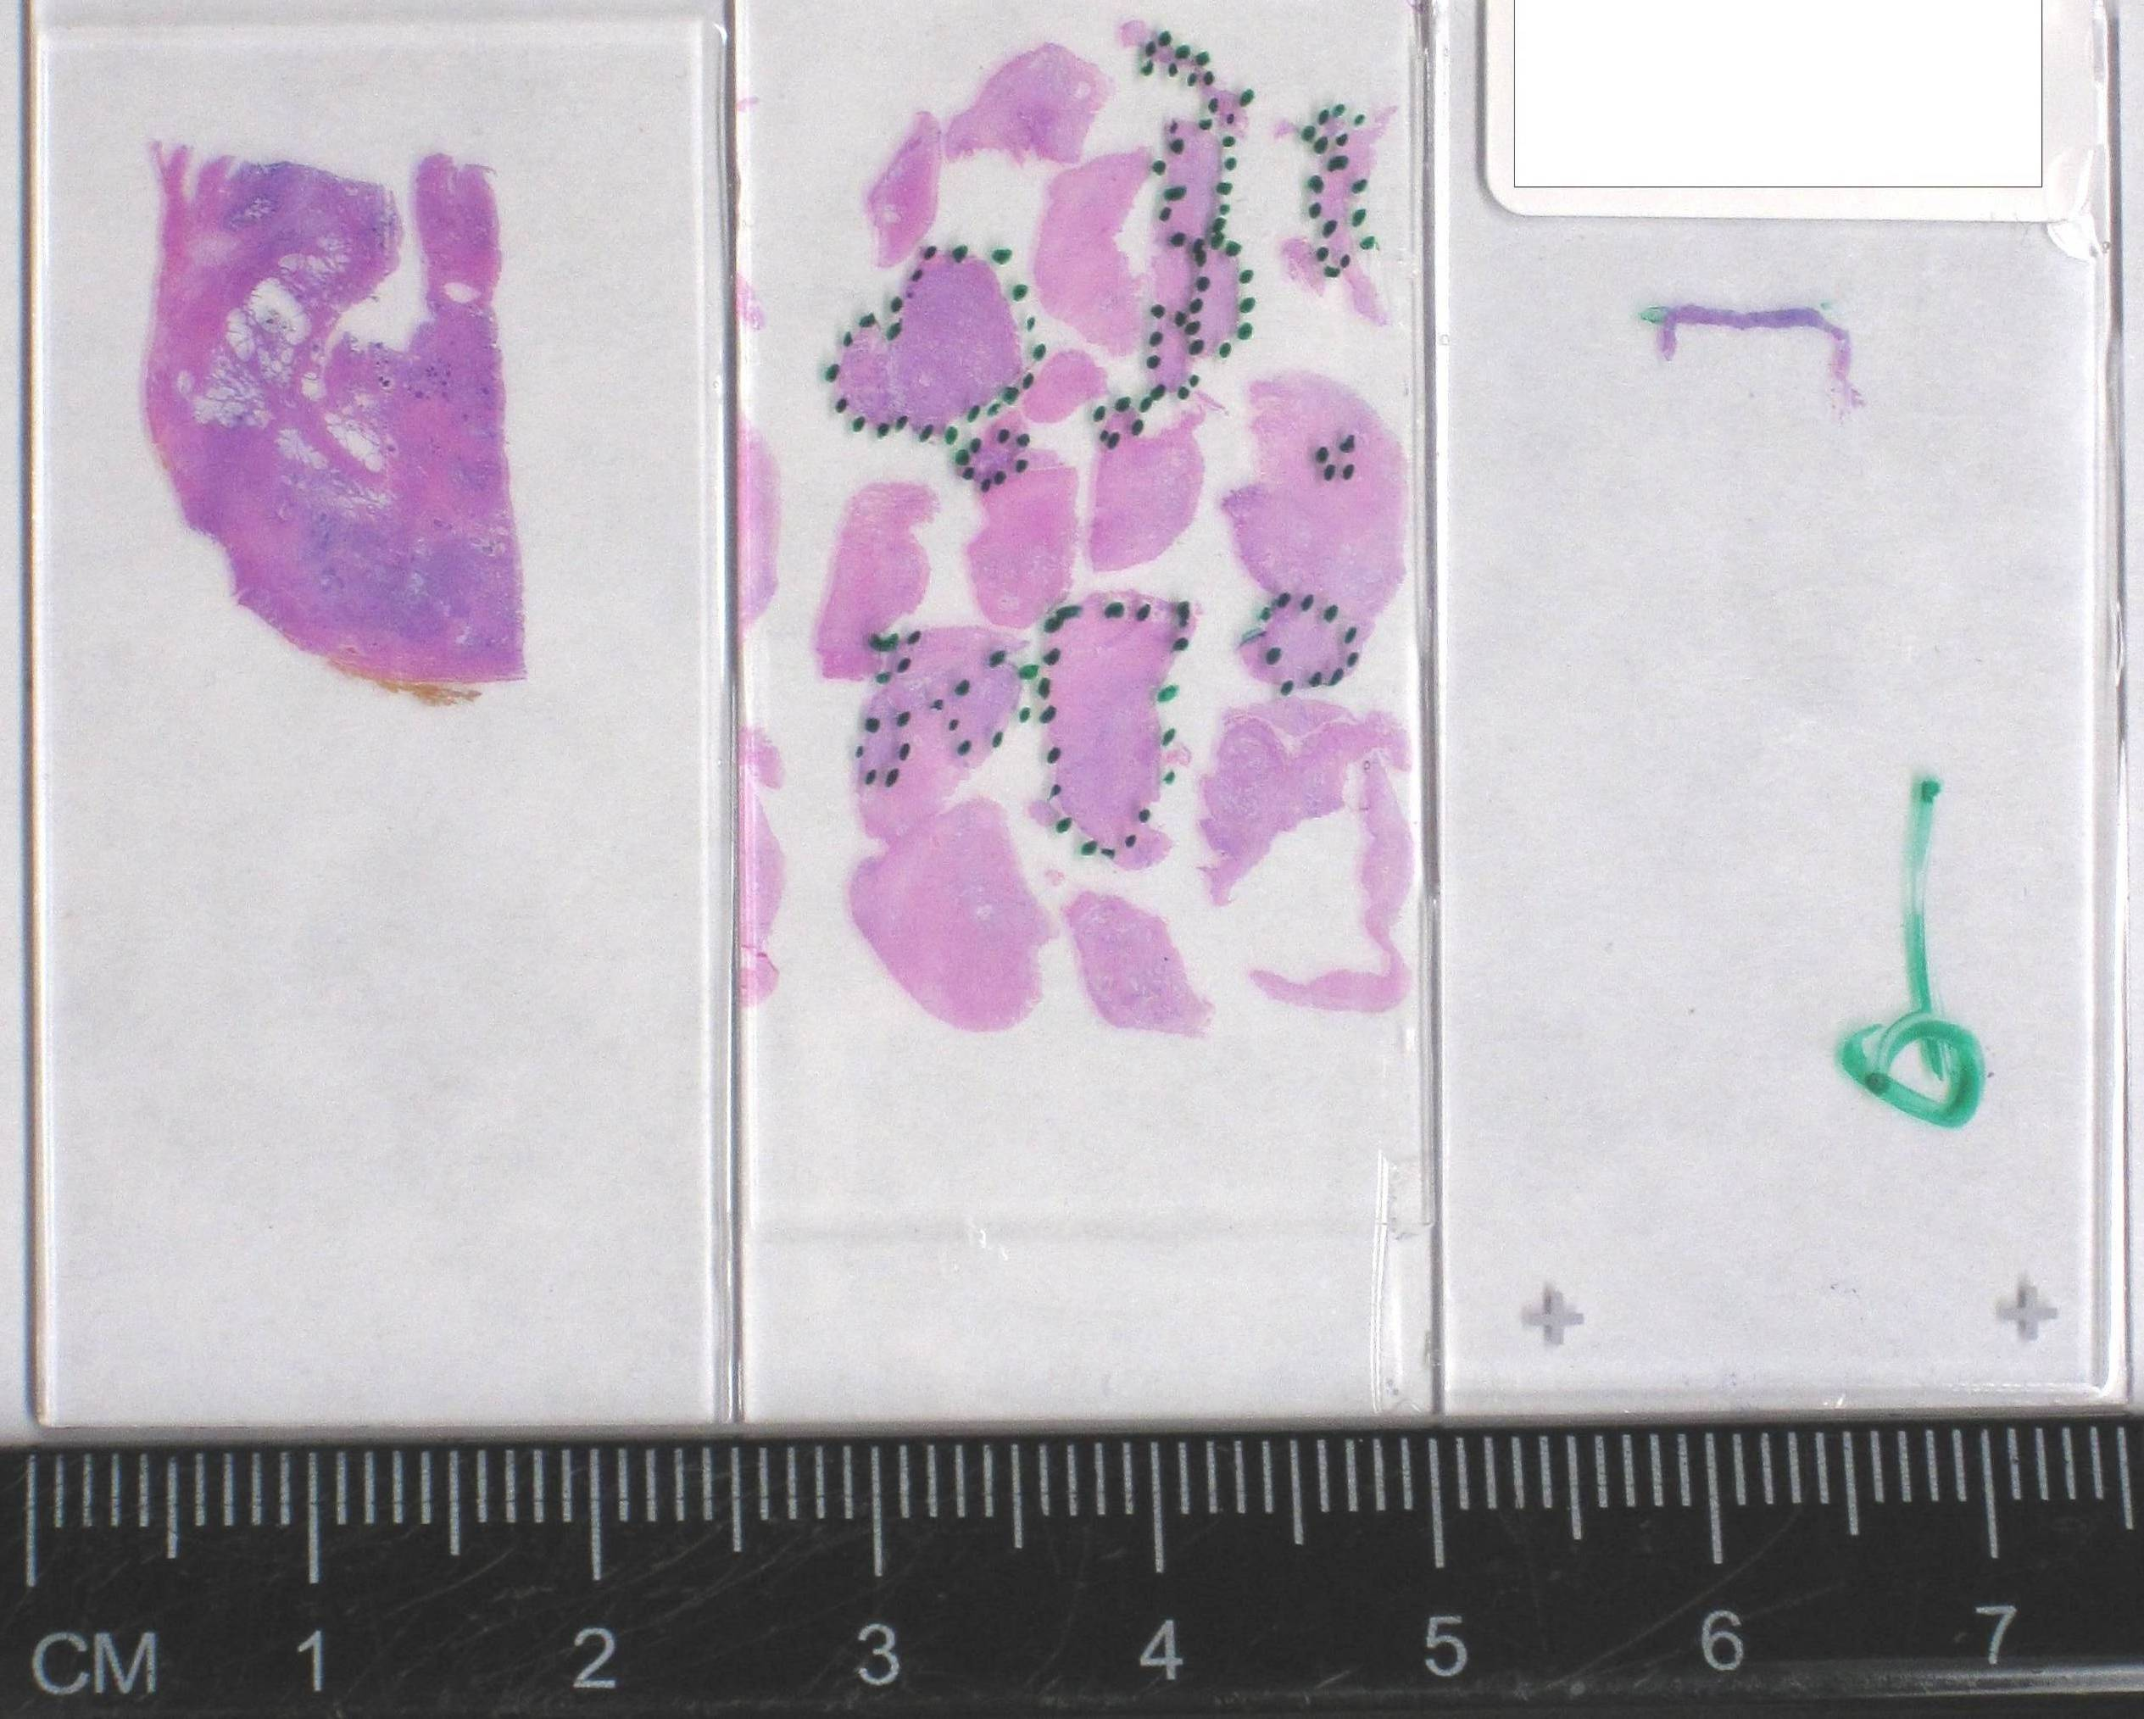
Oncotype DX® GPS
Specifically Designed to Work in Biopsy Tissue
Two spatially distinct areas of tumor representing the dominant (primary) and the highest Gleason pattern for each patient were analyzed to identify genes which are predictive regardless of sampled Gleason pattern
Selected genes which predict clinical outcome in the face of tumor heterogeneity and biopsy under-sampling and perform well in biopsy tissue
Standardized analytical platform for reliable measurement of 17-gene GPS assay in small volume tumor from biopsies
Analytical Performance
  96% of biopsies yielded successful GPS results
  99.5% of samples with > 10 ng RNA yielded successful results
Prostatectomy
TURP
Prostate
Biopsy

Slide 13
Gene Selection for the Oncotype DX® GPS Assay
727 candidate genes in dominant Gleason samples
727 candidate genes in highest Gleason samples
288 genes predictive
regardless of sampled
Gleason pattern
367 genes predict outcome
(highest)
374 genes predict outcome
(dominant)
288 Genes
Consistent performance in biopsies
Predict PC death, adv. path, BCR
Value beyond existing measures
Represent key pathways
Analytical performance
Final 17 GPS Genes
PC, prostate cancer; BCR, biochemical recurrence.

Slide 14
GPS Incorporates Multiple Biologic Pathways
Predictive of Prostate Cancer Aggressiveness
Genes Associated with Worse Outcome
Genes Associated with Better Outcome
Stromal Response
BGN
COL1A1
SFRP4
Androgen Signaling
AZGP1
FAM13C
KLK2
SRD5A2
The combination of
multiple pathways
is more
predictive than
any single pathway
Proliferation
TPX2
Cellular Organization
FLNC
GSN
GSTM2
TPM2
Reference Genes
ARF1
ATP5E
CLTC
GPS1
PGK1

Slide 15
Program Overview
Development of the Oncotype DX® Genomic Prostate Score
Validation of the Oncotype DX® Genomic Prostate Score
Utility of the Oncotype DX® Genomic Prostate Score

Slide 16
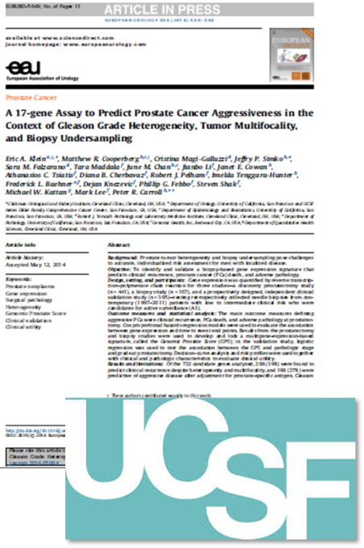
Clinical Validation Study #1
University of California, San Francisco (UCSF)
Prostatectomy Cancer Feasibility Studies (n=104)
  Objectives:
  To validate GPS as a predictor of adverse pathology in a contemporary clinically low risk patient cohort
  To determine whether GPS adds independent predictive information beyond standard clinical and pathologic data
Prostatectomy Study (n=441)
Endpoints: Clinical Recurrence, Biochemical Recurrence,
Prostate Cancer Death, Adverse Pathology at RP
Biopsy Development Study #1 (n=167)
Endpoint: Prediction of Adverse Pathology at RP
Selection of Final Gene List & Algorithm
Standardization and Validation of Analytical Methods
Clinical Validation Study #1 (n=395)
Endpoint: Prediction of Adverse Pathology at RP
Clinical Validation Study #2 (n=402)
Endpoints: Biochemical Recurrence (n=402),
Prediction of Adverse Pathology at RP (n=382),
Metastasis (n=402)
Clinical Utility Study #1: Decision Impact (n=158)
Clinical Utility Study #2: Chart Pull (n=200)
Klein, Cooperberg et al, Euro Urol (2014).

Slide 17

Successful Validation of GPS: Improved Risk Discrimination with Addition of GPS to NCCN
100
Multivariate Analysis
NCCN p-value = 0.002
GPS p-value = 0.001
90
NCCN Very Low = 84%
80
NCCN Low = 75%
70
60
NCCN Low-Intermediate = 56%
Very Low
Likelihood of Favorable Pathology (%)
Low
50
40
30
Intermediate
20
10
0
0
10
20
30
40
50
60
70
Very Low
Low
Low-Intermediate
0
10
20
30
40
50
60
70
GPS
Cooperberg et al, AUA 2013

Slide 18
Combining Biologic & Clinical Information Refines Risk Stratification for Individual Patients
Population-Based Clinical Risk Assessment
VERY LOW RISK
LOW RISK
LOW-INTERMEDIATE RISK
10% (N=37)
49% (N=191)
41% (N=160)
GPS
UCSF Validation Study NCCN Risk Classification
10% Very Low-risk
49% Low-risk
41% Intermediate Risk
Enables more accurate identification of a larger population of patients who can more confidently choose active surveillance
35% of men in the NCCN Low-risk group had more indolent biology and likelihood of favorable pathology consistent with Very Low-risk
Predicted which patients have risk consistent with their NCCN clinical risk group
Adds more accurate risk assessment by combining biological and clinical risk factors
Precisely identifies a patient’s tumor biology and refines the population-based clinical risk assessment with a more personalized risk assessment
10% of men in the NCCN Low-risk group had more aggressive biology and likelihood of favorable pathology consistent with Intermediate risk
Identified patients in the NCCN Very Low-risk group who had more aggressive biology, with likelihood of favorable pathology consistent with Low and Intermediate risk disease
Identified patients with Intermediate risk who had more indolent biology, predicted to be consistent with Low-risk disease
GPS Provides Biologic Risk Information
More Individualized Biologic and Clinical Risk Assessment
VERY LOW RISK
LOW RISK
LOW-INTERMEDIATE RISK
26% (N=100)
31% (N=119)
44% (N=169)
GPS=8
84%
GPS=51
57%
GPS=25
75%
100%
30%
Likelihood of Favorable Pathology
Cooperberg et al, AUA 2013

Slide 19

Clinical Validation Study #2
Center for Prostate Disease Research (CPDR)
Prostatectomy Cancer Feasibility Studies (n=104)
Primary objective:
Determine if GPS can predict the time to biochemical recurrence (BCR) after RP
Secondary objectives:
Confirm that GPS can predict the likelihood of adverse pathology (AP) at RP
Determine if GPS is associated with development of
metastatic disease
Key Exploratory objective:
Compare the performance of GPS in African-American and
Caucasian patients
Prostatectomy Study (n=441)
Endpoints: Clinical Recurrence, Biochemical Recurrence,
Prostate Cancer Death, Adverse Pathology at RP
Biopsy Development Study #1 (n=167)
Endpoint: Prediction of Adverse Pathology at RP
Selection of Final Gene List & Algorithm
Standardization and Validation of Analytical Methods
Clinical Validation Study #1 (n=395)
Endpoint: Prediction of Adverse Pathology at RP
Clinical Validation Study #2 (n=402)
Endpoints: Biochemical Recurrence (n=402),
Prediction of Adverse Pathology at RP (n=382),
Metastasis (n=402)
Clinical Utility Study #1: Decision Impact (n=158)
Clinical Utility Study #2: Chart Pull (n=200)
Cullen J, et al. Eur Urol. 2014.

Slide 20
GPS correlates with risk of biochemical recurrence (BCR) and development of metastatic disease
Variable | HR | 95% CI | P-value
GPS per 20 Units | 3.83 | (1.13 - 12.60) | 0.032
GPS was strongly associated with time to metastasis in univariable analysis
The small number of events (n=5) precluded multivariable analysis
The average 5-year risk of BCR was 7.5% in men in the
lowest GPS quartile (GPS <23)
The average 5-year risk of BCR was 33.6% in men in the highest GPS quartile (GPS >39)
Cullen J, et al. Eur Urol. 2014.

Slide 21
Validation Study Conclusions
In patients with very low, low and low-intermediate risk prostate cancer, the GPS has been prospectively validated as a biopsy-based predictor of adverse pathology
The GPS adds independent predictive information beyond standard clinical and pathological measures
The GPS assesses underlying biology from very small biopsy tumor volumes, addressing issues of tumor heterogeneity and biopsy under-sampling to more accurately predict disease aggressiveness
Incorporation of the GPS enables more accurate identification of a larger population of patients who can more confidently choose active surveillance or immediate therapy as an initial management strategy

Slide 22
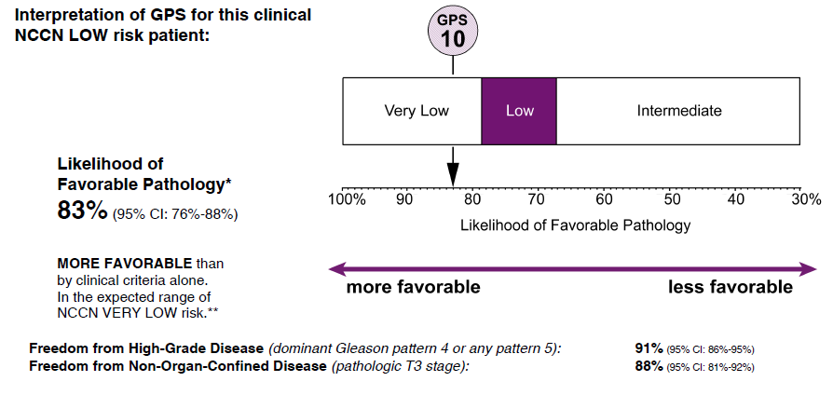
GPS Case Study
59 year-old patient
PSA: 5.8
Gleason Score: 3+3=6
Number of cores positive/collected: 3/12
>50% tumor involvement in any core: No
Stage: T1c
PSA Density: 0.13
Life Expectancy: 25 yrs.
Initial Clinical Risk (NCCN): Low
Pre GPS Recommendation: Undecided
____________________________________
CASE SUBMITTED BY:
Peter Scardino, M.D.
MSKCC, NY
GPS RESULTS
GPS of 10: NCCN Very Low
Likelihood of favorable pathology: 83%
Post GPS Recommendation: AS and patient agreed.

Slide 23
Case Study
59 year-old patient
PSA: 5.8
Gleason Score: 3+3=6
Initial Clinical Risk (NCCN): Low
100
83%
90
80
70
60
Very Low
Likelihood of Favorable Pathology (%)
Low
50
40
30
Intermediate
20
10
GPS
10
0
0
10
20
30
40
50
60
70
GPS
Cooperberg et al, AUA 2013

Slide 24
Program Overview
Development of the Oncotype DX® Genomic Prostate Score
Validation of the Oncotype DX® Genomic Prostate Score
Utility of the Oncotype DX® Genomic Prostate Score

Slide 25
Clinical Utility Framework
Does use of the assay change the management of patients?
Does use of the assay change physician recommendations?
Does the assay provide information for a management decision above and beyond what is available with established clinical and pathological characteristics?
Does use of the assay improve patient outcomes?
Treatment Related Morbidity
Health Care Utilization
Building toward Patient Benefit

Slide 26
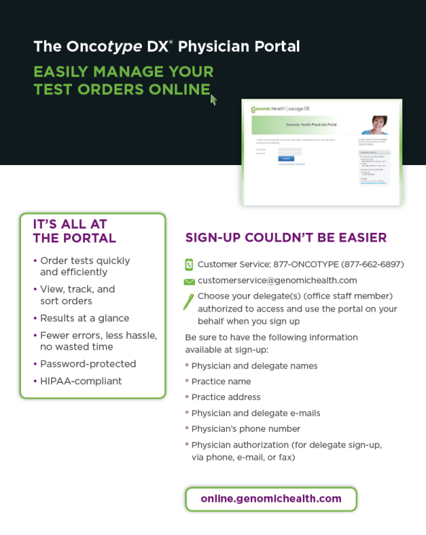
Ordering Process
Order through the portal (online.genomichealth.com) or via fax
The portal offers several advantages:
  Orders may be viewed online, printed,
  or downloaded as PDFs.
  All patient orders and reports are easily
  viewed, tracked and sorted quickly
  and efficiently.
  Fewer errors result in fewer call backs,
  less hassle and no wasted time.
To register for the physician portal:
  877-ONCOTYPE / 877-662-6897 or
  customerservice@genomichealth.com

Slide 27
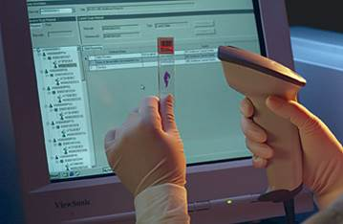
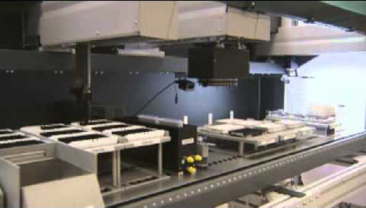
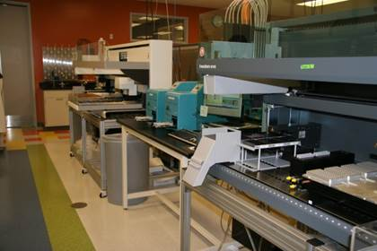
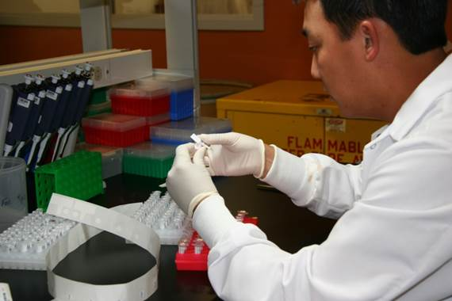
State-of-the-Art Central Laboratory
Central state-of-the-art laboratory with highly regulated quality control processes
High reproducibility¹ and low variability of test results over time²
¹ Cronin M, et al. Clin Chem. 2007. ² Baehner FL et al, San Antonio Breast Cancer Symposium 2011
Notes:
.

Slide 28
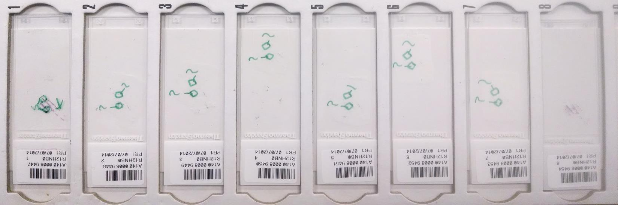
Marking of Tumor for Microdissection
Intervening unstained slides
Top H&E slide
Bottom H&E slide

Slide 29
Clinical Utility Study #1
Prostatectomy Cancer Feasibility Studies (n=104)
  Objective:
  Assess the utility of the GPS by evaluating changes in urologist’s treatment recommendations or actual treatment received before and after receiving GPS results
  Primary objectives:
  Assess all changes in treatment modality and/or treatment intensity recommendations post-GPS
Prostatectomy Study (n=441)
Endpoints: Clinical Recurrence, Biochemical Recurrence,
Prostate Cancer Death, Adverse Pathology at RP
Biopsy Development Study #1 (n=167)
Endpoint: Prediction of Adverse Pathology at RP
Selection of Final Gene List & Algorithm
Standardization and Validation of Analytical Methods
Clinical Validation Study #1 (n=395)
Endpoint: Prediction of Adverse Pathology at RP
Clinical Validation Study #2 (n=402)
Endpoints: Biochemical Recurrence (n=402),
Prediction of Adverse Pathology at RP (n=382),
Metastasis (n=402)
Clinical Utility Study #1: Decision Impact (n=158)
Clinical Utility Study #2: Chart Pull (n=200)
Badani et al, Urology Practice (2015); Dall’Era M et al, Urology Practice (2015)

Slide 30
Clinical Utility Study #1:
Changes in Treatment Recommendations
30
Pre-GPS: n=64
Post-GPS: n=81
20
10
24%
0
Treatment Recommendation (%)
Relative Change in
19%
-10
-
21%
-
33%
-
-20
Pre-GPS: n=57
Post-GPS: n=46
Pre-GPS: n=22
Post-GPS: n=18
-30
Pre-GPS: n=10
Post-GPS: n=6
-40
AS
RP, Standard LN
RP, No LN
EBRT
Recommended Treatment*
For all risk groups, GPS resulted in a 26% change in recommended treatment modality or intensity
There was a 24% relative increase in recommending AS based on the biologic information provided
by the GPS result (AS increased from 41% to 51%)
*Only modalities with at least 10 patients pre-GPS were included; multimodal increase from 2% to >3% and RP with extensive LN increase from 1% to 2%
Badani et al, Urology Practice (2015)

Slide 31
Clinical Utility Study #2:
Impact of GPS on AS Decisions
GPS increased the decision to pursue AS* across all risk groups
Very Low | Nearly all (89%) of the Very Low GPS patients pursued AS compared to those without a GPS result (61%)
Low | A large percentage of the Low GPS patients (63%) pursued AS compared to those without a GPS result (37%)
Intermediate | For the Intermediate GS 3+4 men, GPS patients pursued AS more often (35%) compared to those without a GPS result (20%)
* Included Active Surveillance/Watchful Waiting
Dall’Era M et al, Urology Practice (2015)

Slide 32
Oncotype DX Ongoing Studies
Clinical Validation Studies
  Validation Studies in Active Surveillance Cohorts
  Validation Studies in men who progressed to metastatic disease and PCSM
  Validation Studies in a Radiation Therapy cohort
Is there an opportunity for Prospective Randomized Controlled Trial to validate genomic predictors of early stage prostate cancer?

Slide 33





Thank You
Do I need
chemotherapy?
Do I need
radiation?
Do I have
aggressive
disease?
Do I need
Immediate treatment?
INVASIVE
BREAST CANCER
DCIS
BREAST CANCER
STAGE II/III
COLON CANCER
PROSTATE CANCER

Slide 34
Thank You

