Slide 1
Active Surveillance for Prostate Cancer:
Utility of Genomic and Genetic Testing
Brian T. Helfand MD, PhD
Division Chief of Urology
Ronald L. Chez Family and Richard Melman Family Endowed Chair of Prostate Cancer
NorthShore University HealthSystem
Clinical Associate Professor, Department of Surgery
University of Chicago Pritzker School of Medicine

Slide 2
Problems in Prostate Cancer
No “absolute truths” in medicine and prostate cancer
Errors that occur from time of screening to treatment:
  PSA screening
    25-30% daily variability in PSA levels
  Prostate biopsy
    30% of men who undergo biopsy may have cancer that miss
    30-40% of men may have more aggressive tumor than biopsy
  Low risk prostate cancer
    30-40% of men will develop more aggressive tumors

Slide 3
Problems Associated with Errors
Over-diagnosis of many ”indolent” tumors
Over-treatment of many “indolent” tumors
Under-diagnosis of some aggressive/lethal cancers
Under-treatment of some aggressive/lethal cancers

Slide 4
Why are there Errors?
Not all tumors constructed equally
  Some more aggressive and others less aggressive potential
Prostate tumors are multifocal
  Not just 1 tumor in the prostate
Gl 4
Gleason 3= non-aggressive
Gleason 4= intermediate
Gleason 5= very aggressive
Gl 3
Biopsy #2:
Negative Biopsy
Gl 3
Biopsy #1:
Positive with Gl 3+4
Gl 5

Slide 5
Active Surveillance (AS)
Response to these errors and problems
Strategy to safely monitor men with seemingly
low risk tumors and avoid over-treatment and
possible side effects (e.g. incontinence,
erectile dysfunction)

Slide 6
NSUHS Active Surveillance cohort
1007 men enrolled in formal program
  another 250 off protocol
Initiated in 2007
Age at diagnosis: mean 63.4 years
PSA at diagnosis: median 5.1
Duration of follow up: median 56 months
90% low risk, 10% intermediate risk
27% re-categorization rate

Slide 7
Identification of Ideal Candidate for AS
My Belief:
There is no single test that can reliably identify
patients that will never develop
more aggressive disease

Slide 8
Identification of Ideal Candidate for AS
Overall Gestalt of Tests that Contribute to Decision
PSA (<10)
PSA “density” (PSA/gland volume) (< 0.15)
PHI, 4K score (<35)
Stage (T1/2)
Cancer grade (3/3)
Cancer grade - volume, subtype
MRI (PIRADS 1- 3)
Genomics (Prolaris, OncotypeDX or Decipher)
Genetics

Slide 9
Genomics and Genetics of Prostate Cancer
Genomics is a relatively broad terminology that refers to study of an individual’s complete DNA content and structure
Includes many aspects from DNA sequence to RNA sequence to proteins

Slide 10
Genomics and Genetics of Prostate Cancer
DNA is in every cell
DNA-->
RNA→
Protein
DNA is passed from
generation to generation

Slide 11
Germline Mutations
Present in egg or sperm
Can be inherited
All cells in affected offspring
Cause of cancer familial syndromes
In every cell
Altered DNA →
Altered RNA→
Altered Protein

Slide 12
Somatic Mutations
DNA mutations accumulate in cells and tissue
Result of many factors (e.g. sun exposure, chemicals)
Not inherited
Only in cells with alterations
(ex. Prostate)
Altered DNA →
Altered RNA→
Altered Protein

Slide 13
Genomics and Genetics of Prostate Cancer:
Keep it Simple
Genomic Tests:
Evaluating RNA produced in Cancer Cells
Genetic Tests:
Evaluating if abnormalities or mutations in
Germline DNA (any cell)
Somatic DNA (cancer cells)

Slide 14



Overview of three genomic tests for the active surveillance (AS) decision
31 cell cycle progression (CCP) genes and 15 housekeeper genes¹
22 genes in multiple PCa-related pathways⁵
12 genes in multiple PCa-related pathways and 5 reference genes¹⁰
Reports:
Risk of metastasis at 10 years²
Risk of PCa-specific death at 10 years^{3,4}
Reported % risk incorporates clinicopathologic features with molecular score
Reports:
Risk of high-grade (>GG3) disease⁶
Risk of metastasis at 5 years^{7,8}
Risk of PCa-specific death at 10 years^{8,9}
Reported % risk based on molecular score alone
Reports:
Risk of high-grade (>GG3) disease^{10,11}
Risk of >pT3a disease^{10,11}
Risk of metastasis at 10 years¹²
Risk of PCa-specific death at 10 years¹²
Reported % risk incorporates clinicopathologic features with molecular score
1. Cuzick et al. Lancet Oncol. 2011. 2. Bishoff et al. J Urol. 2014 3. Cuzick et al. British Journal of Cancer. 2012. 4. Cuzick et al. British Journal of Cancer. 2015. 5. Erho et al. PLOS ONE. 2013. 6. Klein et al. Urology. 2016. 7. Nguyen et al. Prostate Cancer Prostatic Dis. 2017. 8. Nguyen et al. Eur Urol. 2017. 9. Karnes et al. Eur Urol. 2017. 10. Klein et al. Eur Urol. 2014. 11. Cullen et al. Eur Urol. 2015. 12. Van Den Eeden et al. Eur Urol. 2017.
Notes:
Key Education Points:
This is an overview of the three commercial assays intended to guide the active surveillance (AS) decision.
Note that all three tests report risk of prostate cancer-specific death (PCD) and risk of metastasis.
The Prolaris® test reports risk of PCD using a cohort of patients on watchful waiting, while The Decipher® and Oncotype DX® tests report risk of PCD using data from radical prostatectomy (RP)-treated patients.
All three assays report risk of metastasis based on data in RP-treated patients.
The Prolaris test does not report risk of adverse pathology (high-grade or high-stage disease).
The Decipher test reports risk of high-grade disease only. The Oncotype DX test reports risk of adverse pathology (high grade and/or non-organ-confined disease).
This slide is a good place to note to the audience that the Prolaris and Oncotype DX tests both combine clinicopathologic features and molecular score into reported risks. while the Decipher reports risk based on molecular score alone.
References:
Cuzick et al. Lancet Oncol. 2011.
Cuzick et al. British Journal of Cancer. 2012.
Cuzick et al. British Journal of Cancer. 2015.
Bishoff et al. J Urol. 2014.
Erho et al. PLOS ONE. 2013.
Karnes et al. Eur Urol. 2017.
Nguyen et al. Eur Urol. 2017
Nguyen et al. Prostate Cancer Prostatic Dis. 2017
Klein et al. Urology. 2016.
Klein et al. Eur Urol. 2014
Cullen et al. Eur Urol. 2015.
Van Den Eeden et al. Eur Urol. 2017.

Slide 15
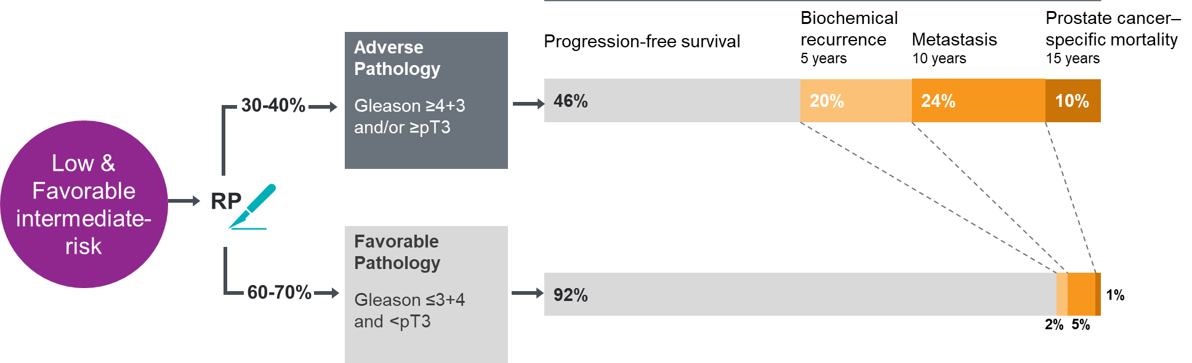
Presence of adverse pathology (AP) is a strong prognostic factor
RP – Radical Prostatectomy
Epstein et al. Eur Urol. 2016. Eggener et al. J Urol. 2011. Dinh et al. J Urol. 2015. Cooperberg et al. Cancer. 2011. Tilki et al. J Urol. 2015. Tososian et al. J Urol. 2013..
Notes:
Key Education Points:
Approximately 60-70% of men who have favorable pathology on initial biopsy will have favorable pathology on radical prostatectomy (RP), in contemporary series. Favorable pathology on biopsy in the setting of clinically low-risk disease is in most cases predictive of favorable pathology on RP. However, between 30-40% of men who are clinically low risk on biopsy will harbor occult adverse pathology (AP) features on surgical pathology after RP. AP is a critical determinant of long-term prognosis.
Because the men who have AP at surgery are the ones at greatest risk of disease progression, accurately determining which patients are at high risk of having AP at surgery (and hence benefit from immediate treatment) should be determined BEFORE surgery. Similarly, men who are at low risk for AP and have favorable disease are the best candidates to defer treatment and consider active surveillance.
A genomic test can provide the actionable information about who is at risk for AP.
How the Chart Was Generated
The estimates for rate of AP versus favorable pathology have been gleaned from a variety of studies including Epstein, Eggener, and Dinh.¹⁻³ There is obvious variability in the rate of pathologic upgrading in different patient populations, but this range is broadly reflective of current trends.
The estimates for rates of biochemical recurrence, metastasis, and death from prostate cancer are composites from Epstein (biochemical recurrence [BCR] within 5 years),¹ Cooperberg and Tilki (metastasis within 10 years),^{4,5} and Eggener (prostate cancer–specific mortality within 15 years),² respectively. In the raw data, the rate of metastasis at 10 years (reported by Cooperberg⁴ and Tilki⁵) was somewhat lower than the rate of death at 15 years reported by Eggener.² This led to some formatting issues with the way the data would be presented so the metastasis piece is a bit higher than Tilki and Cooperberg reported but within an approximate range.
Because AP as defined in the GPS assay comprises a wide range of aggressiveness (Gleason score [GS] 4+3 to GS 5+5 and pT3a to pT4), the percentage estimates are derived from averaging between prognostic groups. Compared with the percentages depicted here, the rate of BCR/metastasis/death is lower in men with GS 4+3 and higher in men with GS 8-10, but to keep the slide simple all these groups were collapsed together.
The bar depicting the favorable pathology group includes men ranging from low volume GS 3+3=6 to men with higher volume but organ-confined GS 3+4=7 disease. Hence, the ranges depicted here are also a composite of a variety of percentage estimates that were collapsed together. The difference in rate of various adverse events is obviously lower in this group compared with the AP group because outcomes are generally similar for organ-confined GS 3+3 and organ-confined GS 3+4.
The outcomes data is an approximation based on multiple sources.
References
Epstein et al. Eur Urol. 2016.
Eggener et al. J Urol. 2011.
Dinh et al. J Urol. 2015.
Cooperberg et al. Cancer. 2011.
Tilki et al. J Urol. 2015.
Tososian et al. J Urol. 2013

Slide 16
Oncotype DX
A genetic test panel testing the expression of 17 genes (12 genes that are related to different pathways, 5 housekeeper genes) , a Genomic Prostate Score (GPS) will be calculated.
Predict prostate cancer progression in AS population (prediction for aggressive prostate cancer).
Especially for those who are under AS. To make the decision of further treatment for patients with high risks.

Slide 17
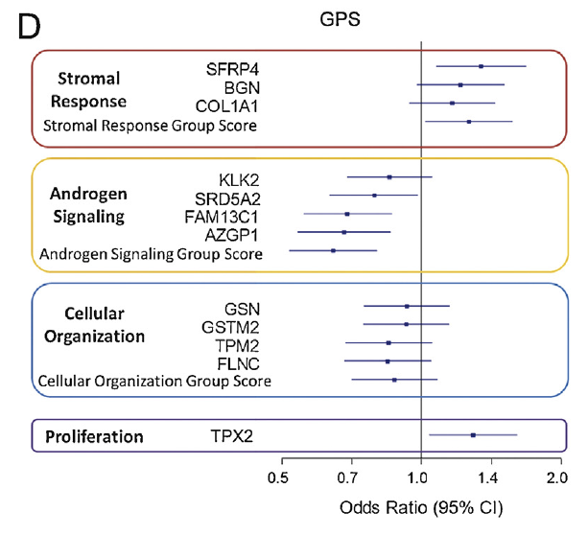
Oncotype DX
12 genes related to 4 different pathways

Slide 18
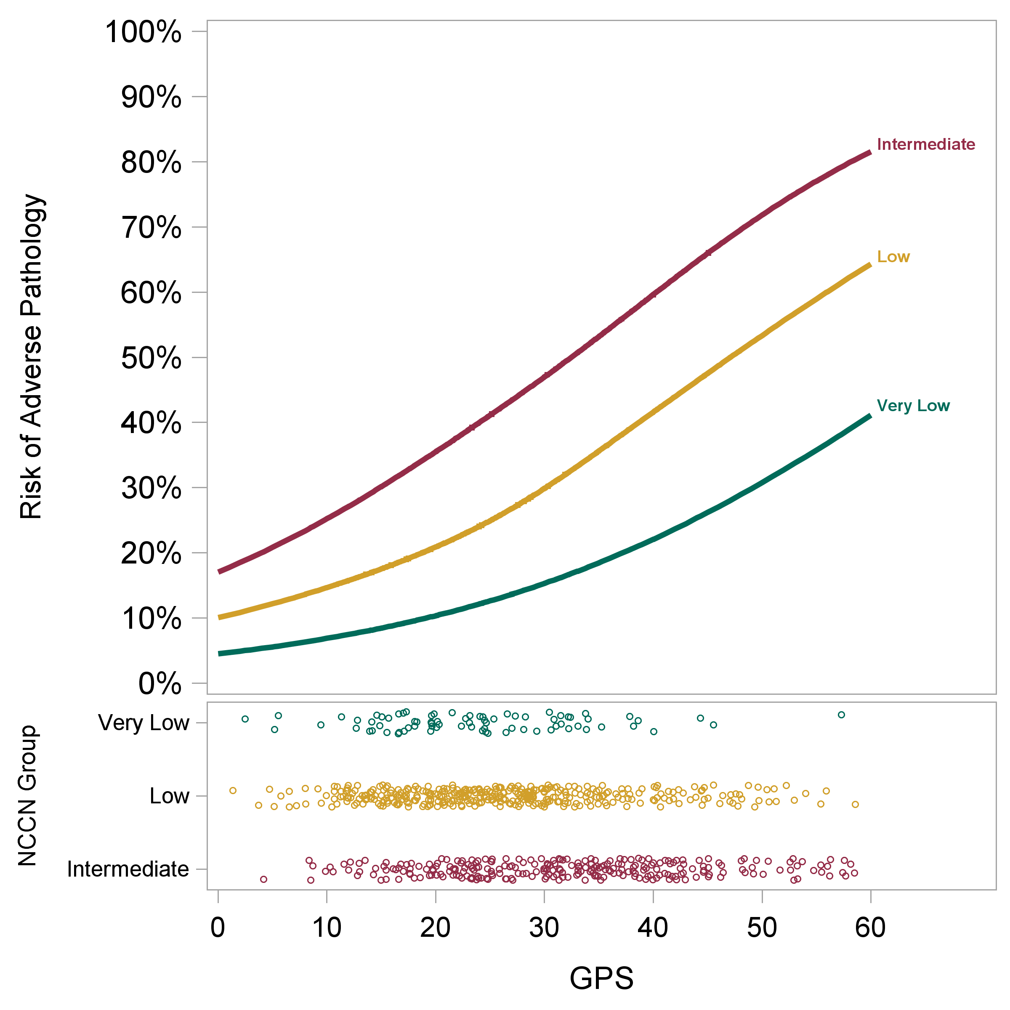
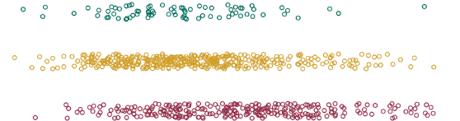
The GPS™ assay improves risk stratification and is validated as an independent predictor of adverse pathology
Intermediate
Low
Very Low
These may not be the ideal patients for radical prostatectomy
These may not be the ideal patients for active surveillance
Notes:
Key Education Points:
In validation studies one and two, using similar criteria for AP and centralized pathology review, the GPS™ assay was independently associated with AP risk after adjustment for individual clinical and pathologic factors AND/OR predictive nomograms that integrate these factors into risk groups (eg, NCCN, CAPRA).^{1,2}
Patients from these studies were combined into a patient-specific meta-analysis. By combining the cohorts
A cohort more representative of the US prostate cancer population was generated
Larger cohort size improved precision of AP estimates (narrower confidence intervals)
Estimates for outcomes in GS 3+4 cancer can be derived on patients with any volume disease (the UCSF validation was restricted to patients with 3 or fewer cores of GS 3+4 and <33% any core positive)
The risk profile curves of the meta-analysis provides improved risk stratification
With NCCN alone, 11% of patients have risk of AP consistent with NCCN Very Low
With GPS result + NCCN, 23% of patients have risk of AP consistent with NCCN Very Low
Additional Speaker Notes:
The second validation study (Cullen 2015 study) included 82 African American men. In sub-set analysis, the GPS assay was a significant and independent predictor of both AP and BCR in African-American men. These data indicate that the GPS assay can be useful for African-American men with clinically low risk disease who are considering initial management options.
The patient-specific meta-analysis can be thought of as combination of information in two studies that is specific to the individual patient in front of the physician.
Speaker Notes References
Klein et al. Eur Urol. 2014.
Cullen et al. Eur Urol. 2015.
Katz et al. AUA. 2015.
Slide Figure Reference
Brand et al. Urology. 2016.
Katz et al. AUA. 2015.

Slide 19
GPS score and upgrade on AS
Cox regression for risk of upgrade to Gleason ≥3+4 on subsequent biopsy for AS cohort of men diagnosed with Gleason 3+3
Characteristic | HR | 95% CI | p
Age at diagnosis (years) | 1.01 | 0.99-1.03 | 0.47
PSA density at diagnosis (log) | 1.33 | 0.92-1.91 | 0.13
Biopsy cores % positive at GPS | 1.01 | 1.00-1.02 | 0.03
GPS score (per 5 units) | 1.27 | 1.18-1.38 | <.01
J Urol. 2019 Feb;201(2):300-307. doi: 10.1016/j.juro.2018.08.047.

Slide 20
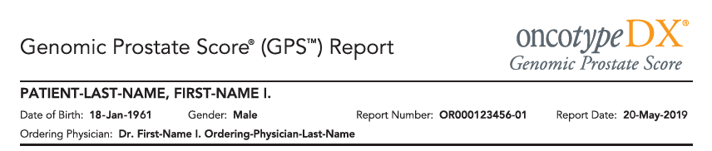
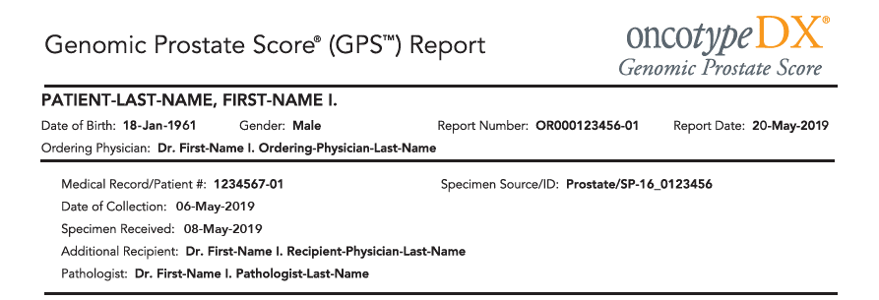
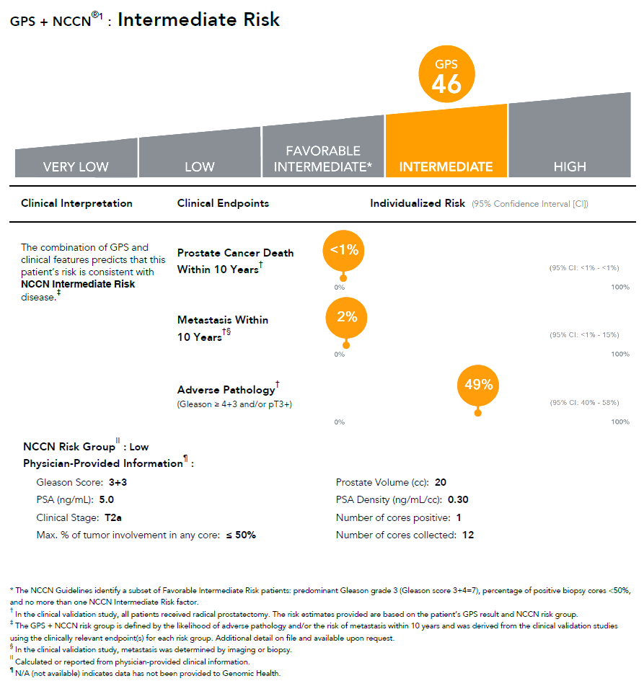
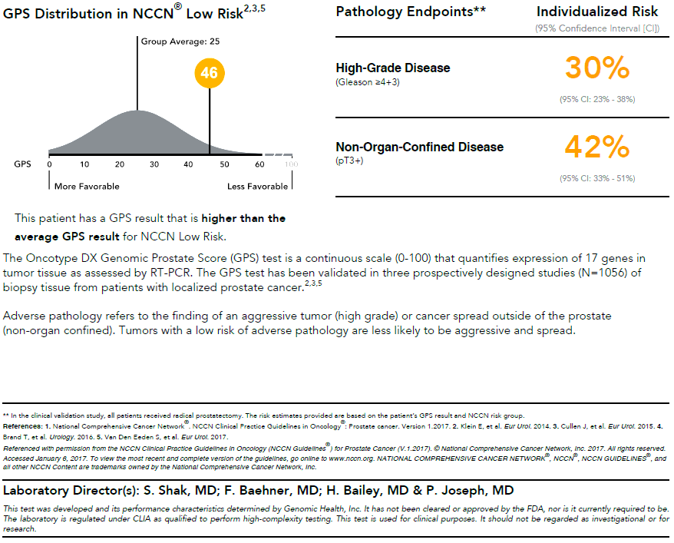
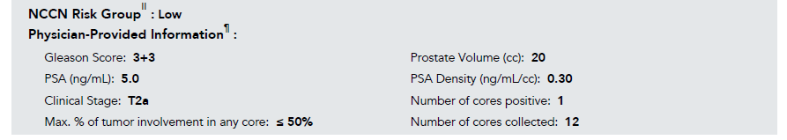
The GPS™ report provides an informative estimate of risk
Notes:
Key Education Points:
The GPS™ report consists of 2 pages, and the information can be broken down and simplified for the patient.
The first page of the report delivers clear risk stratification for an overall sense of a patient’s clinical risk and provides risk of death and metastasis within 10 years after radical prostatectomy and risk of adverse pathology.
This example report shows an NCCN low-risk patient whose risk after GPS testing is estimated as NCCN intermediate risk. These results indicate that the patient may harbor more aggressive disease than indicated by clinical features alone.
The bottom of the first page summarizes clinical variables. The intention is to help facilitate conversations by consolidating all essential prostate cancer parameters into a single document.
The second page of the report provides information to help personalize conversations and facilitate treatment decisions. It includes a bell curve that depicts the patient’s GPS result relative to other patients, and reports a patient’s individual risk of high-grade and non-organ-confined disease.

Slide 21
Prolaris
A RNA expression test of cell cycle progression(CCP) genes. CCP genes are considered as those genes that fluctuated in different stage of the cell cycle.
In PCa testing, it includes 31 CCP genes and 15 housekeeping genes. A CCP score will then be calculated.
Can predict prostate cancer recurrence and PCa specific mortality after RP or PCa specific death for AS population.

Slide 22















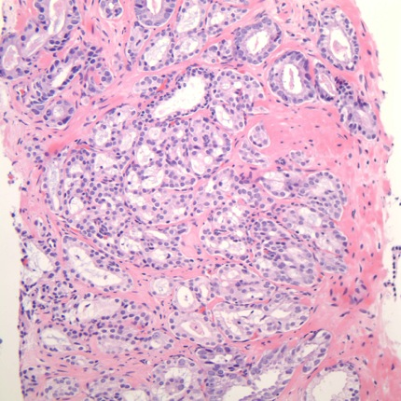







Prolaris
Genes: FOXM1, CDC20, CDKN3, CDC2, KIF11, KIAA0101, NUSAP1, CENPF, ASPM, BUB1B, RRM2, DLGAP5, BIRC5, KIF20A, PLK1, TOP2A, TK1, PBK, ASF1B, C18orf24, RAD54L, PTTG1, CDCA3, MCM10, PRC1, DTL, CEP55, RAD51, CENPM, CDCA8, and ORC6L
Cell division
(mitosis)
Cell prepares
to divide
M
G2
Normal
Abnormal
Cycle
begins
Replication
of DNA
S
G1
R
Cell grows
Cell decides
whether to continue

Slide 23
Prolaris
Risk Stratification Involving Clinical Features
AUA risk classification lumps patients in one of three risk groups
100
50
20
With AUA risk alone, all low risk patients assigned same risk
10
AUA PCa Mortality Risk %
Prolaris further differentiates intermediate risk patients whose risk is more similar to a low risk patient
5
2
Low risk patients may have higher risk than expected
HIGH
INTERMEDIATE
LOW
1
3%
1
2
5
10
20
50
100
AUA + Prolaris PCa Mortality Risk %

Slide 24
Decipher- biopsy
A genetic test panel testing the expression of 22 genes
Predict prostate cancer up-grading in AS population
To make the decision of further treatment for patients with high risks.

Slide 25
Decipher Outcomes
Predict Chance of Primary Gleason 4 in Biopsy, Metastasis and PCSM

Slide 26
Decipher® Biopsy Endpoints
  Risk at RP - Percent likelihood
  High Grade Disease (Gleason 4 or 5)
  Metastasis 5 years post-RP
  Prostate Cancer Specific Mortality (PCSM) 10 years post-RP
Notes:
High grade disease (Primary Gleason 4 or 5)
Urologist Utility
Predicting high-grade disease is useful when ruling out Active Surveillance.
Rad Onc Utility
Predicting high-grade disease is useful when deciding between Multi-modal Therapy or Mono-Therapy.
Metastasis 5 year post RP endpoint
Endpoint important for NCCN lower risk patients.
Helps determine if the patient is a candidate for Active Surveillance.
Helps determine if the patient is a good candidate for surgery.
Supports the long term treatment plan, what kind of treatment as well as the intensity.
Prostate Cancer Specific Mortality (PCSM) 10 years post RP
Endpoint important for NCCN higher risk patients.
Helps determine what treatment as well as intensity of treatment.
The majority of very low/low risk patients, will likely not experience PCSM.

Slide 27
GERMLINE GENETICS
AND
PROSTATE CANCER

Slide 28



Benefits of Genetic Assessment in Prostate Cancer
Diagnosis:
Identification of men at high risk for prostate cancer
  Recommend increased surveillance to diagnosis early prostate cancer
Prognosis:
Improved management of men with localized prostate cancer
  Consider more aggressive management of men with non-metastatic prostate cancer
Prognosis:
Improved management of men with advanced prostate cancer
  Consider more aggressive management of men with metastatic prostate cancer
Counseling:
Benefits to family members
  Relatives may be tested to learn more about their cancer risks
  Personalized surveillance and prevention options available to family members

Slide 29
Rare Pathogenic Mutations (RPMs)
Most commercially available panels include 14 genes
Mutations within some of these genes have been implicated in
hereditary prostate cancer (e.g. ≥3 affected first degree relatives)
but many have not
Important to understand which RPMs implicated in susceptibility,
aggressiveness and disease response

Slide 30

Predicting Prognosis at Time of Diagnosis
Identify men who likely to develop aggressive / lethal cancer
Reasonable assumption:
  If genetic variant associated with increased risk of
  advanced disease, then….
  Treatment strategies such as Active Surveillance or
  Watchful Waiting should be avoided
  2. Definitive treatment with Surgery or Radiation should be
  considered early
  3. Potential Caution with Focal Therapies

Slide 31
Comparison of High Grade:
Associations with Gleason Grade Group 5
Xu, Helfand, Walsh, Isaacs et al. Submitted
1,694 PCa patients underwent radical prostatectomy at
Johns Hopkins Hospital
  706 patients with Gleason grade (GG) 4 and 5
  988 patients with low-grade disease (GG1)
Sequenced at Ambry Genetics for 13 genes
  ATM, BRCA1, BRCA2, CHEK2, HOXB13, MLH1, MSH2, MSH6, NBN, PALB2, PMS2, RAD51D, TP53
Comparison of mutations between different Gleason grade groups

Slide 32
Mutations Specifically Increase Risk of Gleason Grade Group 5
ATM, BRCA2, MSH2
ATM alone
>
>
0.6%
GG4
3.5%
GG5
2.4%
GG4
7.7%
GG5
OR 3.38 (1.48-8.68)
P=0.002
OR 5.91(1.32-54.32)
P=0.008
Difference in Biology of Oncogenesis in Mutation Carriers?
Xu, Helfand, Walsh, Issacs et al. Submitted

Slide 33
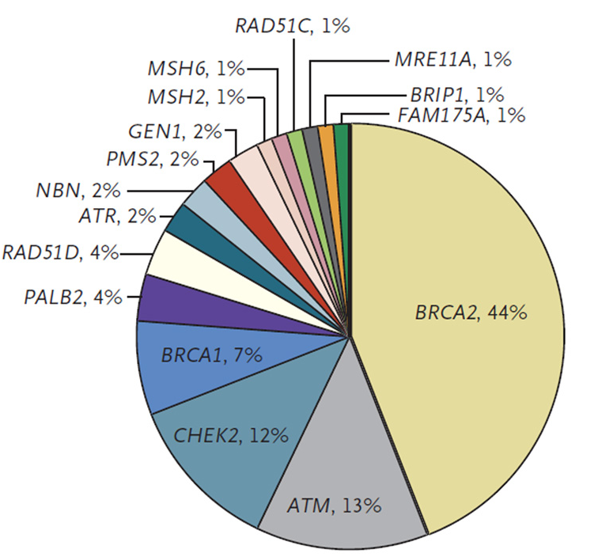
Rare Pathogenic Mutations & Associations with Metastatic Prostate Cancer
Large sequencing studies of metastatic and lethal prostate cancer
8-12% of cases with
Pathogenic or Likely Pathogenic
mutations within DNA Damage
Response Genes
Mutations within some of these genes (BRCA2, ATM, CHEK2) validated to associate with advanced and lethal disease
  Unaffected men with these mutations may benefit from earlier screening
Pritchard et al. N Engl J Med 2016;375(5): 443-53
Robinson et al. Cell 2015;161(5):1215-1228

Slide 34
Germline Mutations in ATM and BRCA1/2 Distinguish Risk for Lethal and Indolent Prostate Cancer and are Associated with Early Age at Death
Na et al. Eur Urol. 2017 May ; 71(5): 740–747

Slide 35
Utility of Gene Mutation Associations with Aggressive Prostate Cancer: Relevance in Active Surveillance (AS)?
2 independent cohorts of prostate cancer patients undergoing AS
  NorthShore and Johns Hopkins
All men had Gleason 6 at enrollment and followed over-time
Grade re-classification to Gleason 7 or greater documented
Germline sequencing for 3 genes
  ATM, BRCA1, BRCA2
Association of mutation carrier status and Grade re-classification was evaluated by a competing risk analysis.
Carter et al. Eur Urol. 2019 May ; 75(5): 743–749

Slide 36
Active Surveillance:
Grade Re-classification for Rare Pathogenic Mutation Carriers
Carter, Xu, Helfand et al. (European Urology, 2018
Hazard rate 2.40 (1.01,5.71)
p=.048
Hazard rate 5.01 (2.22,11.61)
p=.001
3 gene panel: BRCA1/2, ATM
BRCA2 alone
carrier
carrier
non-carrier
non-carrier

Slide 37
Predicting Prognosis at Time of Diagnosis
Strong Consideration
Against AS
Actionable
BRCA2, ATM
Risks / Benefits
Discussion
Uncertain
BRCA1, CHEK2, MSH2
AS Considered
Safe
  HOXB13, MLH1, MSH6,
  NBN, PALB2, PMS2,
  RAD51D, TP53
Not Actionable

Slide 38
SOMATIC GENETICS
AND
PROSTATE CANCER BIOPSY RESULTS
THE FUTURE?

Slide 39

Somatic DNA CNAs: Hallmark of Aggressive Prostate Tumors
  Frequency of CNAs (deletions/gains) are significantly higher in aggressive prostate tumors

Slide 40
Somatic DNA CNAs: Clonal Evolution for Metastatic Disease
  CNAs occur early and are seeds of metastasis
Liu W et al., 2009

Slide 41
Frequency of CNAs in Three Types of PCa Patients
Higher frequency of CNAs in patients with lethal/mets for four genes (PTEN, MYC, BRCA2 and CDKN1B)
A dose-response trend of CNAs frequency: lethal/mets > BCR > non-progression
Significantly higher number in those who progressed on AS
Liu W et al., 2020

Slide 42
SUMMARY
Currently, NO single test that reliably predicts AS failure
Results of multiple tests are therefore needed to identify clinical picture of which men likely to fail AS
Should include biomarkers
  RNA based (Oncotype, Prolaris, Decipher)
  DNA based (BRCA2, ATM, CHEK2)
Future tests identifying men most likely to harbor aggressive disease
  Somatic DNA tests

Slide 43
Thank you
NorthShore University
  Rong Na, MD, PhD - Margo Quinn MS
  Siqun Zhang MD - Jacquelyn Peckewicz MS
  Jianfeng Xu MD, DrPH - Pooja Talaty MS
  Charles Brendler, MD - Elena Genova-Peeva PhD
  Chi‐Hsiung Wang, PhD
  Hongjie Yu, PhD
  Justin Brueck, MBA
  Michael Caplan, MD
Johns Hopkins
  William Isaacs, PhD
  Ballantine Carter, MD
  Patrick Walsh, MD
“Through our personalized medicine efforts
we can help everyone achieve their best”

