Slide 1

Active Surveillance for Prostate Cancer – An Update
Peter R. Carroll, MD, MPH
Department of Urology and
UCSF Helen Diller Family Comprehensive Cancer Center
University of California, San Francisco
July, 2020

Slide 2
Disclosure
I am a very busy surgeon
I think prostate cancer over – diagnosis and over – treatment are problems
I also think that prostate cancer is often under – treated
The information I will share is largely my own
I will walk you through it

Slide 3
Active Surveillance
Active surveillance is a response to the over - detection and - treatment of prostate cancer brought about by widespread and repeated PSA screening.
Its uptake by the urology community helped pave the way for an upgraded assessment by the USPTF on the early detection of prostate cancer

Slide 4
Active Surveillance - Goals
Avoid or Delay the costs (functional, monetary) of treatment without compromising cancer cure
Compliant with screening/treatment guidelines
Based on the rationale that
  Initial assessment is reasonably accurate
  Monitoring is accurate and identifies sub – clinical progression at a time that initial treatment options are still available and curative
Active surveillance is about timing of treatment

Slide 5
A spectrum of disease
Prostate Cancer

Slide 6
Describe your cancer?
UCSF CAPRA Score
Very low risk
Low risk
Favorable intermediate risk
Unfavorable intermediate risk
High risk
Variable | Level | Points | Variable | Level | Points
PSA | ≤6 | 0 | T-stage | T1/T2 | 0
 | 6.1-10 | 1 |  | T3a | 1
 | 10.1-20 | 2
 | 20.1-30 | 3 |  | <34% | 0
 | >30 | 4 |  | >34% | 1
 | 1-3/1-3 | 0
 | 1-3/4-5 | 1 | Age | <50 | 0
 | 4-5/1-5 | 3 |  | >50 | 1
Sum points from each variable for 0-10 score
https://urology.ucsf.edu/research/cancer/prostate-cancer-risk-assessment-and-the-ucsf-capra-score

Slide 7
Is AS Right for You? What You Need to Consider
PSA
PSA “density” (PSA/gland volume) (< 0.15)
Stage (T1/2)
Cancer grade (3/3)
Cancer grade ¾ - volume, subtype
MRI (PIRADS 1- 3)
Genomics (Prolaris, OncotypeDX or Decipher)
Age and health
Patient and family preferences
Confidence in your providers

Slide 8
UCSF active surveillance cohort
2113 enrolled
Year of diagnosis: median 2010 (range 1990, 2019)
Age at diagnosis: mean 62.5 years (SD 7.68)
PSA at diagnosis: median 5.5 (IQR 4.2, 7.5)
Duration of follow up: median 73 months (IQR 43, 112
85% low risk, 15% intermediate risk

Slide 9
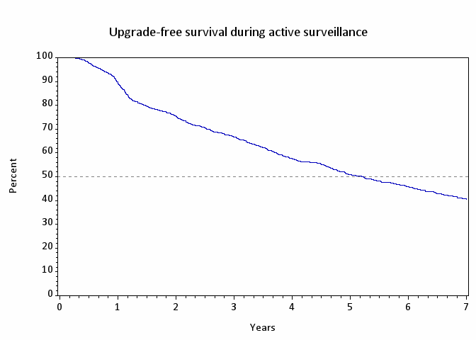
Biopsy upgrade-free survival
Upgrade Free Survival
41% at 7 years. N=689 upgraded at median 25 months (IQR 13, 52)

Slide 10
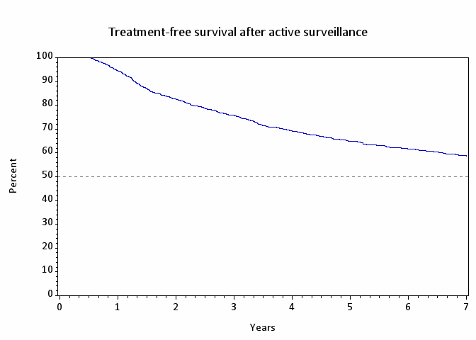
Treatment Free Survival
Many changes in grade/volume are low, marginal
59% at 7 years. N=682 upgraded at median 27 months (IQR 15, 50)

Slide 11
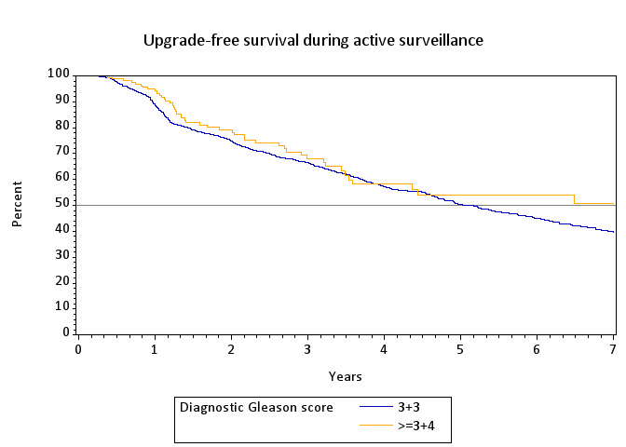
Progression Based on GG 1vs 2 (p = 0.22)

Slide 12
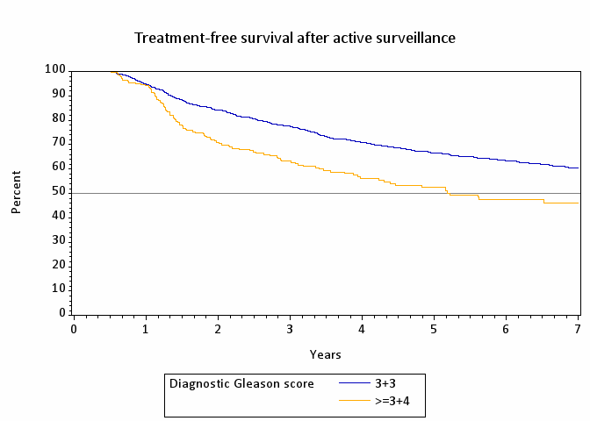
Treatment Free Survival by GG
Overall Survival 96%
Prostate Cancer Specific Survival 99%
Metastases – free Survival 99%

Slide 13
Deferred Treatment
Outcome after delayed radical prostatectomy

Slide 14
Delayed Radical Prostatectomy
J Urol. 2019 Sep;202(3):506-510.

Slide 15
Active Surveillance
IMPACT OF NEW TECHNOLOGY

Slide 16
2019 National Comprehensive Cancer Network Guidelines Recommendations on Genomic Testing
Risk Category | Definition | Recommendation
Very Low | T1c, GG1, PSA <10, <3 positive cores, ≤50% core involved, PSAD <0.15 | Not Indicated
Low | T1-T2a, GG 1, and PSA <10 | Consider if life expectancy >10y
Intermediate | T2b-T2c, or GG 2 or 3, or PSA 10-20 | Consider for favorable-intermediate-risk if life expectancy >10y
High | T3a or GG4 or 5, or PSA >20 | Not routinely recommended
Very High | T3b-T4, or primary Gleason pattern 5, or >4 cores with GG 4 or 5 | Not routinely recommended

Slide 17
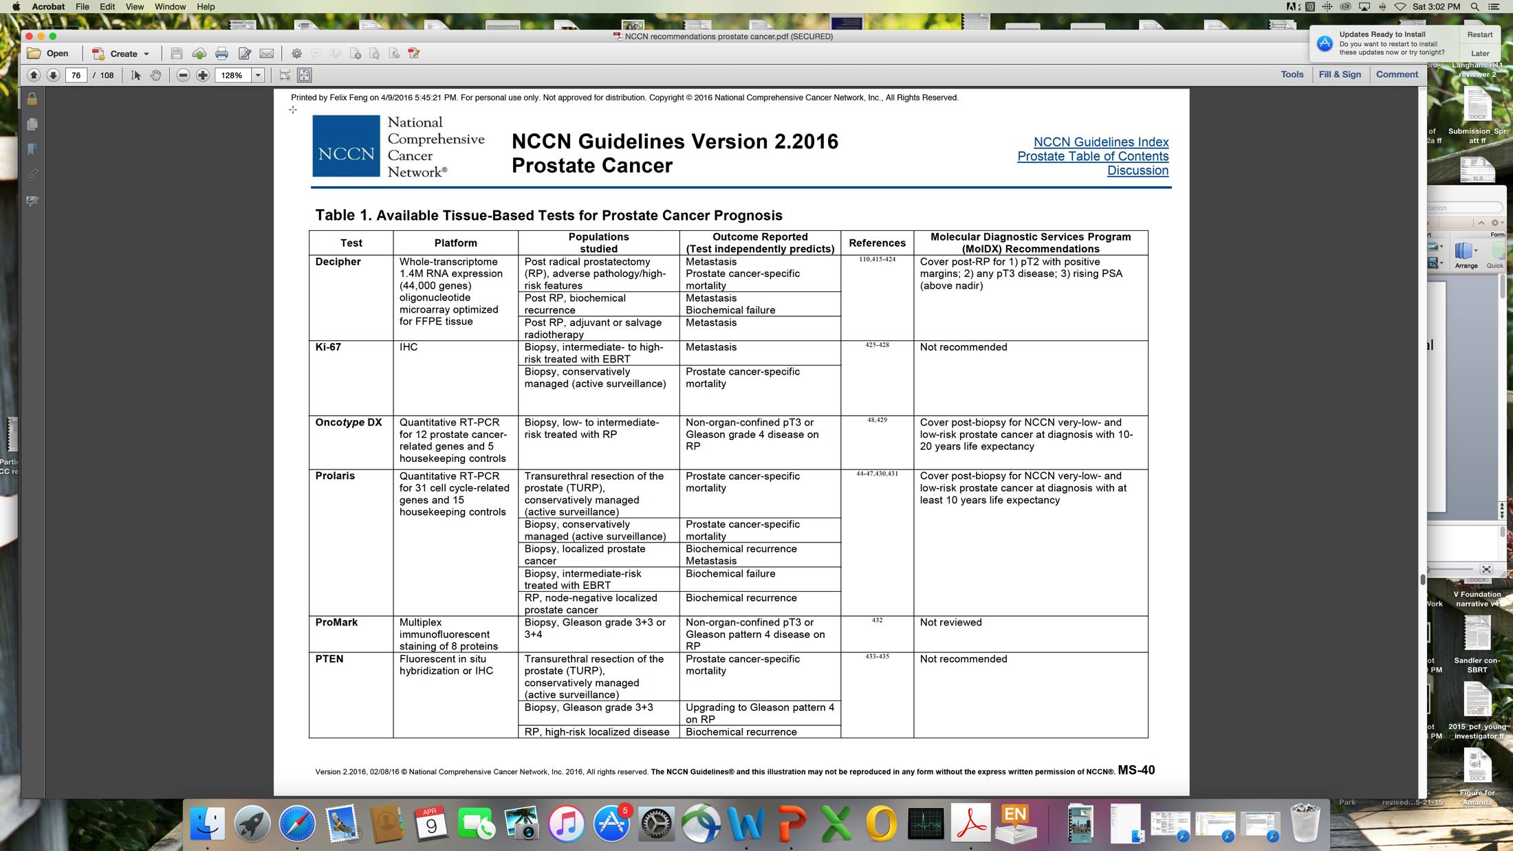
Clinically Available Genomic Tests
Decipher
GPS
Prolaris
All of these assays have prognostic value
none are predictive biomarkers

Slide 18
Oncotype DX GPS (Genomic Health)
Quantitative 17-gene RT-PCR assay on manually microdissected tumor tissue from needle biopsy
Genes and biological pathways predictive of multiple endpoints, with emphasis on clinical recurrence
Optimized for very small tissue input: six 5 micron sections of single needle biopsy block with as little as 1 mm tumor length
Androgen Signaling
AZGP1
FAM13C
KLK2
SRD5A2
Cellular Organization
FLNC
GSN
GSTM2
TPM2
Stromal Response
BGN
COL1A1
SFRP4
Reference
ARF1
ATP5E
CLTC
GPS1
PGK1
Proliferation
TPX2
GPS =
0.735*Stromal Response group
-0.352*Androgen Signaling group
+0.095*Proliferation group
-0.368*Cellular Organization group
Scaled between 0 and 100
Eur Urol. 2014 Sep;66(3):550-60. doi: 10.1016/j.eururo.2014.05.004. Epub 2014 May 16.

Slide 19
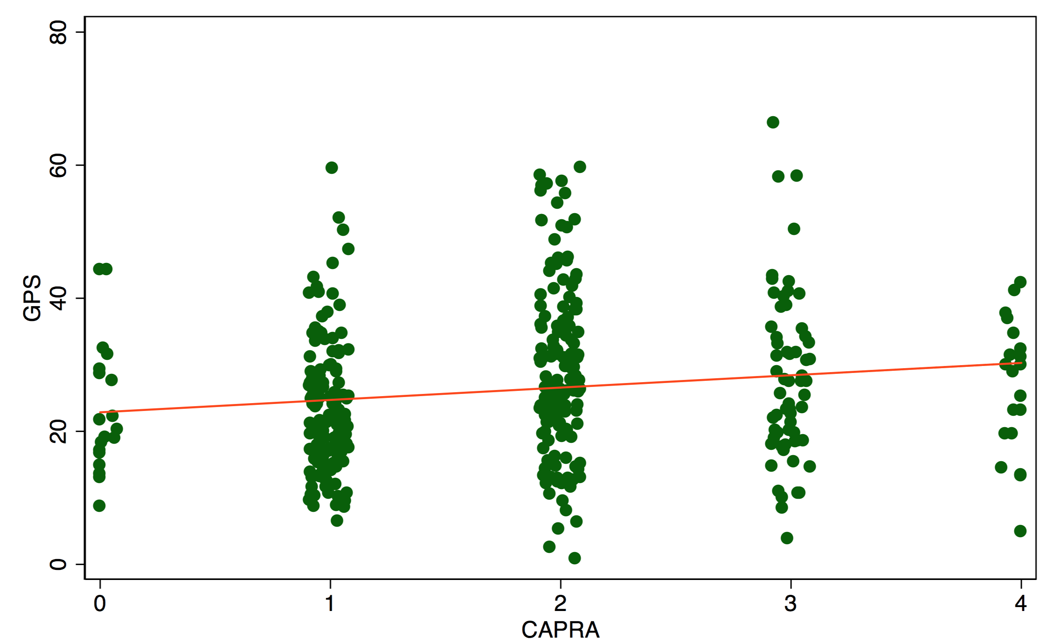
Weak correlation between CAPRA and GPS
Eur Urol 66:550, 2014

Slide 20
Adding GPS to CAPRA: predicting pathology
CAPRA 0 = 86%
CAPRA 1 = 78%
CAPRA 2 = 67%
5%
CAPRA 3 = 55%
CAPRA 4 = 43%
36%
5%
38%
16%
49% of pts have ≥5% change in predicted risk
26% to more favorable
23% to less favorable
Eur Urol 66:550, 2014

Slide 21
GPS score and upgrade on surveillance
Cox regression for risk of upgrade to Gleason ≥3+4 on subsequent biopsy for AS cohort of men diagnosed with Gleason 3+3
Characteristic | HR | 95% CI | p
Age at diagnosis (years) | 1.01 | 0.99-1.03 | 0.47
PSA density at diagnosis (log) | 1.33 | 0.92-1.91 | 0.13
Biopsy cores % positive at GPS | 1.01 | 1.00-1.02 | 0.03
GPS score (per 5 units) | 1.27 | 1.18-1.38 | <.01
J Urol. 2019 Feb;201(2):300-307. doi: 10.1016/j.juro.2018.08.047.

Slide 22
GPS – Impact on Adverse pathology (AP) and PSA relapse after delayed RP
AP = T3, primary pattern 4 and/or N+
PSA relapse = PSA > 0.02 and/or second treatment
Adverse pathology
PSA Relapse
 | p | HR | 95% Confidence Interval
GPS (per 5 units) | <.01 | 1.16 | (1.06, 1.26)
Age at diagnosis (years) | <.01 | 1.07 | (1.03, 1.11)
Clinical CAPRA at diagnosis | 0.60 | 0.92 | (0.66, 1.27)
PSA density at GPS (log) | 0.06 | 1.70 | (0.97,2.96)
 | p | HR | 95% Confidence Interval
GPS (per 5 units) | 0.04 | 1.10 | (1.00, 1.21)
Age at diagnosis (years) | 0.41 | 0.98 | (0.94, 1.02)
Clinical CAPRA at diagnosis | 0.19 | 1.29 | (0.88, 1.90)
PSA density at GPS (log) | 0.65 | 0.88 | (0.49, 1.57)
J Urol. 2019 Apr 26:101097 [Epub ahead of print] PMID: 31026214

Slide 23
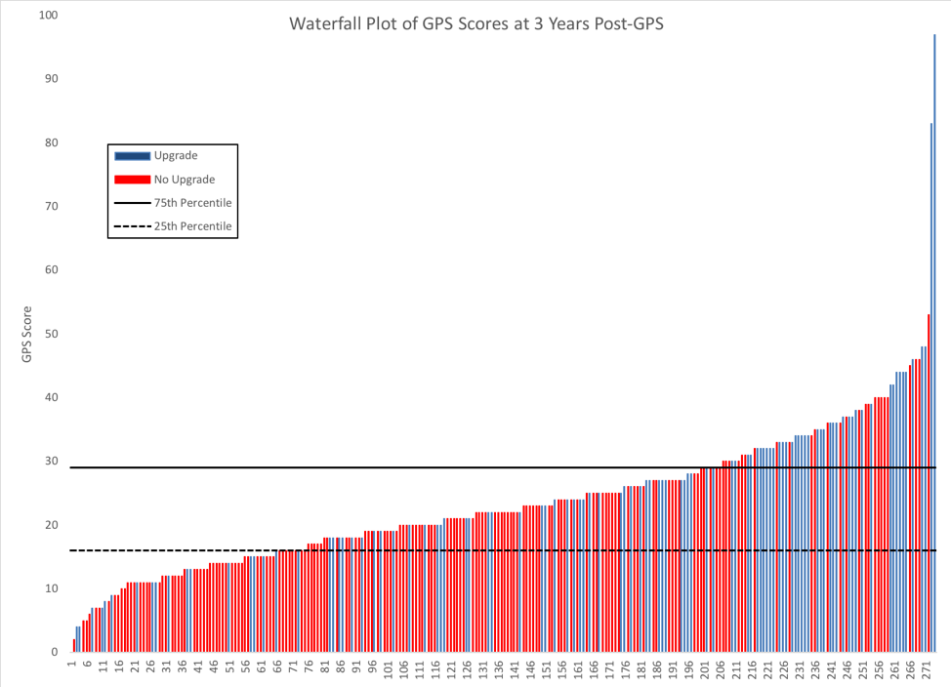
GPS and Progression
Caveat – there is no GPS that completely excludes or predicts progression
Waterfall plot showing range of individual patient outcomes
J Urol. 2019 Feb;201(2):300-307. doi: 10.1016/j.juro.2018.08.047.

Slide 24
Genomic Classifiers- Concerns
Tumor heterogeneity
Do all patients benefit?
  Very low risk
  Which low and favorable-intermediate risk?
Are they cost-effective?
What are the long-term outcomes?

Slide 25
Active Surveillance
Are there other biomarkers?

Slide 26
PSA Density
 | Outcome
 | Delayed Treatment | Biopsy Progression
Independent Variable | HR (95% CI) | HR (95% CI)
Met strict criteria | 1.12 (0.82-1.53) | * 0.67 (0.50-1.04)
PSA diagnosis | 1.01 (0.97-1.05) | 0.97 (0.91-1.02)
Biopsy Density^ | 1.21 (0.66-2.22) | 1.31 (0.66-2.57)
PSAD strata <0.1 | Ref | Ref
0.1-0.15 | * 1.64 (1.09-2.47) | ** 2.06 (1.30-3.29)
>0.15 | ** 1.89 (1.25-2.87) | ** 2.83 (1.73-4.62)
J Urol. 2015 Mar;193(3):807-11.

Slide 27
The Impact of a Negative Biopsy on Follow - up
Carissa Chu et al, UCSF

Slide 28
PIRADS score and upgrade on surveillance
Characteristic | HR | 95% CI | P-Value
PI-RADs 1-2 (reference) | 1.00 |  | <.01
PI-RADS 3 | 1.55 | (0.68, 3.51) | 0.29*
PI-RADS 4 | 2.62 | (1.45, 4.76) | <.01*
PI-RADS 5 | 4.38 | (2.36, 8.16) | <.01*
Age at diagnosis (years) | 1.01 | (0.98, 1.04) | 0.40
PSA density at diagnosis (log) | 1.47 | (0.98, 2.20) | 0.06
Biopsy cores % positive at Diagnosis | 1.01 | (0.99, 1.02) | 0.24
Serial MRI
Changes in MRI are common
PIRADS 4/5 and any increase in PIRADS predicts progression

Slide 29
Active Surveillance
Current Controversies
What risk categories are appropriate?
  Very low risk, low risk
  Low CAPRA scores
  Those with GS ¾ disease
Is it safe in African American men?
Are younger men appropriate candidates?

Slide 30
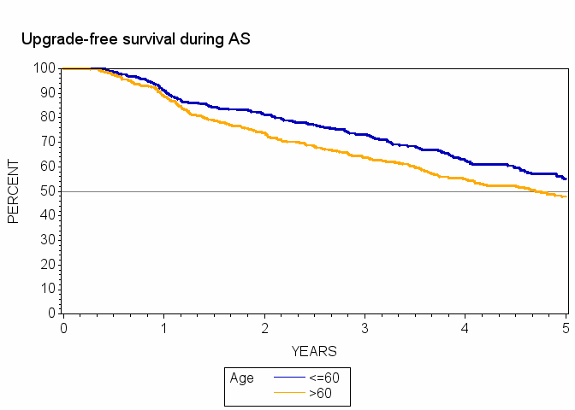
Is Active Surveillance Safe in Younger Men?
3 and 5- year upgrade-free survival rates: 73 and 55% versus 64 and 48% (p<0.01)
Younger patients more likely to receive subsequent treatment with RP (26%) versus RT (7%)
On Cox multivariable regression age ≤60 associated with freedom from biopsy upgrade (HR 1.48, 95% CI 1.21-1.82) and biopsy progression (HR 1.32, 95% CI 1.11-1.57)
No significant association between younger age and time to treatment or BCR following delayed RP
Younger Patients Have
Slower Rates of Progression
JCO 2017 10:35 (17): 1898

Slide 31
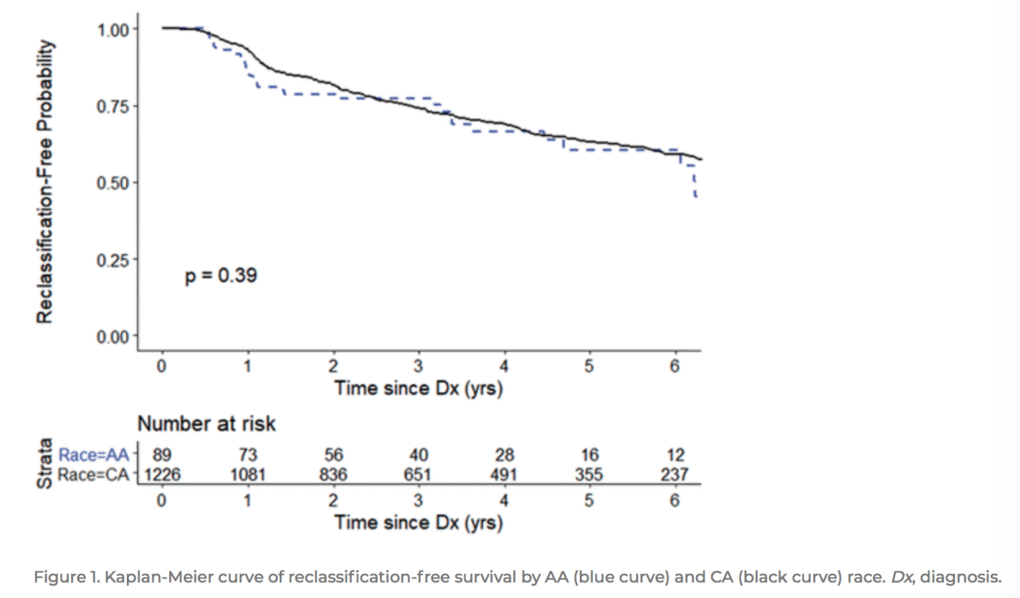
Special Situations
AA vs Caucasian men
Germline mutations
  BRCA 2
African American men
  Make up a small percentage of men in AS cohorts
In the subset of 13 AA and 223 CA men treated with RP the adverse pathology rates at RP were similar (46% and 47%, respectively, p=0.99).
https://doi.org/10.1097/JU.0000000000000621

Slide 32
Should All Men with GS ¾ Undergo Immediate Radical Prostatectomy?
Cancer risk is best assessed with multivariable instruments, not a single variable (J Urol 173:1938)
RP only has a (arguably marginal) benefit in those with palpable tumors, higher – risk disease or PSA > 10 ng/ml (NEJM 367:203; NEJM 370:932)
GS ¾ alone may add little risk (1 point in CAPRA)
Volume (rather than grade alone) predictor of adverse pathology (J Urol 194:85)
Compare those who undergo immediate vs. delayed surgery for GS ¾ disease (Eur Urol 68:458)

Slide 33
Treatment-free survival 3+3 vs 3+4

Slide 34
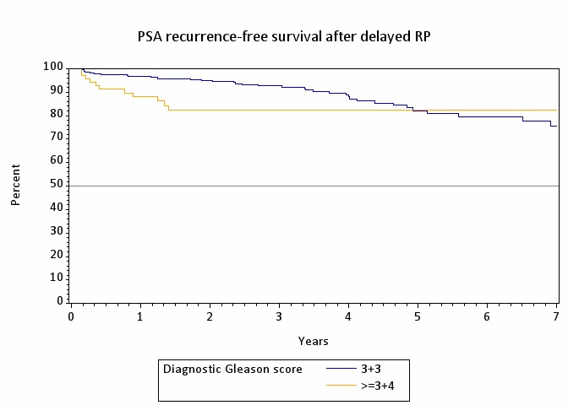
Delayed Radical Prostatectomy - UCSF
J Urol. 2019 Sep;202(3):506-510.

Slide 35
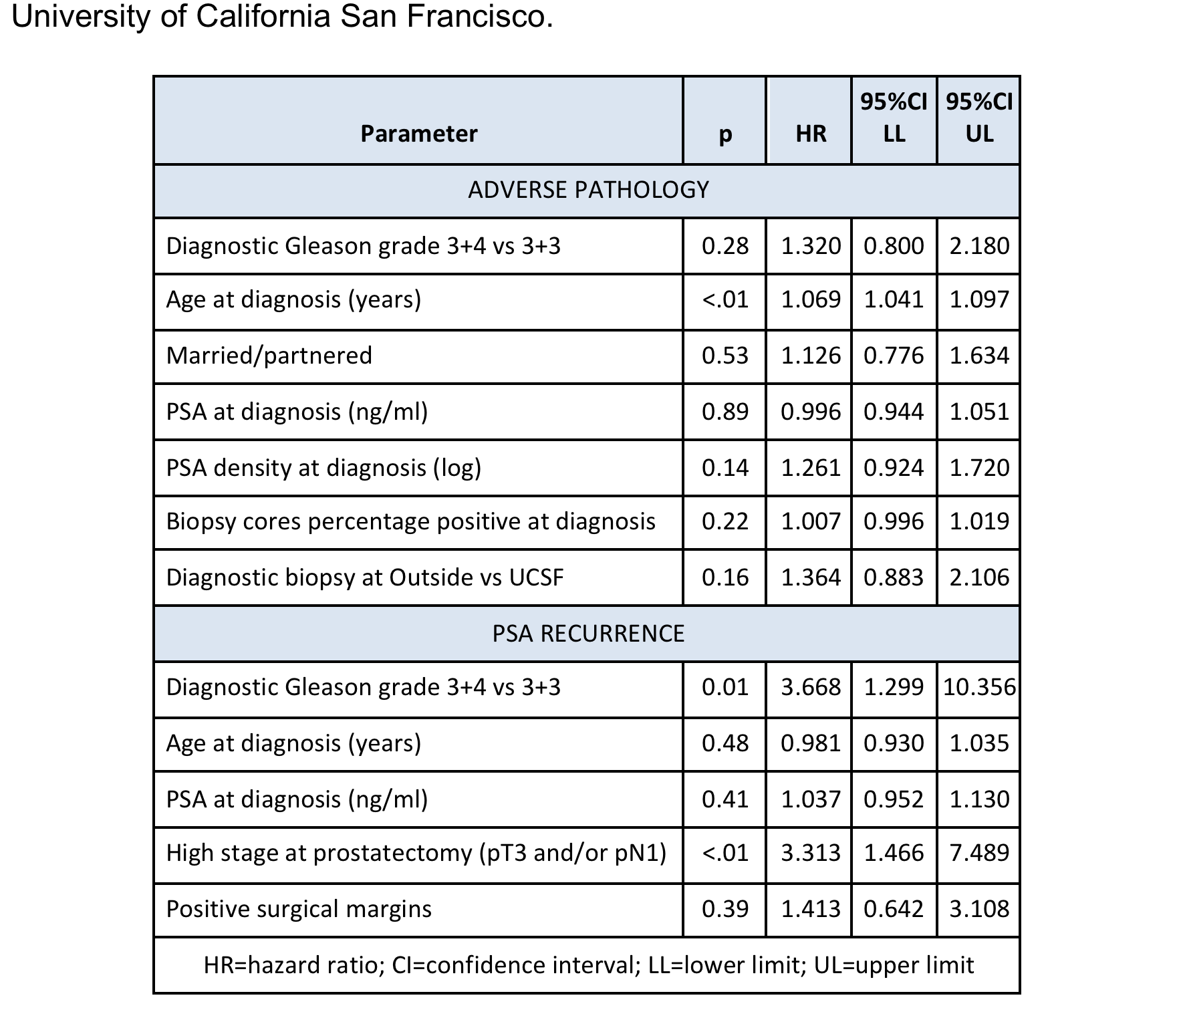
Multivariable Model
Those with a single core (low volume) of ¾ showed no increased risk of progression or biochemical failure

Slide 36
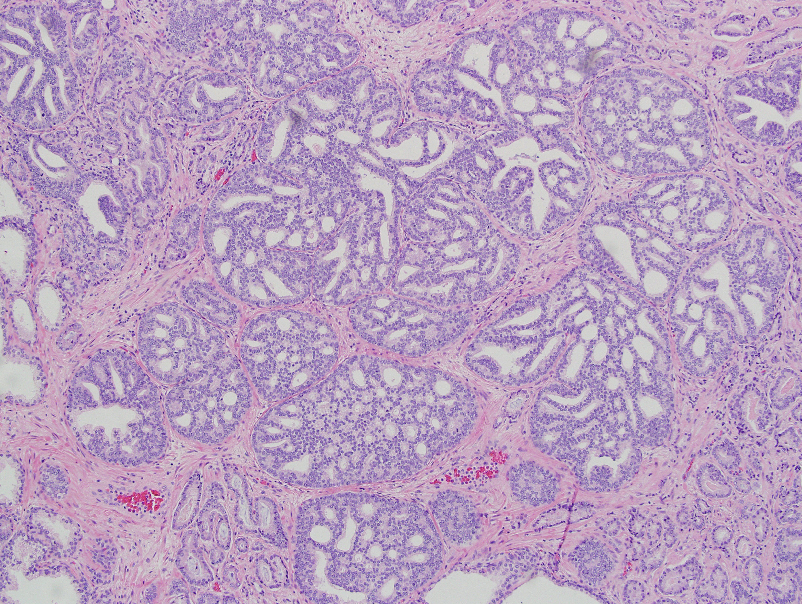
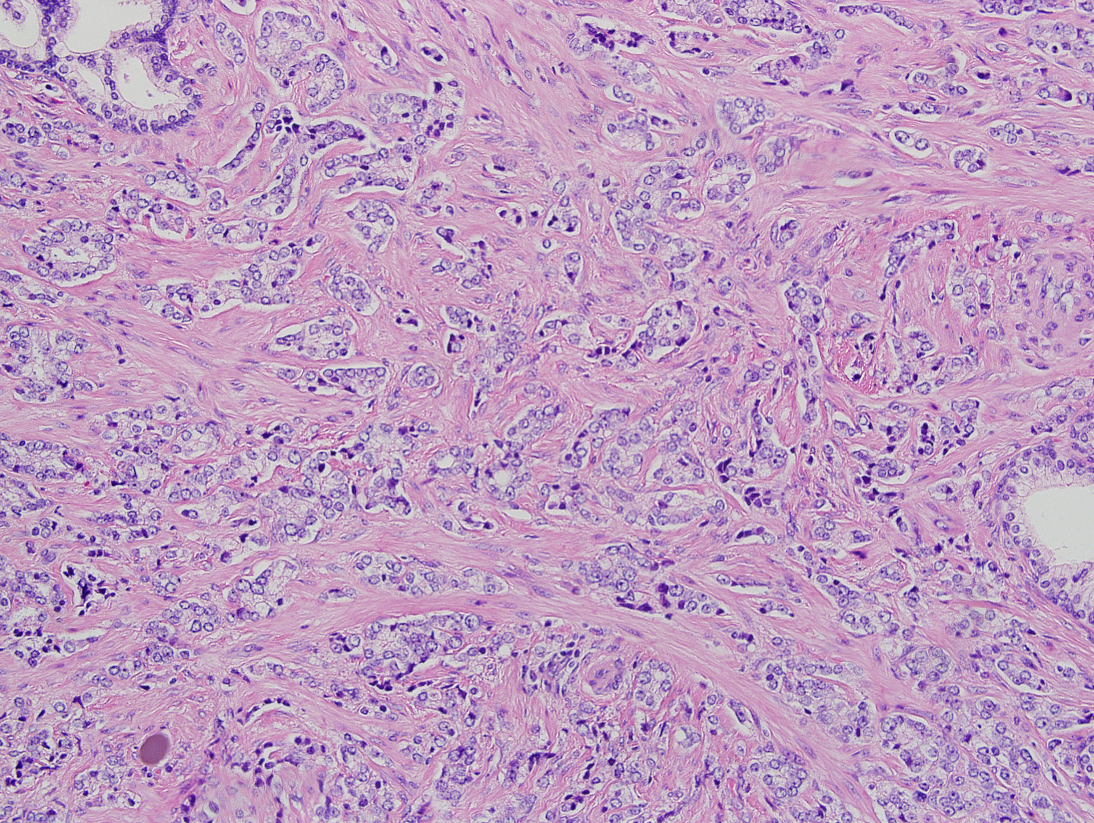
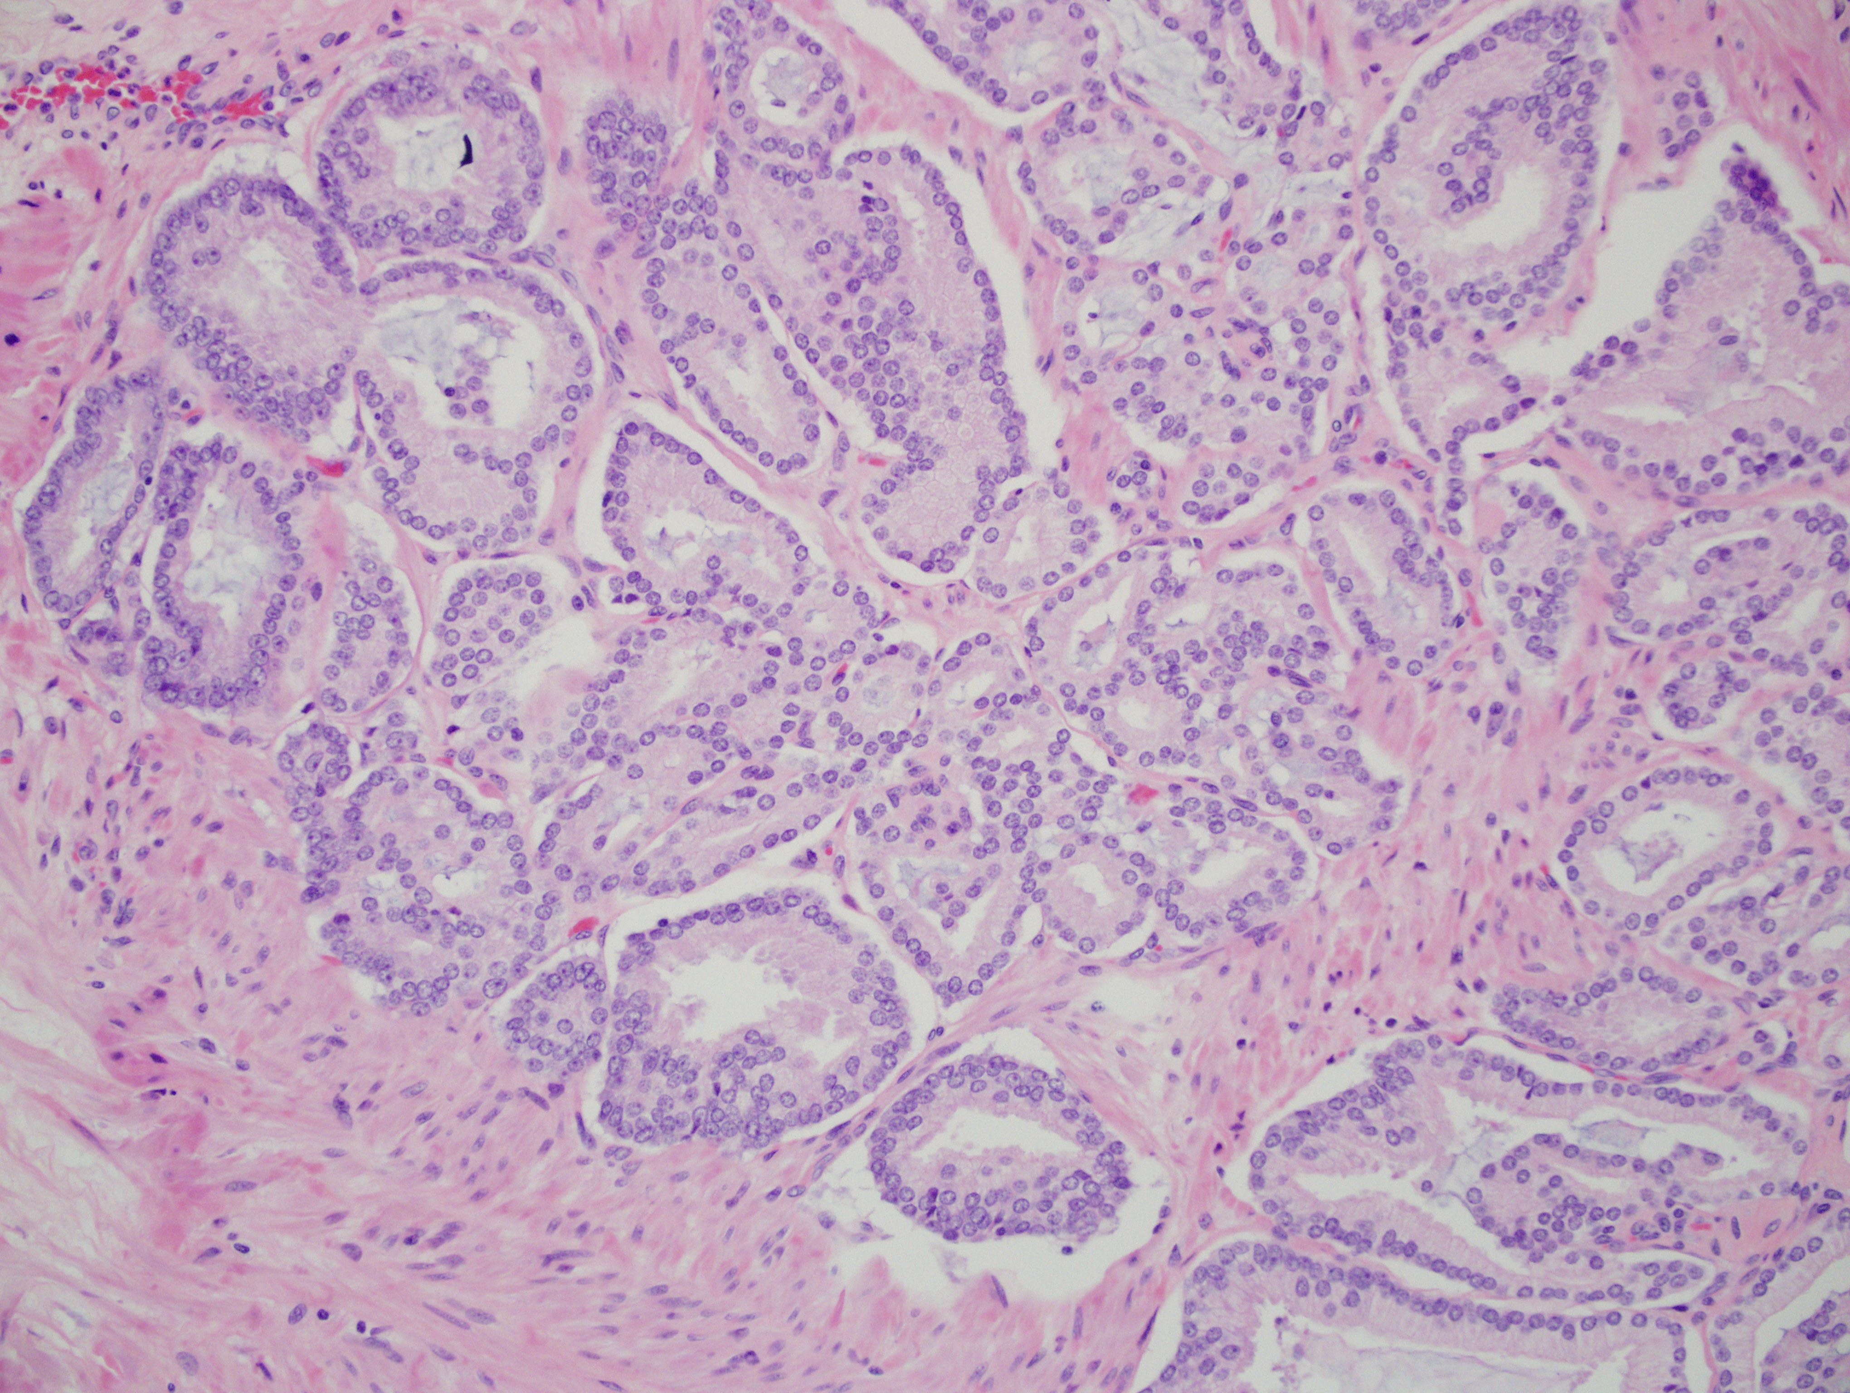
Gleason Grade 4
Subtype of pattern 4 - histopathologic features apparent, but not typically reported
Cribriform histology and stromal reaction are associated with higher genomic scores and the risk of ECE/recurrence compared to glomerulation and no stromal reaction
Expansile
Poorly - Formed
Fused
Expansile cribriform, simple cribriform, poorly formed, fused, glomerulation, stromal reaction
Transl Androl Urol. 2018;7(1):1:145 – 4; Amer J Surg Path45-54. 2016;40(10):1400-6.
J Urol. 2019 Jul;202(1):90-95. doi: 10.1097/JU.0000000000000175. Epub 2019 Jun 7

Slide 37
Predictors of Upgrade
MODEL | PARAMETER | HR | 95%CI | P | COVARIATES
1 | Age (>=65 vs <65 years ) | 1.31 | (1.12, 1.53) | <0.01 | PSA density, GG at diag, % pos cores
2 | PSA density (>=0.15 vs <0.15) | 1.69 | (1.45, 1.98) | <0.01 | Age, GG at diagnosis, % pos cores
3 | Biopsy GPS (>=30 vs <30) | 1.68 | (1.32, 2.14) | <0.01 | Age, PSA density, % pos cores
4 | PI-RADS (3-5 vs 1-2) | 2.20 | (1.57, 3.10) | <0.01 | Age, PSA density, GG at diag, % pos cores
5 | PI-RADS (4-5 vs 1-3) | 1.62 | (1.22, 2.14) | <0.01 | Age, PSA density, GG at diag, % pos cores
6 | Grade (GG2 one HG core vs GG1) | 0.54 | (0.32, 0.91) | 0.02 | Age, PSA density, % pos cores
7 | Negative biopsy (yes vs no) | 0.21 | (0.16, 0.26) | <0.01 | Age, PSA density, % pos cores, PI-RADS 3-5
J Urol. 2019 Feb;201(2):300-307; J Clin Oncol. 2017. Jun 10;35(17):1898-1904; AJR Am J Roentgenol. 2020 Mar;214(3):574-578

Slide 38
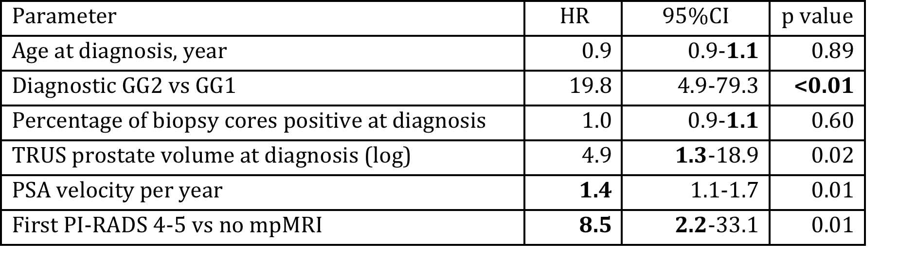
Risk of Metastases – 1%, 69% were to pelvic lymph nodes

Slide 39
Risk Factors for Biopsy Reclassification
(GG ≥2) on Active Surveillance
1,149 men with ≥1 biopsies and ≥3 PSA test after enrollment on AS
 | First surveillance biopsy HR (95% CI) | 1-3 Years HR (95% CI) | 3-5 Years HR (95% CI) | 5-10 Years HR (95% CI)
PSA density ≥0.15 | 3.43 (1.86 - 6.33) | 1.75 (1.27 - 2.41) | 2.22 (1.47 - 3.36) | NS
PSA kinetics | NS | 1.74 (1.40 - 2.15) | 2.86 (1.88 - 4.36) | 4.18 (1.41 - 12.40)
Biopsy cores % positive High genomic score | 1.28 (1.05 - 1.54) 2.74 (1.18 - 6.39) | 1.13 (1.02 - 1.26) 1.99 (1.13 - 3.49) | 1.17 (1.01 - 1.36) NS | NS NS
PI-RADS 4-5 | NS | NS | NS | NS
*Adjusted for age, PSA at diagnosis, biopsy grade group at diagnosis, biopsy source (UCSF vs other)
High genomic score and PSA density ≥0.15 are risk factors for reclassification within 3 years of commencing AS
PSA kinetics is associated with longer-term risk of reclassification at 5 and 10 years
Lonergan et al., J. Urol. 2020 (in press)

Slide 40
Making AS more efficient, less intense
Candidates for Active Surveillance
Treatment or Fusion Biopsy
Standard
Watchful Waiting
Less Intense
Identify markers of progression in serum and urine, obviating need for biopsy – Stay tuned!
3/4 , high volume
High genomics
PIRADS 5
Cribriform?
Poor health
Low PSAD
Neg. biopsy
Favorable MRI/Genomics

Slide 41
Active Surveillance Cohorts
 | UCSF | Toronto | PRIAS | Johns Hopkins | Canary PASS
Enrollment commenced | 1990 | 1995 | 2008 | 1995 | 2008
Number | 2,113 | 993 | 5,302 | 1,818 | 1,041
Age, median (IQR) | 62 | 68 (41-89) | 66 (61-70) | 66 (62-69) | 63 (58-67)
PSA, median | 5.5 (4.2-7.5) | 4.8 (3.2-6.6) | 5.7 (4.5-7.1) | 4.6 (3.5–5.8) | 5.0 (3.8-6.5)
Follow up | 73 (43-112) | 77 (2-238) | 78 (37-101) | 68 (31-109) | 28 (33.5)
Reclassification (GG≥2) | 41% at 7 yrs |  | 22–33% | 21% at 5 yrs 30% at 10 yrs | 24%
Treatment | 59% at 7 yrs | 24% at 5 yrs 36% at 10 yrs | 52% at 5 yrs 73% at 10 yrs | 36% at 5 yrs 48% at 10 yrs | 19%
Metastasis | 1% at 7 yrs | 2.8% | Not reported | 0.1% at 10 yrs | Not reported

Slide 42
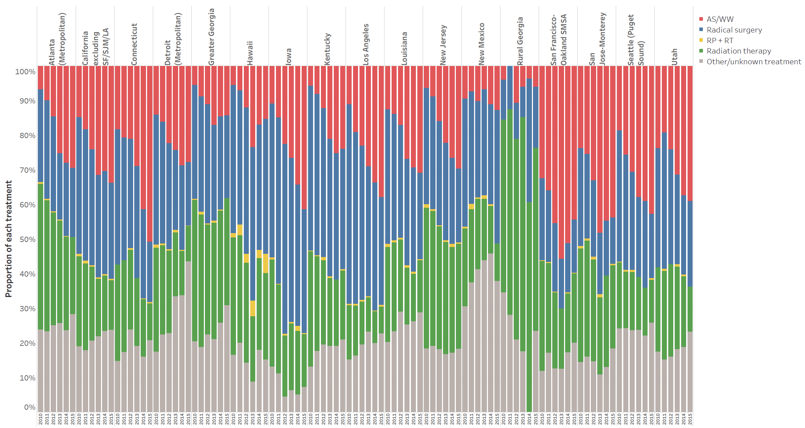
Variation in AS utilization across the US
Washington et al, UCSF
Washington et al., unpublished data
Washington et al., unpublished data
Washington et al., unpublished data
Washington et al., unpublished data
Washington et al., unpublished data

Slide 43
What Can You Do?
Don’t rush, get informed, understand the impact of new technology
Consider a support group
Understand the impact of a healthy lifestyle
  Diet
  Exercise
https://urology.ucsf.edu/sites/urology.ucsf.edu/files/uploaded-files/attachments/pcf_health_wellness_guide.pdf

Slide 44
Is AS Right for You? What You Need to Consider
PSA
PSA “density” (PSA/gland volume) (< 0.15)
Stage (T1/2)
Cancer grade (3/3)
Cancer grade ¾ - volume, subtype
MRI (PIRADS 1- 3)
Genomics (Prolaris, OncotypeDX or Decipher)
Age and health
Patient and family preferences
Confidence in your providers
Need for confirmatory biopsy

Slide 45
Active Surveillance
New Developments

Slide 46
Active Surveillance
New Developments
Use of markers of specificity before biopsy
  Serum/Urine
  Multiparametric MRI
  Reduce biopsy rates 20% - 40%
Focal Therapy in lieu of Active Surveillance

Slide 47
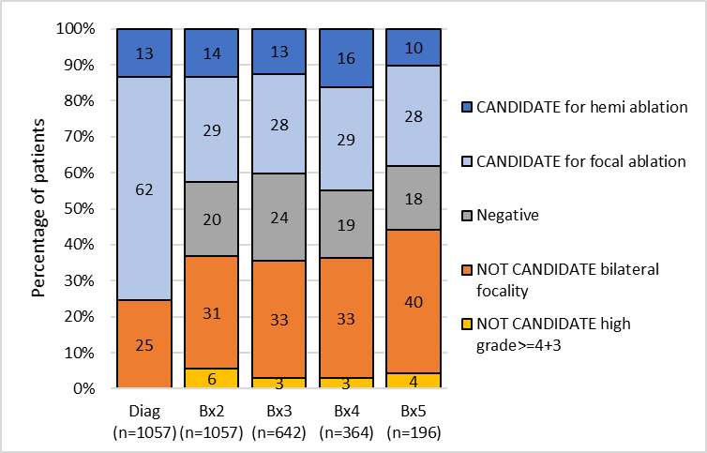
Focal Therapy in Lieu of AS
Candidates for ablation at prostate biopsies
AS can be burdensome
AS may not be practical in patients who do not have local resources for safe AS
Some find AS unacceptable
Less morbid than whole gland treatment
75%
63%
Fasulo et al, UCSF

Slide 48
Active Surveillance
Summary
Active surveillance is the preferred form of treatment for men with very low, low - risk and selected patients with favorable intermediate - risk disease
New technology (MRI, genomics) appears to make it safer
Its use remains highly variable
It will be challenged by focal therapy

