Slide 1
Genomic analysis of circulating tumor DNA in 3,334 patients with advanced prostate cancer to identify targetable BRCA alterations and AR resistance mechanisms
Foundation Medicine
ctDNA is good information for somatic mutations in mCRPC when biopsy is not possible
lots of other data on the importance of CTCs as predictive
93% concordance for BRCA1/2 for tissue and liquid biopsy – but does not detect BRCA deletions
Liquid detected more resistance mechanisms, including novel AR-activating variants.
Assay did not include TMPRSS-ERG and SPOP

Slide 2
Olaparib
Olaparib efficacy in patients with metastatic castration-resistant prostate cancer (mCRPC) carrying circulating tumor (ct) DNA alterations in BRCA1, BRCA2 or ATM: Results from the PROfound study.
  Patients who were positive for alterations in BRCA1, BRCA2 or ATM as detected by ctDNA showed a consistent rPFS improvement with olaparib.
  But PFS was only 7 months and 3 months
Differential activity of PARP inhibitors in BRCA1- versus BRCA2-altered metastatic castration resistant prostate cancer (mCRPC).
  PSA50 responses in BRCA1- vs BRCA2-altered patients were 38% vs 65% respectively .
  Median PFS in BRCA1 vs BRCA2 patients was 3.0 mo vs 8.0 mo respectively.
  Similarly, median OS in BRCA1 vs BRCA2 patients was 11.0 mo vs 24.0 mo respectively
  More P53 mutations in BRCA1

Slide 3
Olaparib – Roundtable discussion
Moderated by Dr. Silke Gillessen of Switzerland; included DeBono
DeBono backs off on efficacy of Olaparib for anything except BRCA.
“Activity was observed in patients with alterations in ATM and CDK12 supporting the need for further studies.”
For ATM, biallelic loss is very important; monoallelic loss insufficient.
EMA approved Olaparib ONLY for BRCA1/2. “FDA more generous.” ?
DeBono believes tissue biopsy is still the gold standard for BRCA mutations (vs. liquid) esp. at low concentrations due to clonal hematopoiesis.

Slide 4
Phase 2 – Cediranib + Olaparib vs. Olap alone
Heavily pretreated mCRPC population
Cediranib is a tyrosine kinase inhibitor of VEGFR; can induce an anti-angiogenic hypoxic tumor environment
Updated clinical data in subgroups by homologous recombination (HR) gene status.
Patient Group |  | Median rPFS (months) |  |  | Median OS (months)
 | N | C+O | O | p-value | C+O | O | p-value
Overall | 84 | 8.5 | 4.0 | 0.033 (HR=0.58) | 11.8 | 17.4 | 0.400
HRD – All | 26 | 10.6 | 3.8 | 0.223 | 13.8 | 18.6 | 0.307
HRD – BRCA2+ATM (only) | 19 | 12.2 | 8.8 | 0.841 | 14.8 | NR | 0.242
HRP | 60 | 5.4 | 4.0 | 0.476 | 10.9 | 15.5 | 0.448

Slide 5
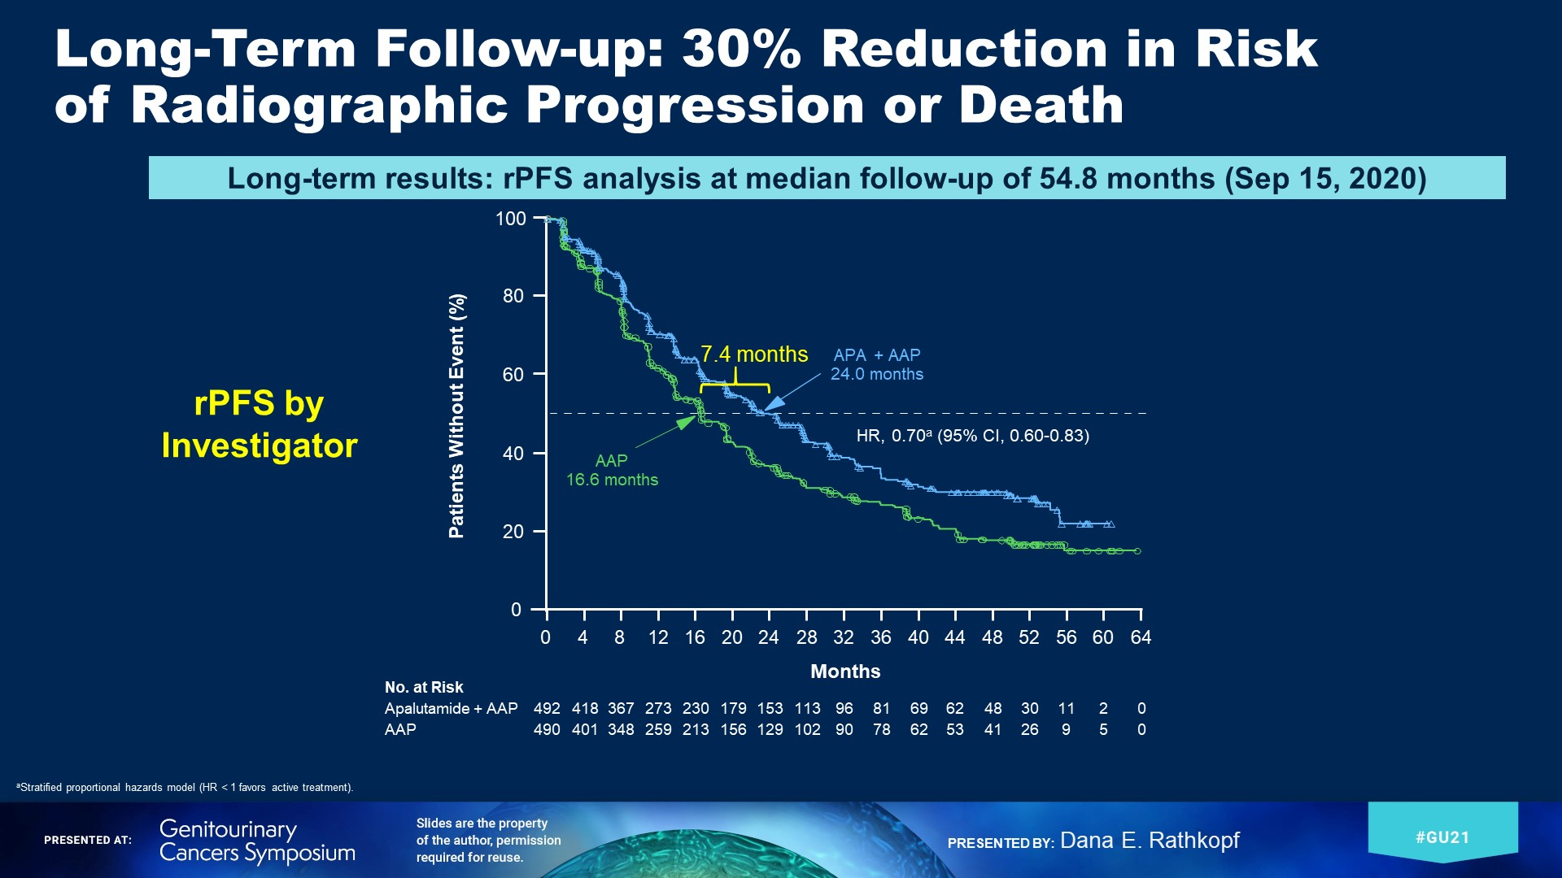
Final results from ACIS, a randomized, placebo-controlled double-blind phase 3 study of apalutamide (APA) and abiraterone acetate plus prednisone (AAP) versus AAP in patients (pts) with chemo-naive metastatic castration-resistant prostate cancer (mCRPC). (Dana Rathkopf – MSKCC)

Slide 6
Phase I trial of apalutamide (Apa) with abiraterone acetate (AA) plus prednisone (P) and docetaxel (Doce) in patients with metastatic castration-resistant prostate cancer (mCRPC).
Weil-Cornell
The combination of apa, AA+P, and doce at full doses is tolerable. The combination is associated with a high proportion with PSA decline, measurable disease response, CTC count control, and favorable rPFS.

Slide 7
Sequential Use of Abi and Enza in mCRPC
Experience from 7 UK centers
In patients receiving Enza post-Abi, the TTP was <16 weeks.
Trials underway comparing Abi alone vs combination of Abi + Enza

Slide 8
Cabazitaxel multiple rechallenge in metastatic castration-resistant prostate cancer: A therapeutic option to increase overall survival?
Multicenter, retrospective study – 22 pts that had 3X cabazitaxel, selected from >700 pts.
Patient (N) | First-use (n=22) | Second-use (n=22) | Third-use (n=22) | Fourth-use (n=5) | Fifth-use (n=1)
Best clinical benefit: Improved, N (%) | 11 (50) | 11 (50) | 10 (45.5) | 1 (20) | 1
Best clinical benefit: Stable, N (%) | 10 (45.5) | 11 (50) | 7 (31.8) | 4 (80) | 0
Best clinical benefit: Progression, N (%) | 1 (4.5) | 0 | 5 (22.7) | 0 | 0
PSA response: ≥ 50%, N (%) | 19 (86.4) | 14 (63.6) | 12 (60) | 4 (80) | 0
PSA response: 0 – 50%, N (%) | 3 (13.6) | 5 (22.7) | 4 (20) | 1 (20) | 1
PSA response: none, N (%) | 0 (0) | 3 (13.6) | 4 (20) | 0 (0) | 0
Median radiological and/or clinical PFS (months) [95% Confidence interval] | 11.8 [9-14.2] | 9.6 [8.6-12.2] | 5.6 [4.2-9] | 10.2 [7-NR] | 9.1 -
Median overall survival (months) [95% Confidence interval] | 50.9 [44.5-NR] | 43.5 [26.9-NR] | 24.8 [13.7-NR] | 19.2 [8.3-NR] | - -

Slide 9
UnCHAARTED territory: The role of docetaxel rechallenge following chemohormonal therapy for metastatic castrate-sensitive prostate cancer.
The median number of cycles of docetaxel received at rechallenge was 5 (range 1-11)
18% of patients requiring treatment delays. 64% of patients stopped treatment due to progression, 16% due to side effects, 7% at the patient’s request, 7% due to completion of the planned number of cycles, and 6% due to death or other causes.
Among 44 informative patients, 23% achieved at least a PSA50, with 18% having a 50-90% PSA reduction, and 5% having a ≥90% PSA reduction. The median time to progression (biochemical, radiographic, or death) was 2.3 months (95%CI 1.7-4.4) and the median overall survival was 11.0 months (95%CI 8.5-14.3).

Slide 10
ICEPAC: A phase II multicenter study of avelumab combined with stereotactic ablative body radiotherapy (SABR) in metastatic castration-resistant prostate cancer
SABR (two sites not all sites) added to PD-1 inhibition increased PFS & OS in mCRPC
a test of the abscopal effect

Slide 11
18F-DCFPyL-PET/CT
A prospective phase II/III study of PSMA-targeted 18F-DCFPyL-PET/CT in patients (pts) with prostate cancer (PCa) (OSPREY): A subanalysis of disease staging changes in PCa pts with recurrence or metastases on conventional imaging
  up-staged 58% (19/33) of pts from M0 to M1, of whom 91% (10/11) were confirmed to have M1 disease by pathology.
  Of the patients who were staged M1at baseline, 18F-DCFPyL-PET/CT upstaged 16% (10/64; M1a to M1b or M1c: n = 4; M1b to M1c: n = 6) and down-staged 22% (18/82) to M0.
PSMA-targeted imaging with 18F-DCFPyL-PET/CT in patients with biochemically recurrent prostate cancer: A phase III study (CONDOR)—A subanalysis of correct localization rate and positive predictive value by standard of truth
  detected and localized metastatic lesions with high CLR and PP in men with BCR who had negative or equivocal baseline imaging

Slide 12
Clinical study of VERU-111, an oral cytoskeletal disruptor, in metastatic castration-resistant prostate cancer (mCRPC) who failed an androgen receptor targeting agent.
The Phase 2 clinical study has been fully enrolled and is evaluation the recommended Phase 1 b dose (63 mg) in patients with mCRPC who also failed at least one androgen receptor targeting agent and prior to IV chemotherapy
• A positive meeting with FDA was held in July 2020 and will initiate the pivotal Phase 3 VERACITY clinical study in Ql 2021

Slide 13
Phase 2b – oral ModraDoc006
A novel, oral tablet formulation of docetaxel
Bioavailability is enhanced with co-admin of ritonavir (cytochrome P450 3A4 and P-glycoprotein)
Advantages: patient convenience; elimination of infusion-related reactions and avoiding prophylactic steroid administration
PSA response rates and rPFS comparable to IV docetaxel
Mild and reversible GI-toxicity.
Myelosuppression and neurotoxcity were low to negligible; low levels of alopecia

Slide 14
Radium-223
Randomized phase II study evaluating the addition of pembrolizumab to radium-223 in metastatic castration-resistant prostate cancer.
  Ra233 + pembrolizumab not lead to prolonged rPFS or OS compared to Ra223 alone
Randomized phase II trial of radium-223 (RA) plus enzalutamide versus EZ alone in metastatic castration-refractory prostate cancer: Final efficacy and safety results.
Endpoint | EZ+RA (n = 35) | EZ (n = 12) | P-value
PSA-PFS, Median Months (95% CI) | 8.9 (4.73-21.4) | 3.38 (2.7-NA) | 0.97
PSA-PFS2, Median Months (95% CI) | 18.7 (12.2-42.8) | 8.41 (5.52-NA) | 0.033
TTNT, Median Months (95% CI) | 15.9 (9.7-35.5) | 3.47 (3.3-NA) | 0.067
OS, Median Months (95% CI) | 30.8 (17.9-NA) | 20.6 (16.8-NA) | 0.73

Slide 15
Radium-223
Clinical outcomes of patients with metastatic castration-resistant prostate cancer (mCRPC) receiving radium-223 (Ra-223) early versus late in the treatment sequence
Retrospective Chart Review

