Slide 1
Advances in Prostate Cancer Diagnosis
Andres F. Correa, MD
Assistant Professor of Surgery
Associated Fellowship Director Urologic Oncology Fellowship
Division of Urologic Oncology

Slide 2
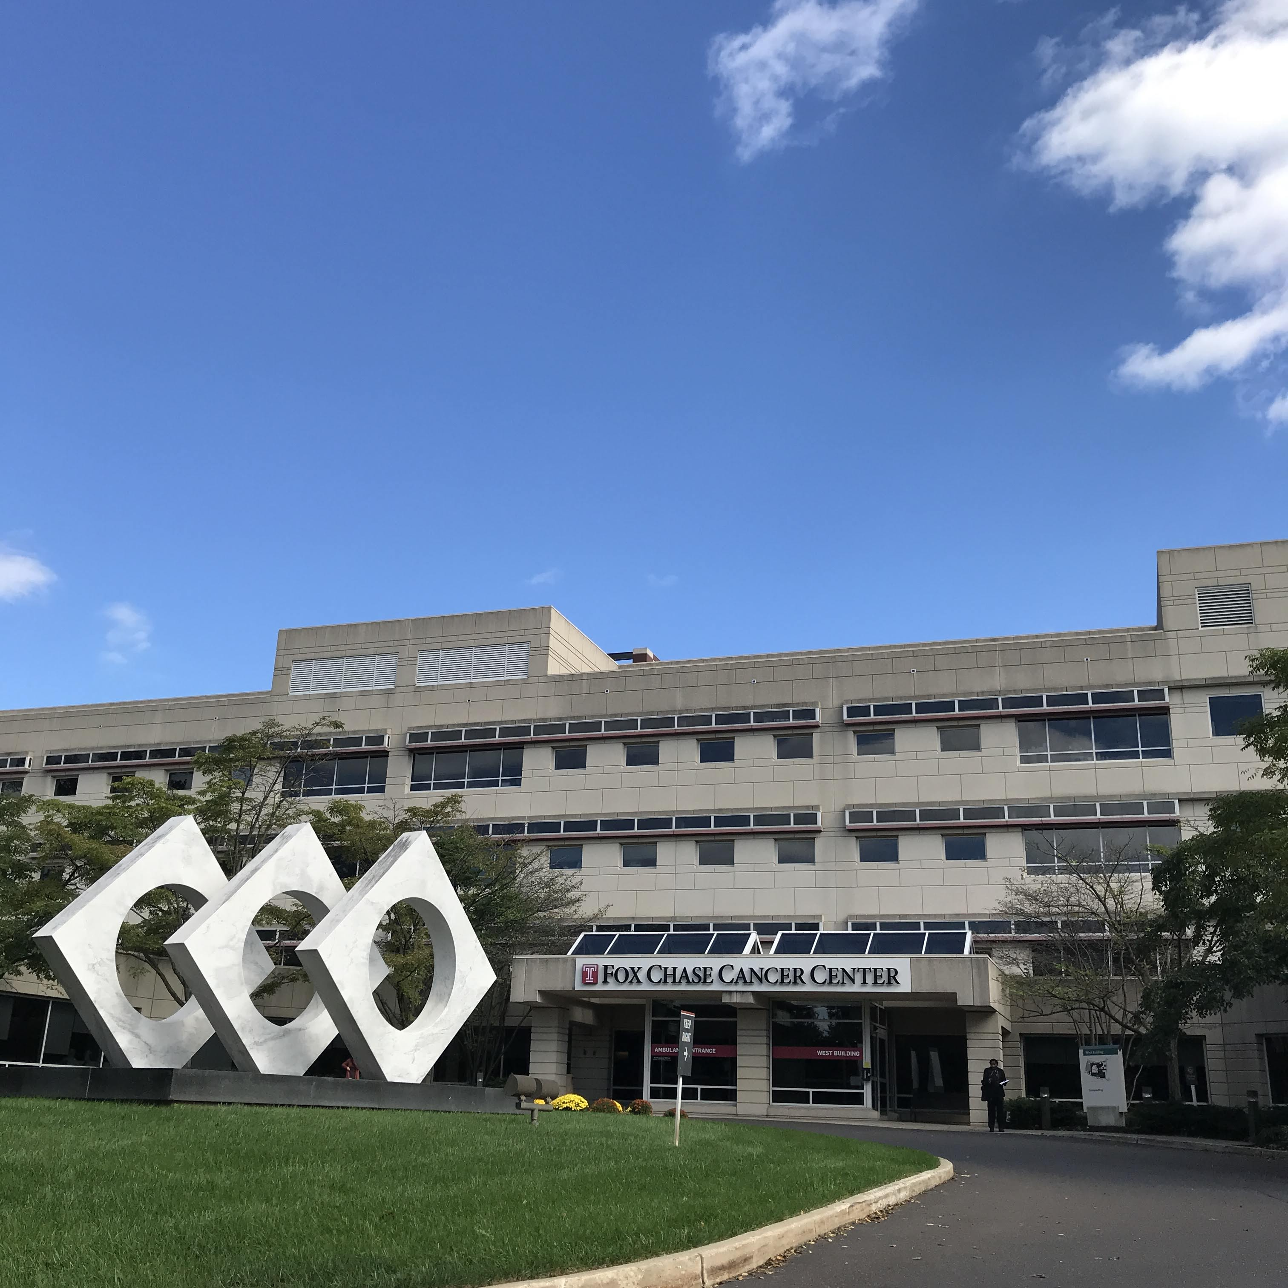
FOX CHASE IS
ONE OF THE
NATION’S FIRST CANCER HOSPITALS.
Fox Chase Cancer Center in Philadelphia has a legacy of nationally competitive basic, translational, and clinical research. Pictured here is the Diamond Sculpture, which symbolizes prevention, patient care, and research, in its location in front of the main hospital building.
FOUNDED
1904

Slide 3
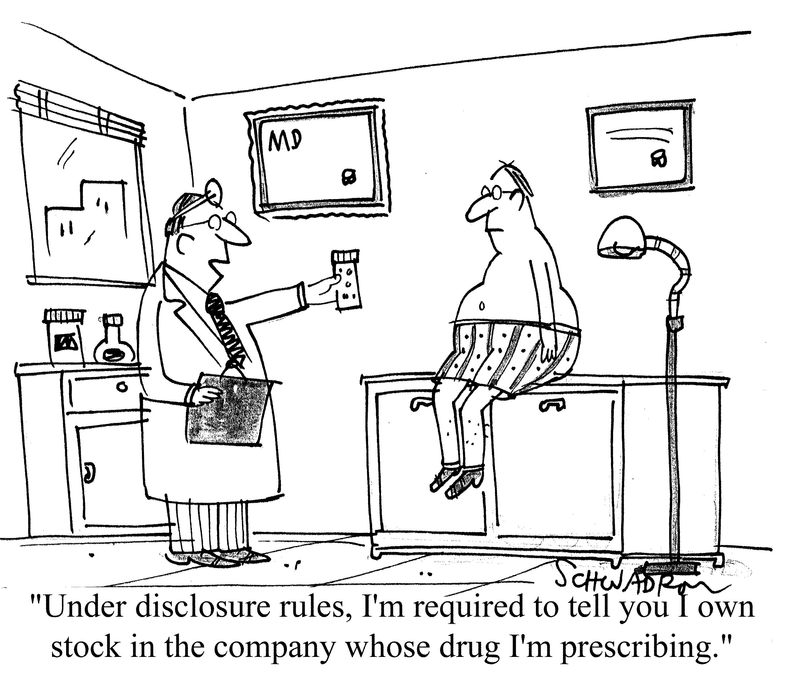
Disclosures
I have no disclosures

Slide 4
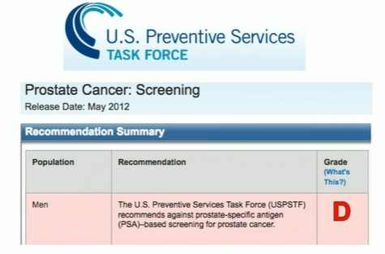

Urology Reckoning 2012
“The USPSTF concludes that there is moderate certainty that the benefits of PSA-based screening for prostate cancer DO NOT outweigh the risks”

Slide 5
US Preventive Task Force Review of the Evidence
Reduced
Morbidity
and/or
Mortality
Persons
at Risk
Screening
Early Detection of Target Condition
Treatment
Intermediate
Outcome
Association
Adverse Effects
Of Screening
Adverse Effects
Of Treatment
Invasiveness of prostate biopsy
Complications associated with prostate biopsy
Limited diagnostic value of prostate biopsy
Treatment related QoL side effects
Aggressive treatment of indolent disease
Poor risk stratification of treatment options

Slide 6
Outline
Advances in Prostate Biopsy → Transperineal Prostate Biopsy
Advances in Prostate Imaging → Transrectal Micro-Ultrasound

Slide 7
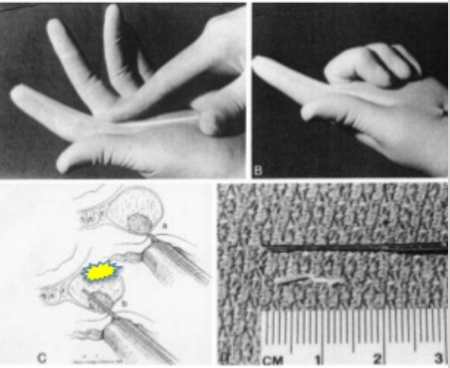
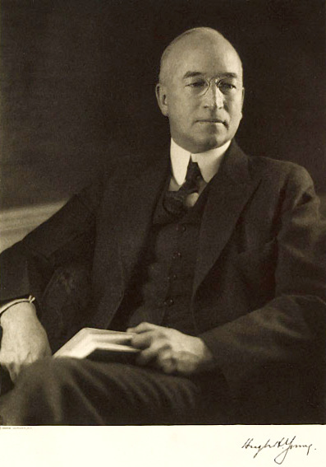
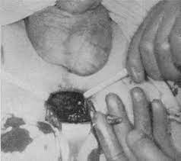
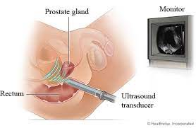
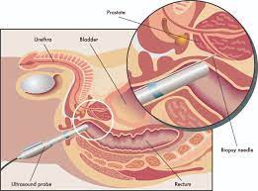
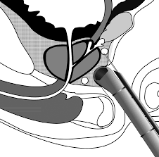
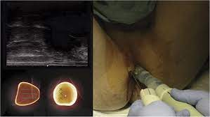
History of Prostate Biopsy
Open Perineal Prostate
Biopsy
1926
Young et al
Transrectal Finger Guided Biopsy
Astradil et al
1937
Introduction of TRUS
1974
Watanabe et al
Modern era Prostate Biopsy
Sextant Method
Hodges et al
1989
Peri-Prostatic anesthetic Block
1996
Nash et al
Free Hand Transperineal Prostate Biopsy
DiBianco et al
2016

Slide 8

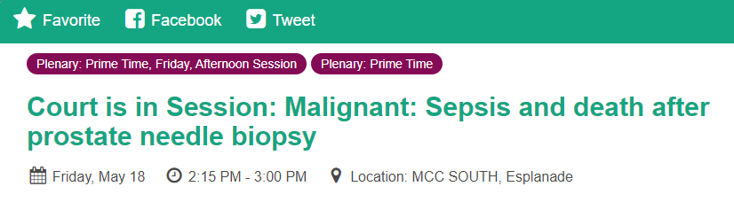
Urology Reckoning 2012

Slide 9
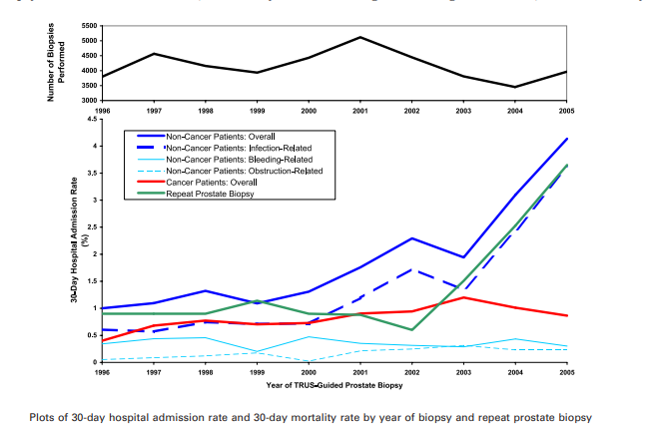
TRUS Biopsy: Infectious Complications
Nam RK et al. J Urol. 2010 Mar;183(3):963-83. Epub 2010 Jan 20.

Slide 10
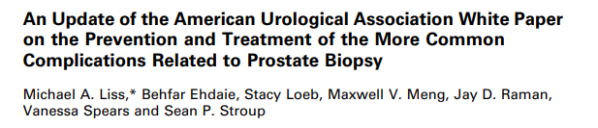
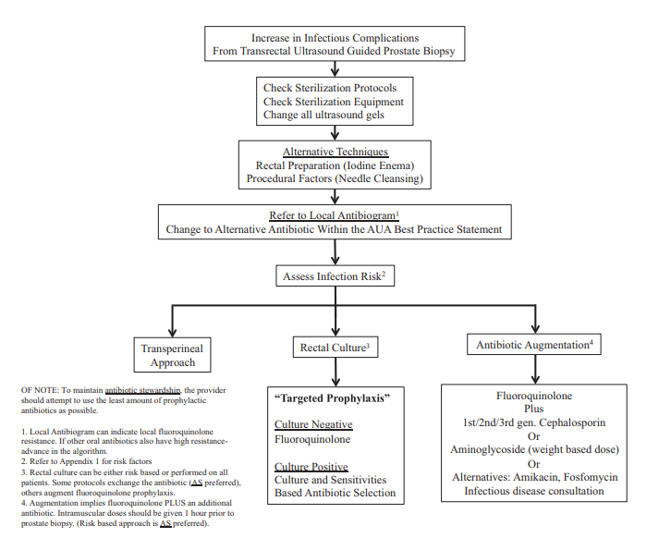

Slide 11
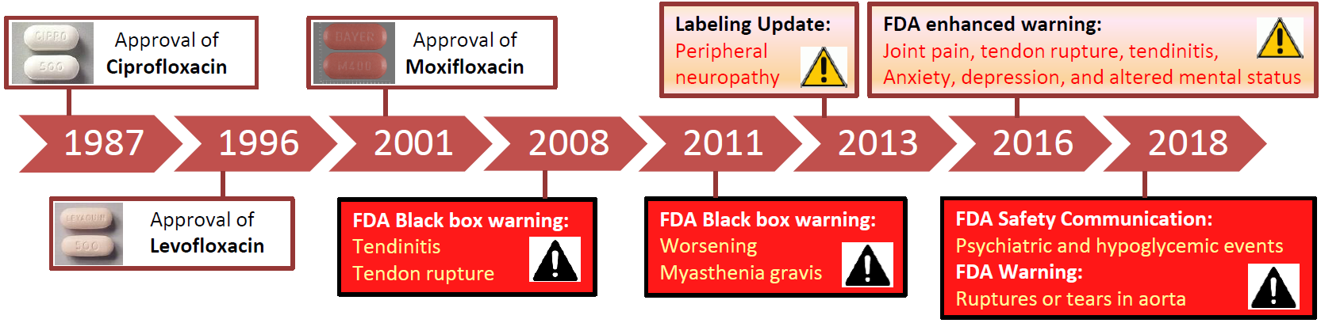
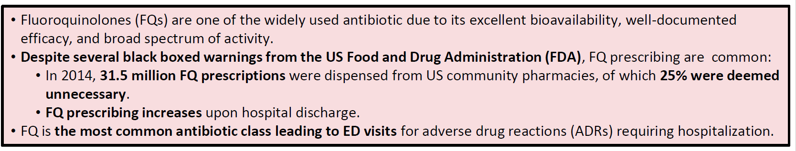
Ciprofloxacin is not Benign

Slide 13
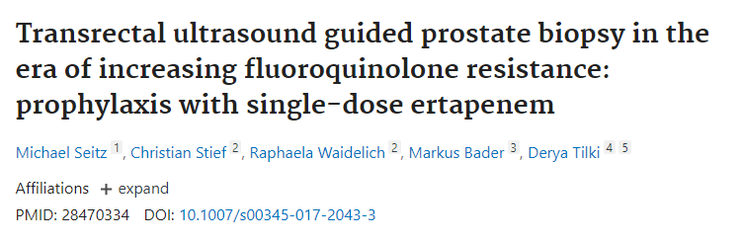

Antibiotic Augmentation: Is not the Answer

Slide 14

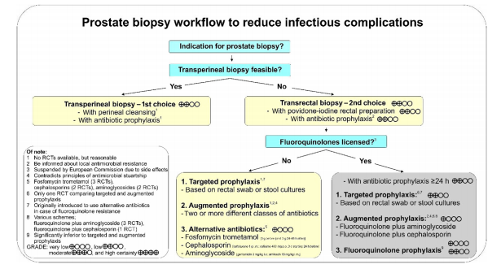

Slide 15
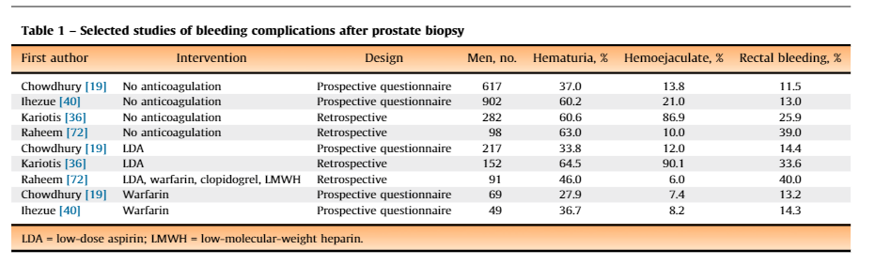
TP Biopsy: No Rectal Bleeding
Loeb, S., et al. (2013). "Systematic Review of Complications of Prostate Biopsy." European Urology 64(6): 876-892.

Slide 16

TR-EXIT
Is the Urology Running Away from TR-Biopsy
Main Issues Affection Adoption:
TR-Biopsy complications are a rare event
Increased risk of urinary retention
Need for general or spinal anesthesia

Slide 17
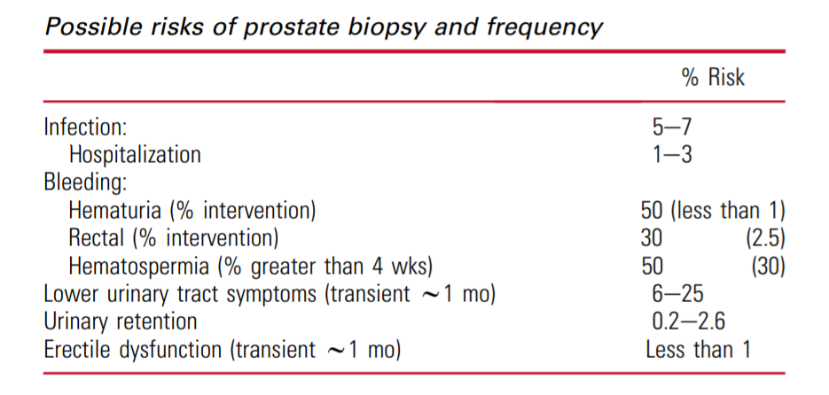


TR-Biopsy Complications are a Rare Event
50,000-70,000
10,000-30,000
Is estimated that approximately 1,000,000 biopsies are performed in the US each year
67,594
19,500

Slide 18
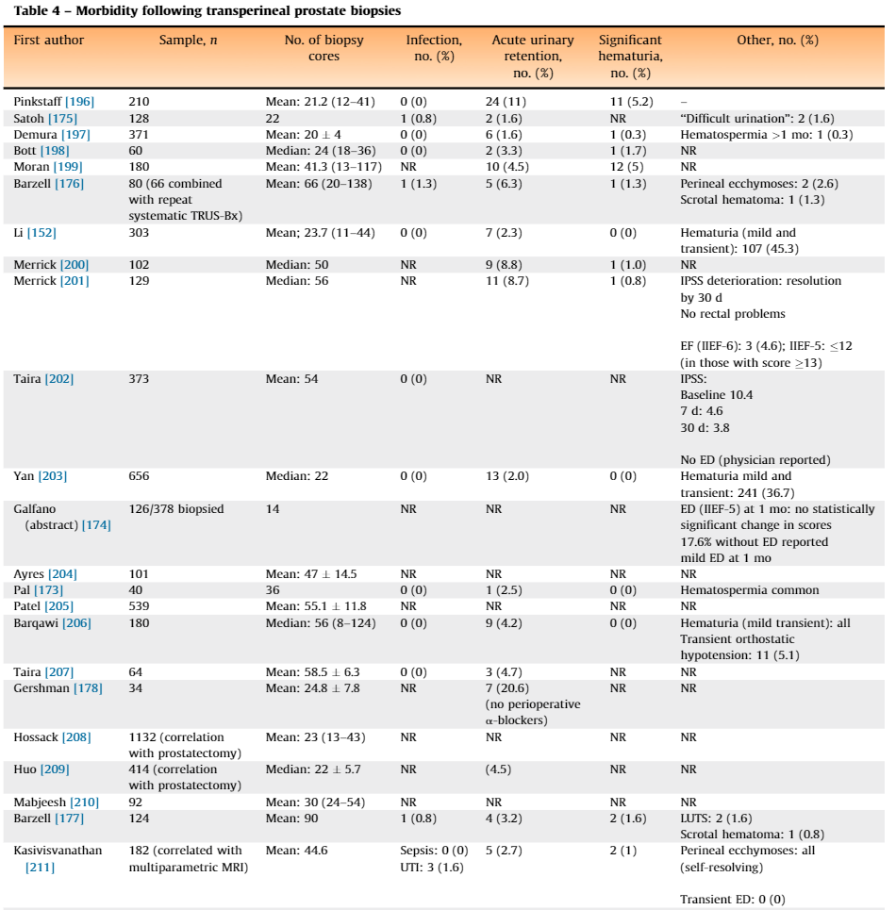
Increased Risk of Urinary Retention
Loeb, S., et al. (2013). "Systematic Review of Complications of Prostate Biopsy." European Urology 64(6): 876-892.

Slide 19
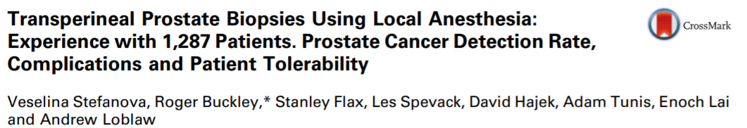
Increased Risk of Urinary Retention
20 patients = 1.6% developed urinary retention
4 patients = 0.3% received post-biopsy antibiotics
No septic events
No hospitalizations
Loeb, S., et al. (2013). "Systematic Review of Complications of Prostate Biopsy." European Urology 64(6): 876-892.

Slide 20
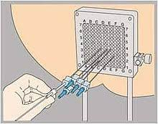
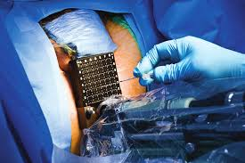
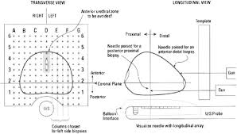
Need for General/Spinal Anesthesia
When urologist hear transperineal biopsy = Brachytherapy or Template Biopsies

Slide 21
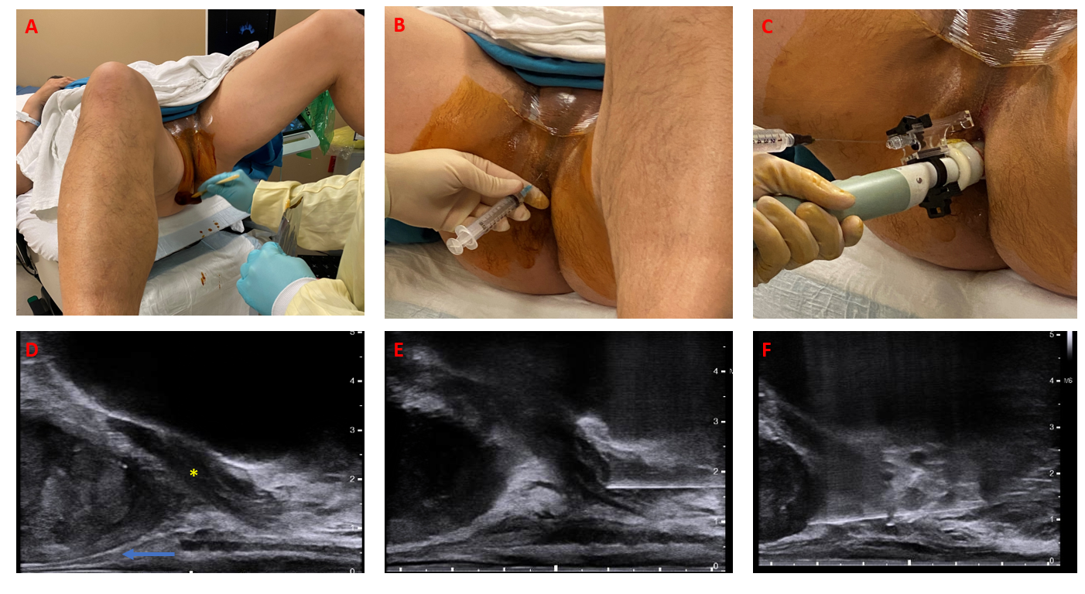
Free Hand TP Biopsy – Very Different

Slide 22
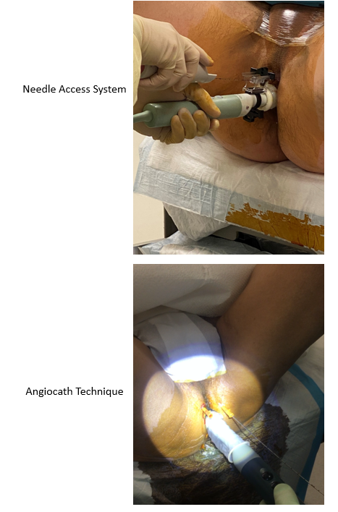
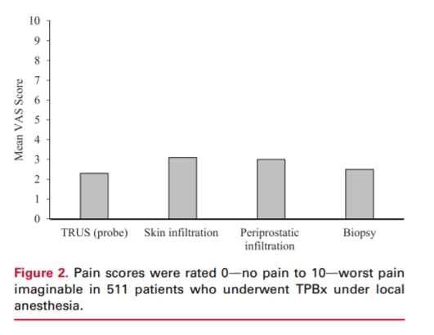
Free Hand TP Biopsy – Very Different

Slide 23
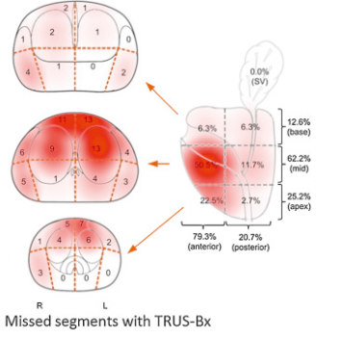
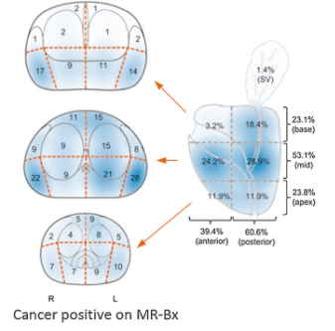
Improved Prostate Sampling
Schouten MG, European Urology 71:896-903, 2017

Slide 24
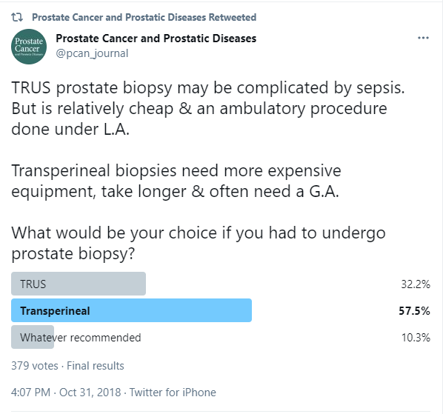
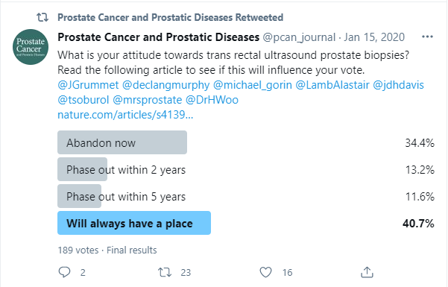
The Debate Continues

Slide 25


Why is there a debate
There is no level one data suggesting that TP-Biopsy is superior to TR-Biopsy
Led by Jim Hu at Cornell
Awarded 4.2 million by PCORI for the trial
10 plus institutions participating in the trial
Primary End-Point:
  To compare infection adverse events of TP-Bx vs. TR-Bx performed under local anesthesia
Secondary End-Points:
  To compare other adverse events such as bleeding and urinary retention
  To compare detection rates of clinically significant and insignificant prostate cancer

Slide 26
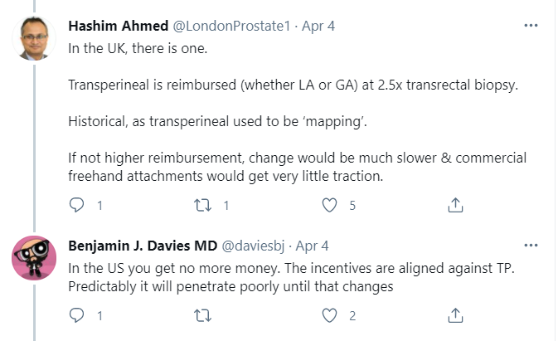
Why is there a debate
2. There is a lack of incentives for urologist to transition

Slide 27
US Preventive Task Force Review of the Evidence
Reduced
Morbidity
and/or
Mortality
Persons
at Risk
Screening
Early Detection of Target Condition
Treatment
Intermediate
Outcome
Association
Adverse Effects
Of Screening
Adverse Effects
Of Treatment
Invasiveness of prostate biopsy
Complications associated with prostate biopsy
Limited diagnostic value of prostate biopsy
Treatment related QoL side effects
Aggressive treatment of indolent disease
Poor risk stratification of treatment options

Slide 28
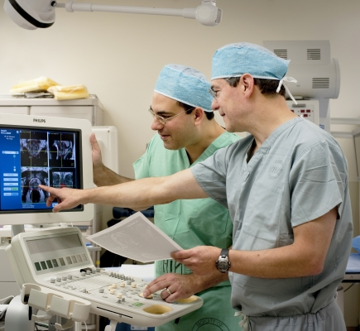
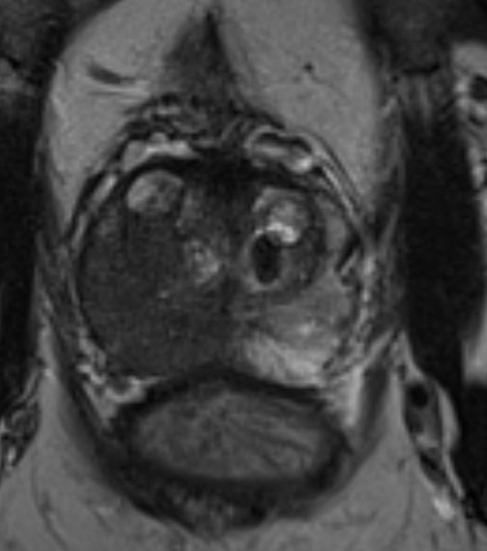
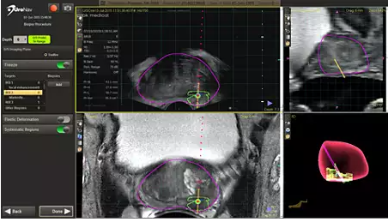

The Peters Come to the Rescue

Slide 29
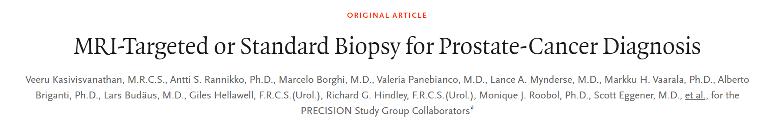
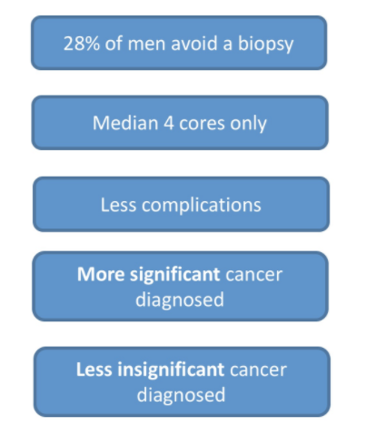
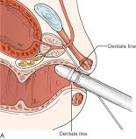
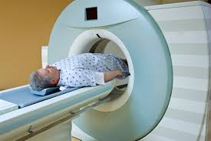

Precision Population
Mean age 64y
Median PSA 6.7
15% Abnormal DRE
Control Arm
Intervention Arm
Abnormal
Normal
PSA Screening
Gleason ≥3+4 =7 (GG 2) = 26%
Gleason 6 ( GG 1) = 22%
Gleason ≥3+4 =7 (GG 2) = 38%
Gleason 6 ( GG 1) = 9%

Slide 30

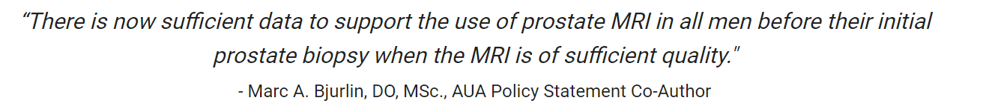
Imaging to Improve Cancer Detection

Slide 31
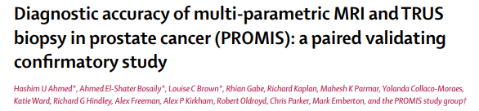
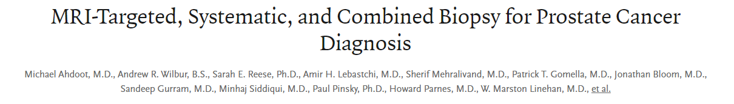
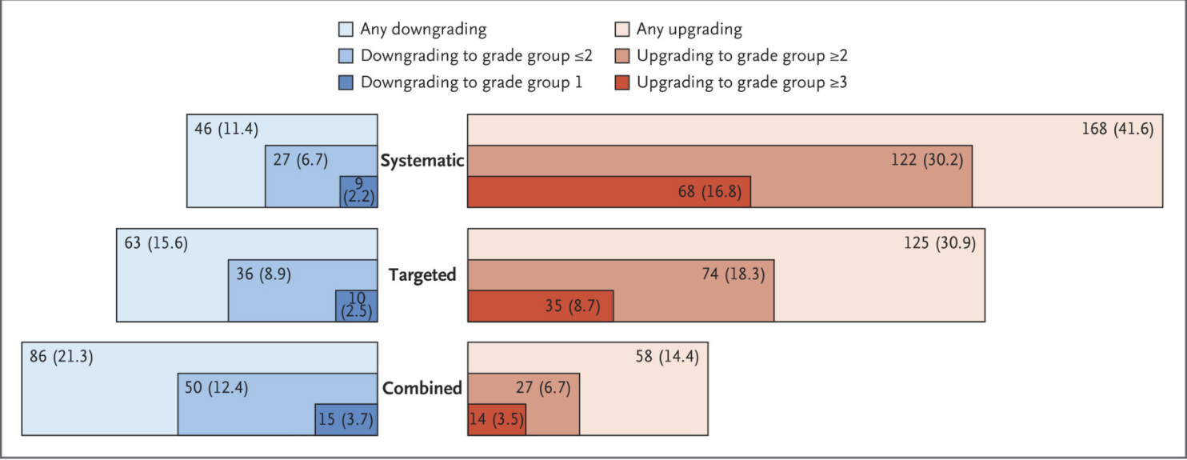


MRI is NOT 100%
MRI guided biopsy alone may miss up to 25 % of Clinically Significant Cancers

Slide 32
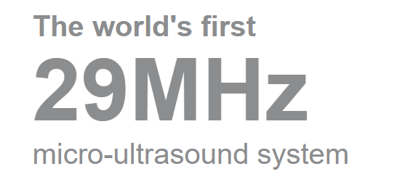
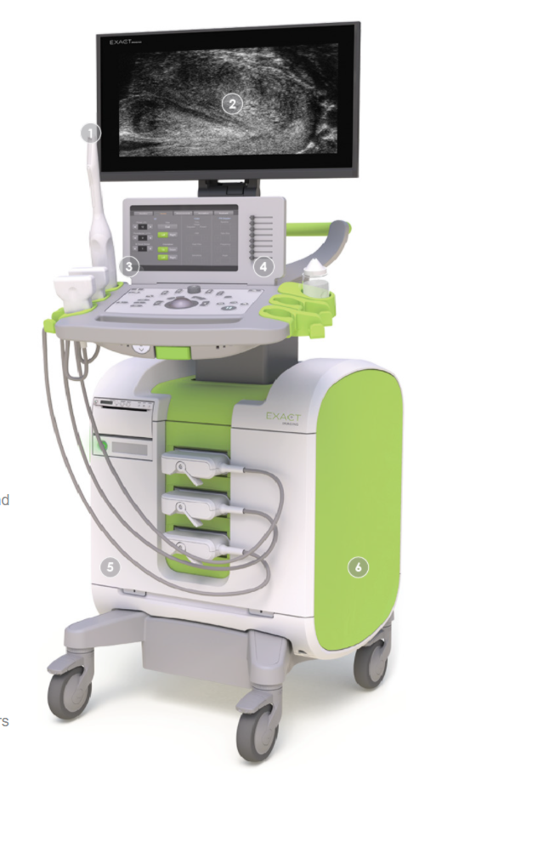
What is in the Horizon: ExactVU Micro-Ultrasound
Micro-ultrasound 300% improved resolution over the standard transrectal probe (6-12 MHz)
Point of Care Examination
  No need for an added MRI visit
Able to perform biopsy at the time of evaluation
There are no limitation in regards to:
  Pacemakers
  Contrast Allergies
  Prosthetics
  Metal
  Claustrophobia

Slide 33
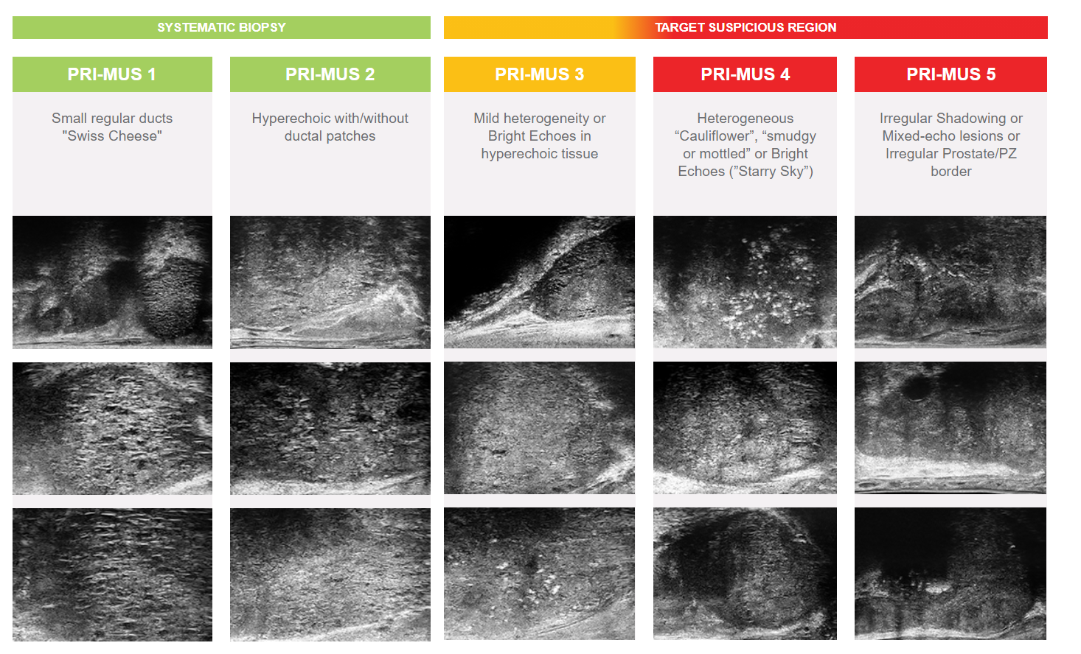
ExactVU Micro-Ultrasound: What are we Looking For ?

Slide 34
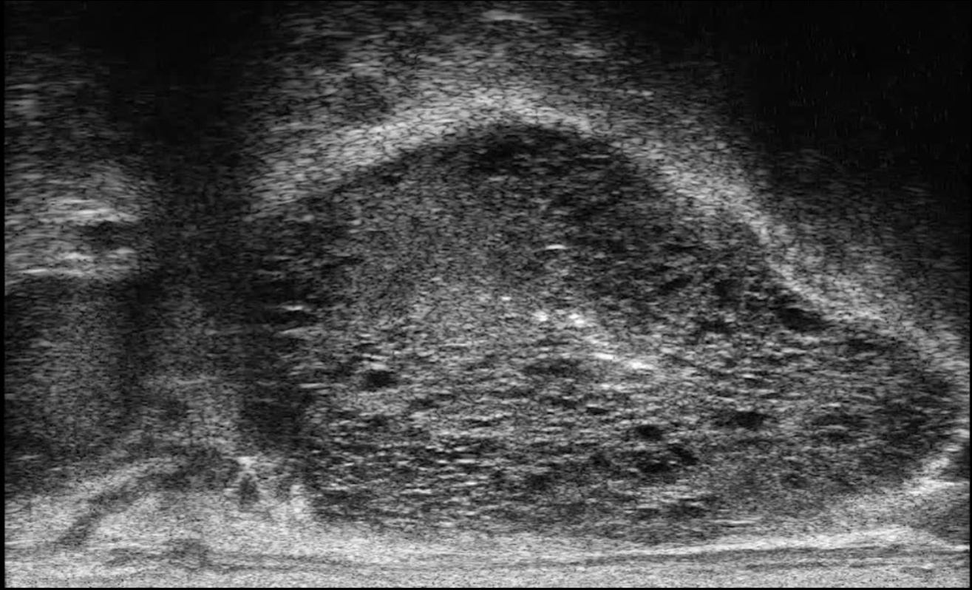
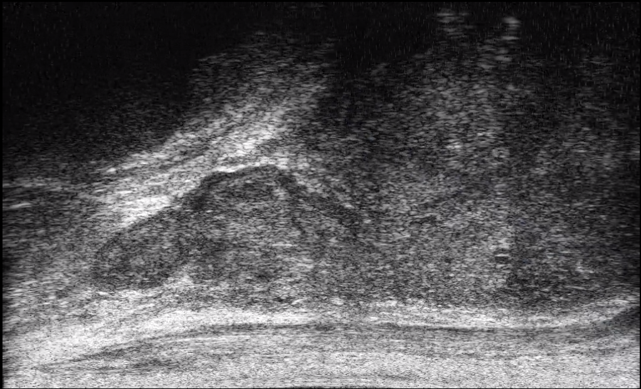
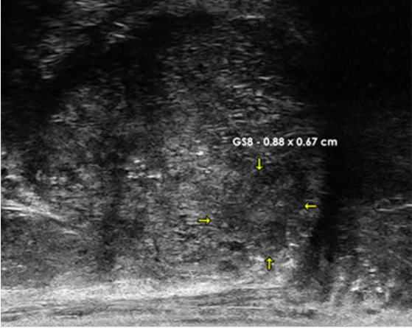



ExactVU Micro-Ultrasound: Cases
PRIMUS 1 lesion “Swiss Cheese”
PRIMUS 4 lesion “Cauliflower”
PRIMUS 5 lesion
GS 7 0.7 x 0.65 cm
PRIMUS 2 lesion
PRIMUS 5 lesion
GS 8 1.2 x 1.1 cm

Slide 35


ExactVU Micro-Ultrasound: The Data

Slide 36


ExactVU Micro-Ultrasound: The Data
Notes:
The largest micro-ultrasound study to date with 1040 biopsy procedures across 11 institutions. Micro-ultrasound demonstrated higher sensitivity and negative predictive value than mpMRI in this real-world registry study (p=0.03

Slide 37
ExactVU Micro-Ultrasound: My 2 Cents
Micro-Ultrasound technology appears to provide comparable detection of clinically significant prostate cancer compared to MRI.
  Level 1 data comparing both modalities is needed
Micro-Ultrasound appears to be more sensitive than MRI at detecting clinically significant prostate cancer with a higher negative predictive value
  A Negative micro-US evaluation is more informative than a negative MRI
The technology has the added benefit of being a point of care device
  No need for an expensive imaging modality (MRI)
  May become the standard of care, given the rising cost of caring for patients on active surveillance
  Provides the ability to perform the diagnostic test and biopsy in the same setting
It does have limitations:
  Anterior zone evaluation is challenging
  It does require significant experience in characterizing the lesion
  TP-Biopsy using the system is cumbersome
Notes:
The largest micro-ultrasound study to date with 1040 biopsy procedures across 11 institutions. Micro-ultrasound demonstrated higher sensitivity and negative predictive value than mpMRI in this real-world registry study (p=0.03

Slide 38
Conclusions
Transperineal prostate biopsy should become the standard technique for prostate biopsies
  Decrease risk of infection
  No need for antibiotic prophylaxis
  No need for general or spinal anesthesia
  Better sampling of the anterior prostate
There is a lag in adoption of the Transperineal technique due to preconceived notions associated with TP procedures
  Need help from advocacy groups to push urologist to adopt the technique
Prostate imaging has been the most significant advancement, since the PSA screening, for the diagnosis of prostate cancer
MRI imaging is expensive, and not available to all patients
Micro-ultrasound technology has the potential to bring MRI imaging into the urologist office
  Emerging data shows micro-US to be comparable to MRI in the detection of clinically significant prostate cancer
  Wide adoption of micro-US technology may help mitigate the rising cost of active surveillance for patients with low to intermediate risk prostate cancer

Slide 39

Questions/Comments

