Slide 1

How does where you live impact active surveillance?
Samuel L. Washington III, MD, MS
Assistant Professor of Urology; Epidemiology & Biostatistics
Goldberg-Benioff Endowed Professorship in Cancer Biology
University of California, San Francisco
@SamWashUro

Slide 2
Active Surveillance
Active surveillance is a response to the over - detection and - treatment of prostate cancer brought about by widespread and repeated PSA screening.
Its uptake by the urology community helped pave the way for an upgraded assessment by the USPTF on the early detection of prostate cancer

Slide 3
Active Surveillance - Goals
Avoid or Delay the costs (functional, monetary) of treatment without compromising cancer cure
Compliant with screening/treatment guidelines
Based on the rationale that
  Initial assessment is reasonably accurate
  Monitoring is accurate and identifies sub – clinical progression at a time that initial treatment options are still available and curative
Active surveillance is about timing of treatment

Slide 4
UCSF active surveillance cohort
2113 enrolled
Year of diagnosis: median 2010 (range 1990, 2019)
Age at diagnosis: mean 62.5 years (SD 7.68)
PSA at diagnosis: median 5.5 (IQR 4.2, 7.5)
Duration of follow up: median 73 months (IQR 43, 112
85% low risk, 15% intermediate risk

Slide 5
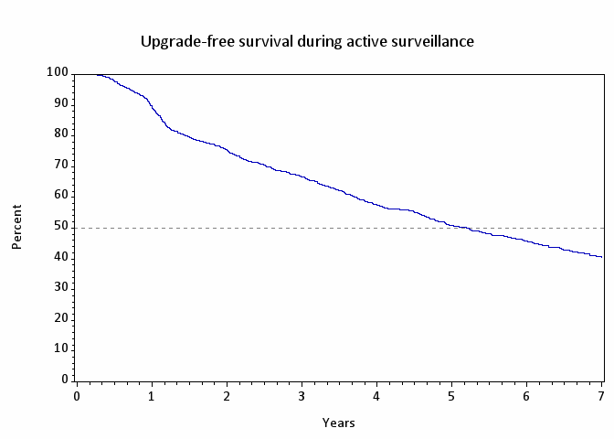
Biopsy upgrade-free survival
Upgrade Free Survival
41% at 7 years. N=689 upgraded at median 25 months (IQR 13, 52)

Slide 6
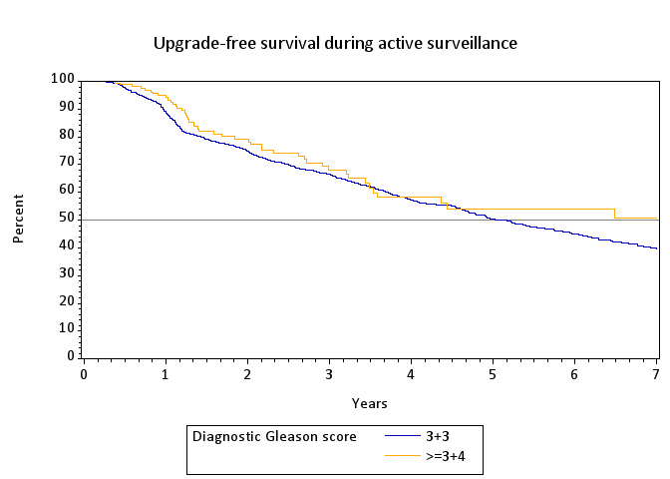
Progression Based on GG 1vs 2 (p = 0.22)

Slide 7
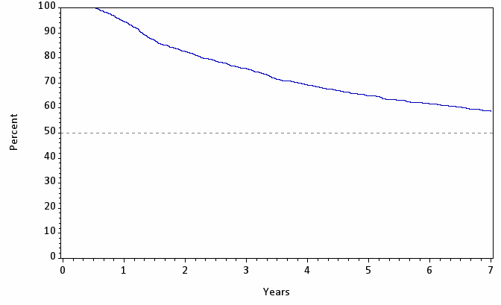
Treatment Free Survival
59% at 7 years. N=682 upgraded at median 27 months (IQR 15, 50)

Slide 8
Can we identify better triggers for treatment
Limitations of current AS endpoints
Reclassification of Gleason score, tumor volume, PSA (density, kinetics), anxiety
What are the dynamics of clinical risk change over time during surveillance?
Change in
CAPRA score
diagnosis to last Bx
(0-10)
Eur Urol. 2017 Sep;72(3):329-332.
Leapman M et al. AUA 2015 New Orleans
Notes:
Conventional endpoints for active surveillance are well recognized, however imperfectly predict the risk of disease progression. These include changes in Gleason score, tumor volume, or PSA.
Indeed, escalation to treatment purely based on one of these factors may expose many patients to early treatment, or conversely may miss opportunities for cure.
We aimed to evaluate whether the magnitude of clinical risk change, apprised of all relevant clinical variables could offer an improved prediction of adverse pathology among men ultimately treated with prostatectomy.
As you can see, the degree of risk change (assessed with the 0-10 CAPRA score) from diagnosis to last follow among 735 men. As you can see it is actually a non-uniform distribution with many gradations of change—IN BOTH DIRECTIONS.

Slide 9
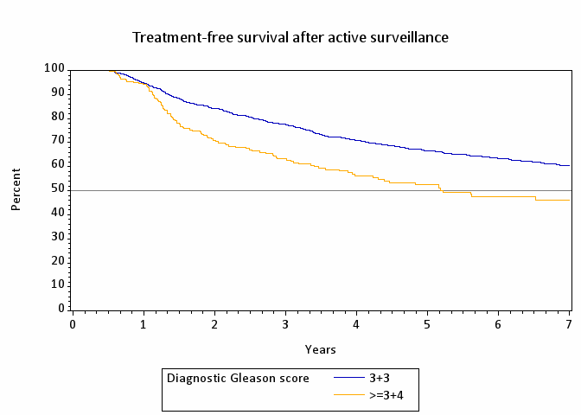
Treatment Free Survival by GG
Overall Survival 96%
Prostate Cancer Specific Survival 99%
Metastases – free Survival 99%

Slide 10
Active Surveillance
IMPACT OF NEW TECHNOLOGY

Slide 11
2020 National Comprehensive Cancer Network Guidelines Recommendations on Genomic Testing
Risk Category | Definition | Recommendation
Very Low | T1c, GG1, PSA <10, <3 positive cores, ≤50% core involved, PSAD <0.15 | Not Indicated
Low | T1-T2a, GG 1, and PSA <10 | Consider if life expectancy >10y
Intermediate | T2b-T2c, or GG 2 or 3, or PSA 10-20 | Consider for favorable-intermediate-risk if life expectancy >10y
High | T3a or GG4 or 5, or PSA >20 | Consider if life expectancy >10y
Very High | T3b-T4, or primary Gleason pattern 5, or >4 cores with GG 4 or 5 | Not routinely recommended

Slide 12
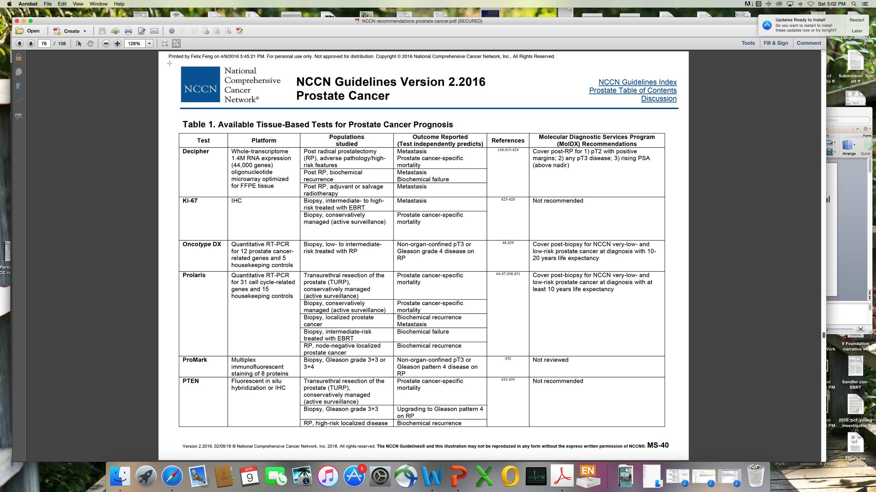
Clinically Available Genomic Tests
Decipher
GPS
Prolaris
All of these assays have prognostic value
none are predictive biomarkers

Slide 13
Oncotype DX GPS (Genomic Health)
Quantitative 17-gene RT-PCR assay on manually microdissected tumor tissue from needle biopsy
Genes and biological pathways predictive of multiple endpoints, with emphasis on clinical recurrence
Optimized for very small tissue input: six 5 micron sections of single needle biopsy block with as little as 1 mm tumor length
Androgen Signaling
AZGP1
FAM13C
KLK2
SRD5A2
Cellular Organization
FLNC
GSN
GSTM2
TPM2
Stromal Response
BGN
COL1A1
SFRP4
Reference
ARF1
ATP5E
CLTC
GPS1
PGK1
Proliferation
TPX2
GPS =
0.735*Stromal Response group
-0.352*Androgen Signaling group
+0.095*Proliferation group
-0.368*Cellular Organization group
Scaled between 0 and 100
Eur Urol. 2014 Sep;66(3):550-60. doi: 10.1016/j.eururo.2014.05.004. Epub 2014 May 16.

Slide 14
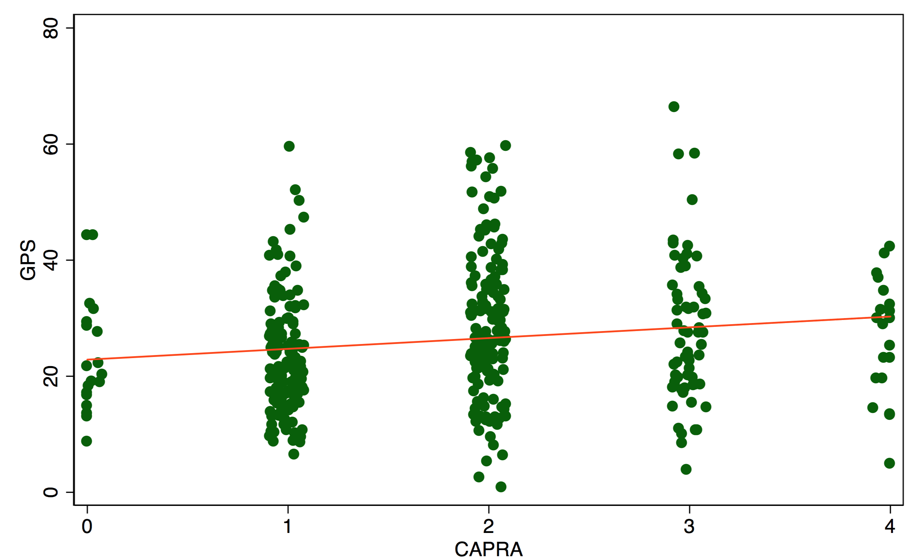
Weak correlation between CAPRA and GPS
Eur Urol 66:550, 2014

Slide 15
GPS score and upgrade on surveillance
Cox regression for risk of upgrade to Gleason ≥3+4 on subsequent biopsy for AS cohort of men diagnosed with Gleason 3+3
Characteristic | HR | 95% CI | p
Age at diagnosis (years) | 1.01 | 0.99-1.03 | 0.47
PSA density at diagnosis (log) | 1.33 | 0.92-1.91 | 0.13
Biopsy cores % positive at GPS | 1.01 | 1.00-1.02 | 0.03
GPS score (per 5 units) | 1.27 | 1.18-1.38 | <.01
J Urol. 2019 Feb;201(2):300-307. doi: 10.1016/j.juro.2018.08.047.

Slide 16
GPS – Impact on Adverse pathology (AP) and PSA relapse after delayed RP
AP = T3, primary pattern 4 and/or N+
PSA relapse = PSA > 0.02 and/or second treatment
Adverse pathology
PSA Relapse
 | p | HR | 95% Confidence Interval
GPS (per 5 units) | <.01 | 1.16 | (1.06, 1.26)
Age at diagnosis (years) | <.01 | 1.07 | (1.03, 1.11)
Clinical CAPRA at diagnosis | 0.60 | 0.92 | (0.66, 1.27)
PSA density at GPS (log) | 0.06 | 1.70 | (0.97,2.96)
 | p | HR | 95% Confidence Interval
GPS (per 5 units) | 0.04 | 1.10 | (1.00, 1.21)
Age at diagnosis (years) | 0.41 | 0.98 | (0.94, 1.02)
Clinical CAPRA at diagnosis | 0.19 | 1.29 | (0.88, 1.90)
PSA density at GPS (log) | 0.65 | 0.88 | (0.49, 1.57)
J Urol. 2019 Apr 26:101097 [Epub ahead of print] PMID: 31026214

Slide 17
Genomic Classifiers- Concerns
Tumor heterogeneity
Do all patients benefit?
  Very low risk
  Which low and favorable-intermediate risk?
Are they cost-effective?
What are the long-term outcomes?

Slide 18
Active Surveillance
Current Controversies
What risk categories are appropriate?
  Very low risk, low risk / Low CAPRA scores
  Those with GS ¾ disease
Is it safe for African American men?
Are eligible men being initially managed with AS rather than active treatment?

Slide 19
African American Men Are Not at Higher Risk for Adverse Pathology
Data from 2 large registries– CaPSURE/UCSF and SEARCH
AA race not associated with upgrade or upstage:
  Upgrade (OR 1.44, 95% CI 0.96-2.16, p=0.13)
  Upstage (OR 1.15, 95% CI 0.67-2.00, p=0.64)
No significant association with AA status and pathologic upgrade, upstage or positive surgical margins
  Remained upon restriction to JHU/UCSF strict AS criteri not associated with risk of BCR after RP
UCSF / CaPSURE (n=4,231)
Few African American Men
in Current Cohorts
SEARCH (n=895)
J Urol. 2016 Nov;196(5):1408-1414. doi: 10.1016/j.juro.2016.06.086.
Jalloh M et al. Eur Urol 67(2015): 451-457

Slide 20
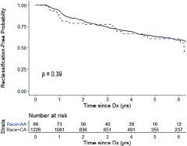
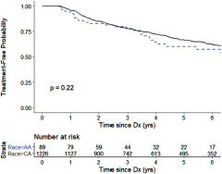
AA Race is not associated with increased risk of reclassification or treatment – Results from CANARY
Reclassification and Treatment – Free Survival
https://doi.org/10.1097/JU.0000000000000621 Vol. 203, 727-733, April 2020

Slide 21
Should All Men with GS ¾ Undergo Immediate Radical Prostatectomy?
Cancer risk is best assessed with multivariable instruments, not a single variable (J Urol 173:1938)
RP only has a (arguably marginal) benefit in those with palpable tumors, higher – risk disease or PSA > 10 ng/ml (NEJM 367:203; NEJM 370:932)
GS ¾ alone may add little risk (1 point in CAPRA)
Volume (rather than grade alone) predictor of adverse pathology (J Urol 194:85)
Compare those who undergo immediate vs. delayed surgery for GS ¾ disease (Eur Urol 68:458)

Slide 22
Treatment-free survival 3+3 vs 3+4

Slide 23
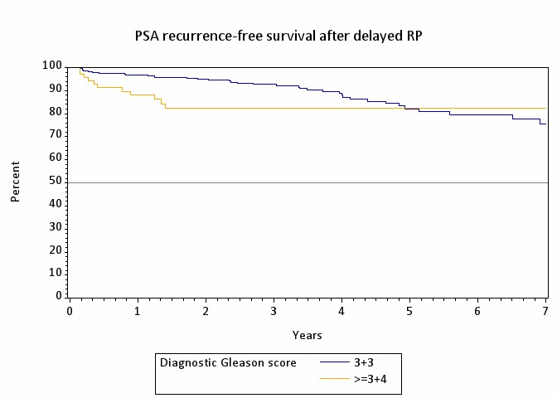
Delayed Radical Prostatectomy - UCSF
J Urol. 2019 Sep;202(3):506-510.

Slide 24
AS for GS ¾ - Caution
High PSAD
PIRADS 5 on mpMRI
Adverse genomics (GPS)
Cribriform (expansile) histology
Larger number of biopsy cores positive at diagnosis (volume)

Slide 25
Are practice patterns changing?
Prostate Cancer

Slide 26
UCSF clinical risk over time for patients undergoing prostatectomy or surveillance

Slide 27
Variation in Conservative management within Veteran Affairs Healthcare System
20,5978 veterans with low-risk prostate cancer
  Diagnosed from 2010 to 2016
  9.4% aged <55 years and 28% Black men
  PSA < 10 ng/ml
  Clinical stage T1/2a
  Gleason Grade Group 1 on prostate biopsy
Outcome: AS/WW vs curative therapy within 1
Loeb S, Byrne NK, Wang B, Makarov DV, Becker D, Wise DR, et al. Exploring Variation in the Use of Conservative Management for Low-risk Prostate Cancer in the Veterans Affairs Healthcare System. Eur Urol. European Association of Urology; 2020 Jun 1;77(6):683–6.

Slide 28
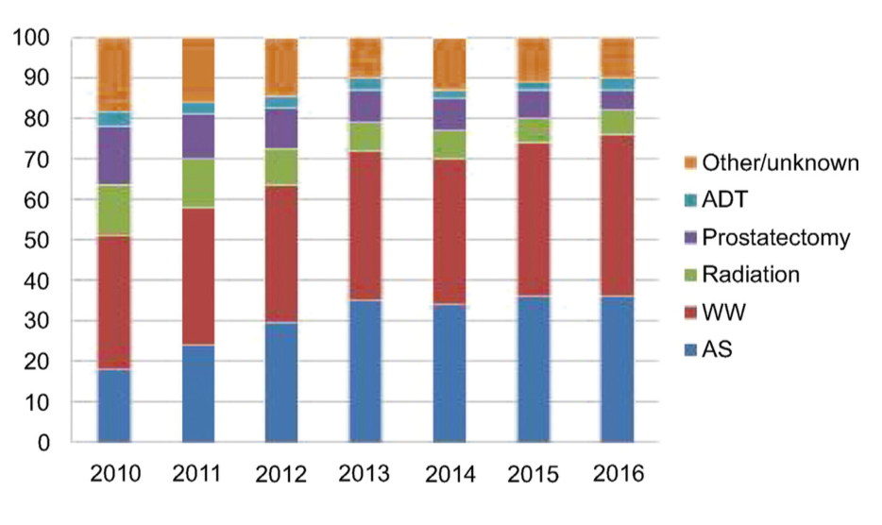
Use of conservative management increasing over time
Increased from 51% in 2010 to 76% by 2016
Increases primarily seen in use of AS over same time interval

Slide 29
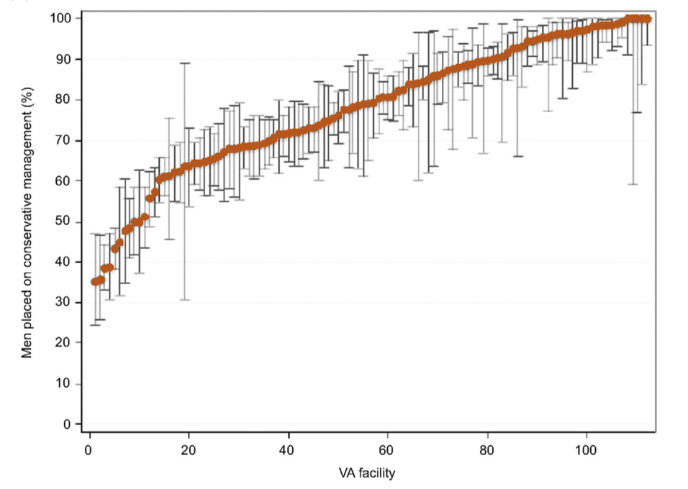
Significant variation across VA facilities
Use of conservative management ranged from 35% to 100%
Geographic region was associated with conservative management use
  Northeast: OR 1.23 (1.10-1.37)
  Midwest: OR 1.09 (0.99-1.20)
  South: OR 1.36 (1.22-1.52)
  West: OR 0.57 (0.45-0.73)
Where you live is independently associated with likelihood of AS utilization within VA system

Slide 30
AS utilization increasing but variations multifactorial
Using SEER-Medicare linked data for 45408 men diagnosed from 2004 to 2007
  AS/WW use increased with
    advanced age, 70-74 years (OR 1.82, 95% CI 1.62-2.06) to 80+years (OR 5.12, 95% CI 4.48-5.86)
    Consultation with medical oncologist (OR 1.83, 95% CI 1.51-2.22)
  Less likely with radiation oncologist consult (OR 0.19, 0.17-0.21)
Chamie K, Williams SB, Hu JC. Population-Based Assessment of Determining Treatments for Prostate Cancer. JAMA Oncol [Internet]. American Medical Association; 2015 Apr 1;1(1):60–7. Available from: http://oncology.jamanetwork.com/article.aspx?doi=10.1001/jamaoncol.2014.192

Slide 31
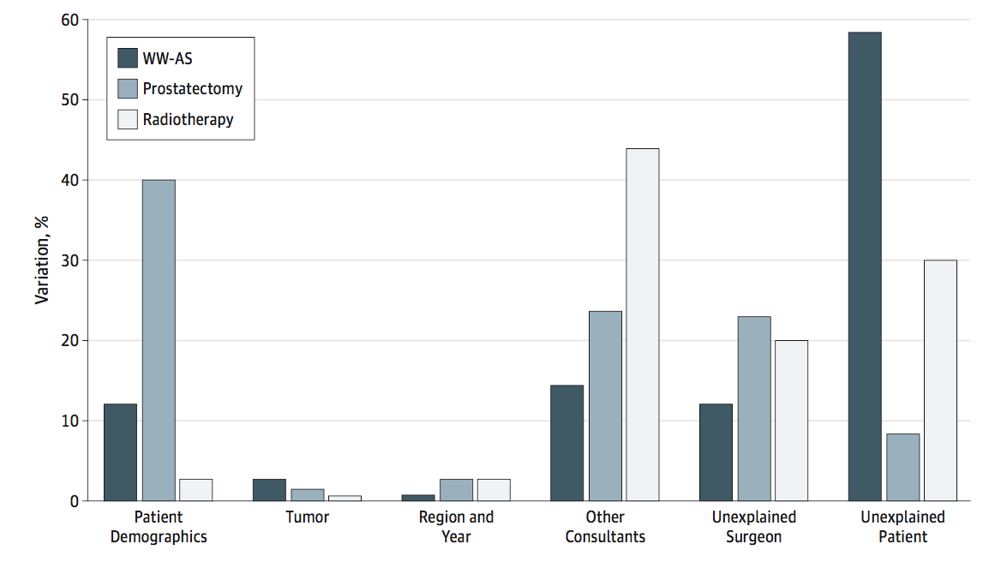
Sources of variation in AS/WW use

Slide 32
Relative contribution of additional factors impacting AS/WW use
Variation in AS/WW use affected by additional unexplained factors:
  Patient factors (58%)
  Patient demographics (12%)
  Other consultations (14%)
  Unexplained surgeon factors (12%)
SEER region also found to impact likelihood of AS/WW use:
  South: OR 1.37 (95% CI 1.12-1.66)
  Midwest: OR 1.20 (95% CI 0.96-1.49)
  West: OR 1.55 (95% CI 1.32-1.81)
Notes:
Northeast SEER region used as referent group for MV regression analysis

Slide 33
Regional variations in Active Surveillance
Using validated measure of intent of AS/WW in the SEER Prostate with Watchful Waiting database
Explored variations between county and SEER regions in AS use across the US
  SEER data merged with County Area Health Resource File
  Patient-level data + healthcare resource measures aggregated at county level using Area Health Resource File
Multivariable logistic regression analyses to evaluate factors associated with AS/WW vs active treatment (surgery/radiation)
  Clustered regression models to examine regional variation in use
Washington SL, Jeong CW, Lonergan PE, Herlemann A, Gomez SL, Carroll PR, et al. Regional Variation in Active Surveillance for Low-Risk Prostate Cancer in the US. JAMA Netw Open. American Medical Association; 2020 Dec 1;3(12):e2031349–9.

Slide 34
Regional variations in Active Surveillance
79,825 with clinically localized low-risk prostate cancer across 17 SEER regions from 2010-2015
14.1% Black, 9.4% Hispanic, 4% Asian/Pacific Islander
93.9% privately ensured
83.6% cT1c
Median follow-up of 40 months (IQR, 22-56)
Overall AS/WW was 22.1% with broad variation by geographic region
San Francisco-Oakland 42.4% and San Jose—Monterery 339%
to
Rural Georgia (4.1%) and New Mexico (9.3%)

Slide 35
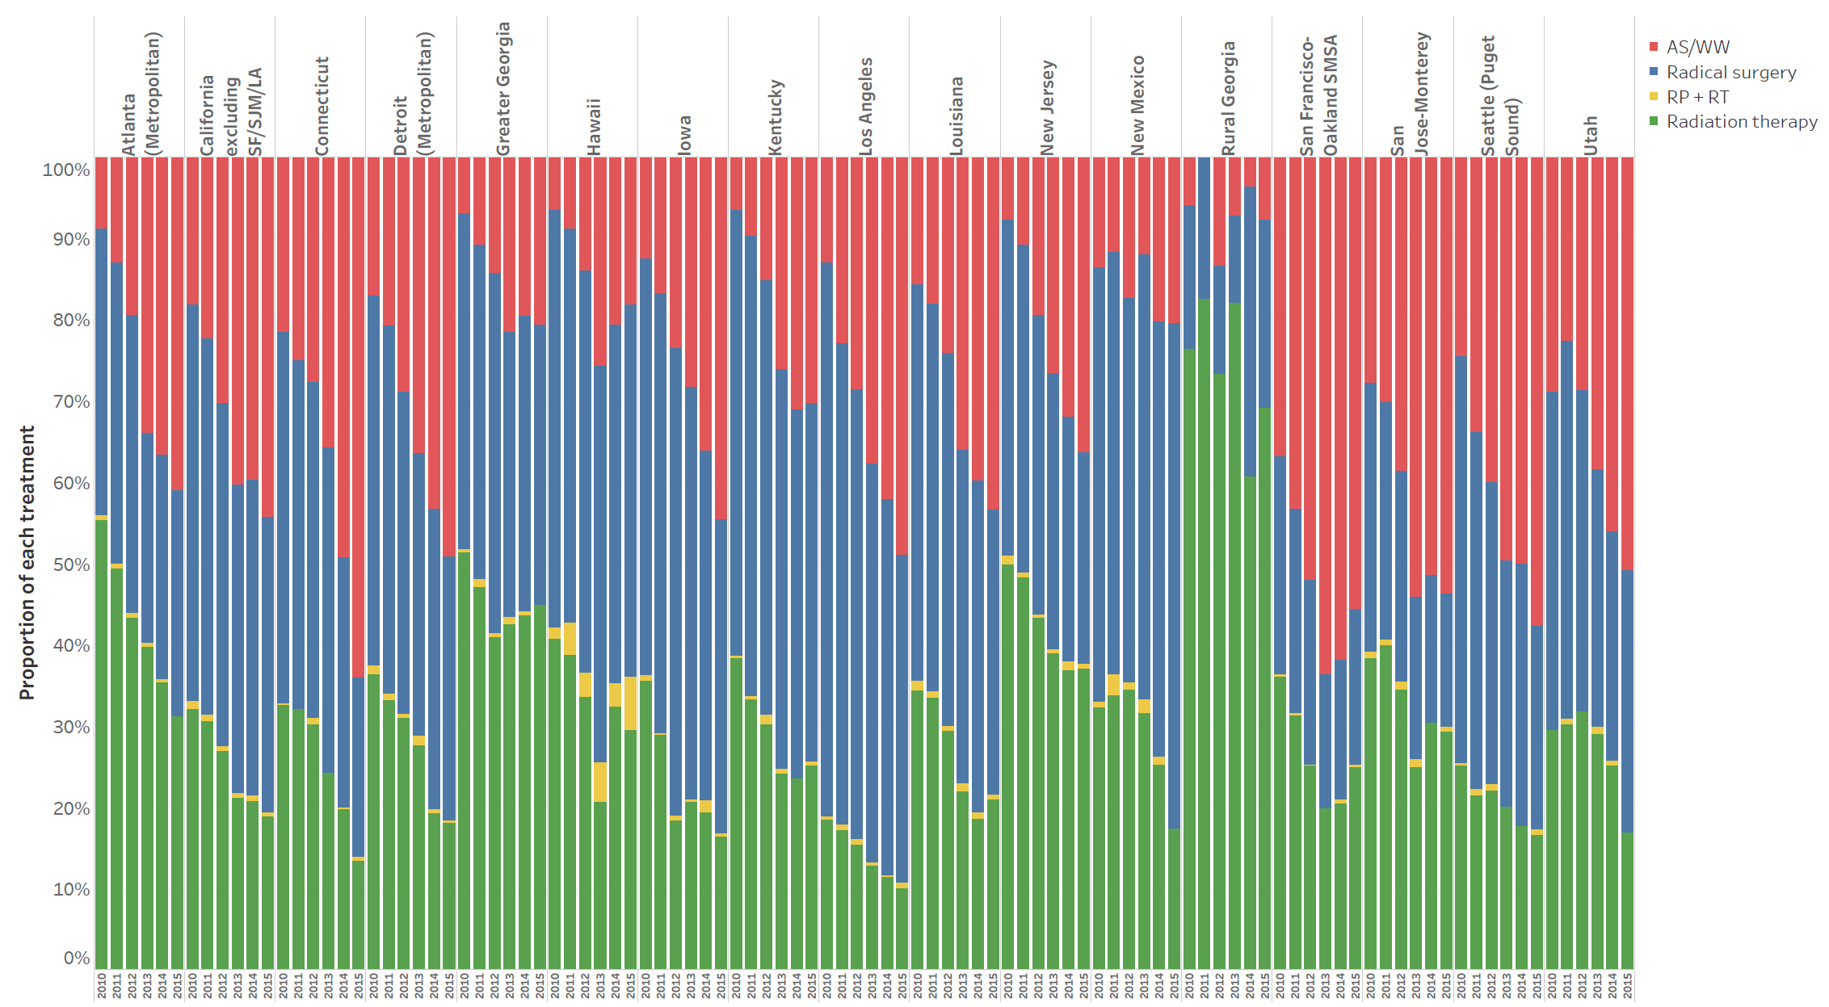
Overall increasing use of AS over time
Nationally, AS/WW use increased from 13/1% in 2010 to 32.5% by 2015
Mean annualized percentage increase ranged from 6.3% (New Mexico) to 81% (New Jersey)

Slide 36
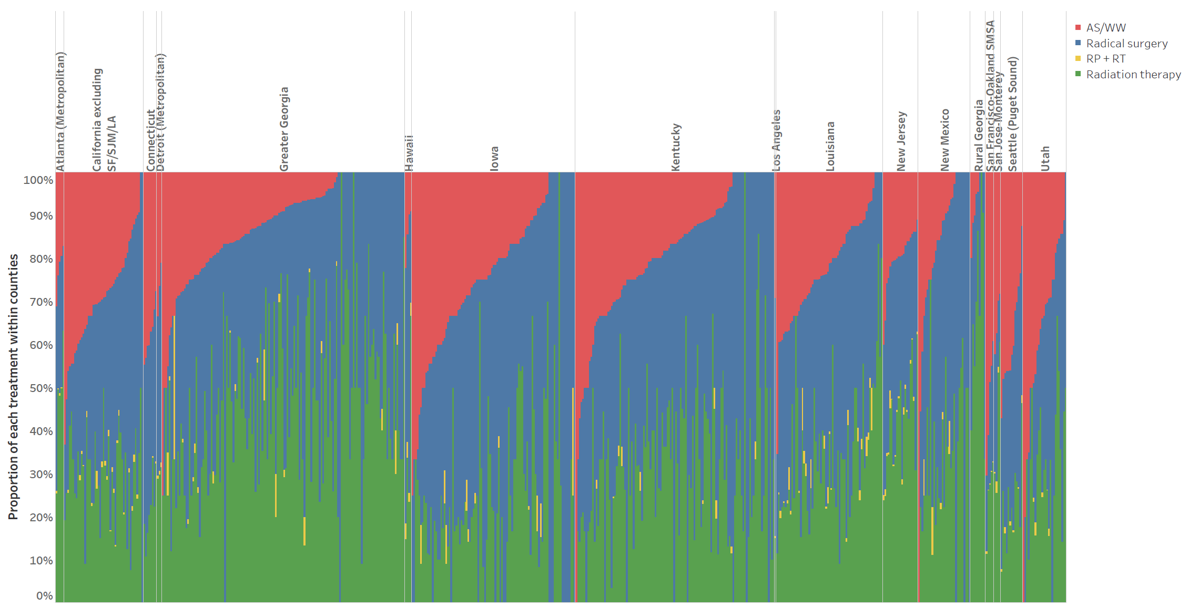
Substantial variation across counties persists
County-level variation in AS/WW use was substantial, ranging from 0-100%
Similar to national trends
Continued incremental increase in AS/WW over time
Increases varied by geography
Notes:
County-level variation in AS/WW use was substantial, ranging from 0-100%
Similar to national trends
Continued incremental increase in AS/WW over time
Increases varied by geography

Slide 37
AS use increasing at local level
Registry | AS rate in 2010 | AS rate in 2015 | Mean annual increase in AS rate | Mean annual % increase in AS rate
Atlanta (Metropolitan) | 6.65 | 29.3 | 4.53 | 68%
California excluding SF/SJM/LA | 13.65 | 33.66 | 4.0 | 29%
Connecticut | 18.26 | 50.71 | 6.49 | 36%
Detroit (Metropolitan) | 14 | 27.68 | 2.74 | 20%
Greater Georgia | 5.47 | 14.21 | 1.75 | 32%
Hawaii | 5.36 | 15.28 | 1.98 | 37%
Iowa | 10.77 | 41.25 | 6.1 | 57%
Kentucky | 5.6 | 23.86 | 3.65 | 65%
Los Angeles | 10.95 | 37.76 | 5.36 | 49%
Louisiana | 12.42 | 30.82 | 3.68 | 30%
New Jersey | 6.23 | 29.58 | 4.67 | 75%
New Mexico | 9.33 | 12.68 | 0.67 | 7%
Rural Georgia | 3.85 | 5.88 | 0.41 | 11%
San Francisco-Oakland SMSA | 32.37 | 44.35 | 2.4 | 7%
San Jose-Monterey | 23.7 | 43.7 | 4.0 | 17%
Seattle (Puget Sound) | 18.53 | 42.66 | 4.83 | 26%
Utah | 23.72 | 38.96 | 3.05 | 13%

Slide 38
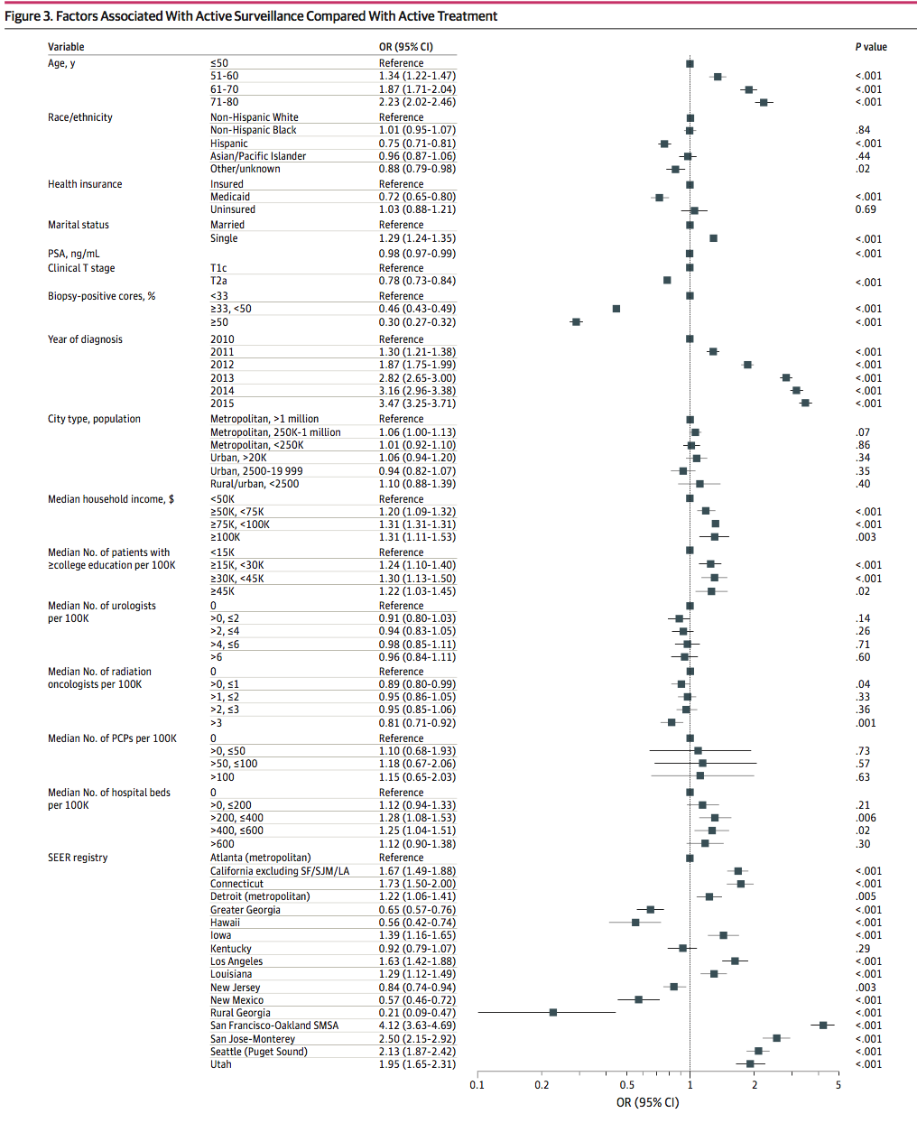
Factors associated with AS/WW use across the U.S.
Differences across SEER regions accounted for 18% of total regional variation
  Reduced to 17% with inclusion of county-level factors
  Patient-level data such as age and year of diagnosis associated with AS/WW use
  County-level factors like median household income, education, and provider density (urologist, primary care providers) not associated with AS/WW use
    No Black-White disparity in AS use after accounting for county level factors
    Hispanic men 25% lower odds of AS compared to White men

Slide 39
Active Surveillance - Summary
Active surveillance is the preferred form of treatment for men with very low, low - risk and selected patients with favorable intermediate - risk disease
New technology (MRI, genomics) appears to make it safer
Its use remains highly variable across the U.S.
  Multifactorial but geographic remains a factor that impacts utilization

Slide 40
Thank You
Peter R. Carroll MD MPH
Matt Cooperberg MD, MPH
Janet Cowan MS
Peter Lonergan MD
Michael Leapman MD
Hao Nguyen MD, PhD
Katsuto Shinohara MD
Scott Greenberg MD
Claire de la Calle MD

