Slide 1


Anthony Henry
- My Story

Slide 2
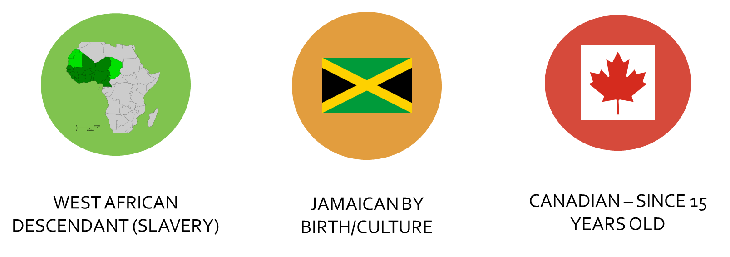
My Story

Slide 3
FAMILY EXPERIENCE WITH PROSTATE CANCER (Pca)
Father diagnosed stage 4 metastasized at 64
Father had family doctor/country offered universal healthcare/compliant patient.
How was this possible?
    MD did not believe in the PSA
    Never had a biopsy until 11th hour
    MD FELT THE PSA TEST WAS TOO EXPENSIVE (AT $15!!!) AT THE TIME.
Outcome: Father died at 68 from pca.

Slide 4
TRUST FACTOR IN MY FAMILY = LOW
Lesson:
Brother & I started regular monitoring PSA/Digital exams.
Began screening at age 40.
Subsequently my brother was diagnosed at 57 years old and had surgery
Anthony diagnosed at 54 years old.
Uncle advised of my diagnosis. His response:
He shared that he was also diagnosed after Dad passed and took care of it. *(Secrecy)*

Slide 5
MY DIAGNOSIS:
  Deemed a GLEASON 6 with low Grade Prostate Cancer
  2 0F 12 CORES POSITIVE
Immediate inclination was to opt for surgery given FAMILY HISTORY and our EXPERIENCE WITH DAD + EXPERIENCE OF MOST EVERYONE I KNOW WHO HAD BEEN AFFLICTED with Pca.
had the luxury of drawing on experience of the men in my men’s health group…The Walnut Foundation.
Most had opted for proactive treatment (Surgery/brachy/radiation etc)
only knew of person who was active surveillance at the time.

Slide 6
Disappointment/recalibration after AS recommendation
In fact, there was a bit of a blur after that:
All well intentioned from friends, family, clients, well-wishers
HIFU
Cost
Prayers
Herbal remedies
See my surgeon/he is the best
Nerve sparing
“You don’t need your prostate/get rid of it!”
“You are not your dad….his cancer is his cancer/your cancer is yours”
“You are making a mistake AS not for black men/our cancer too aggressive.”
Active Surveillance = Madness

Slide 7
MY Decision:
  Defer immediate treatment
  participate in a two-year Active Surveillance Study at one of the top teaching hospitals in Toronto
AS Study:
To see if MRI’s could be a substitute for Biopsies and
Investigate how MRI’s cold be better utilized in assisting with low grade prostate cancer management
Involved more frequent PSA & Digital exams/Biopsies when necessary/MRI guided biopsies as well as regular updates with urological oncologist.
Participation of 2 years
Result: AS still recommended as preferred path but option to do more intervention if/when necessary.

Slide 8
My Current Situation:
Still on ACTIVE SURVEILLANCE:
6 YEARS and counting
Regular monitoring every 6 months; PSA/Digital exam/Specialist visits.
Constant learning in forums like these + opportunities to Sharing experiences

Slide 9
My Thoughts on Active Surveillance
AS still seen to be on the fringes of prostate cancer management.
  Less than 5 members of my organization on AS.
  Very few in my community seem to be on AS or if they are they don’t talk about it.

Slide 10
Active Surveillance and Black Men - Some Questions
We are told Pca is very aggressive in Black men.
  Is this true?
  Is it that that we present too late in the process and so we are deemed at higher risk ?
  Who gets referred to Active surveillance ?
  Is there differential access to active surveillance based on race? Based on economic/social status ?
  Is it even a consideration for most Black men?
  Are they aware this might be an option for the short term/ medium term/long term ?
Passion Compassion Action https://thewalnutfoundation.com

