Slide 1
Willie Underwood, III, MD, MSc., MPH
Executive Director of Buffalo Center for Health Equity

Slide 2
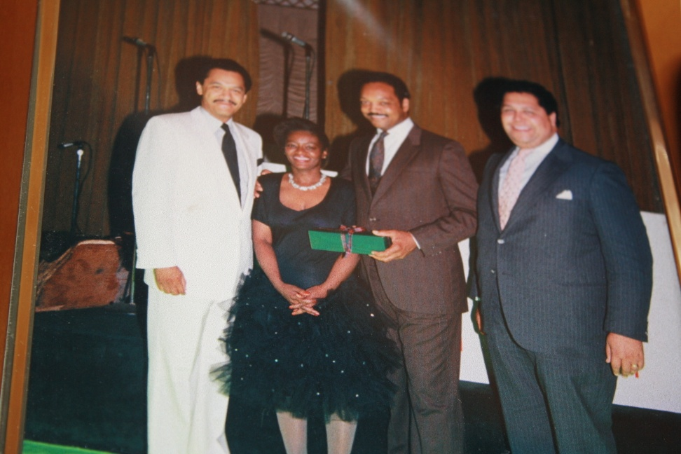
A LITTLE ABOUT ME:
HOW DID I GET INTO THIS IN THE FIRST PLACE?
When I was eight my aunt, Joyce Johnson in the presence of my mother, grandmother and aunt Joann, asked “what I wanted to be when I grew up?”
She founded of the National Association of Security Professionals with Maynard Jackson and two others.

Slide 3
WHAT BEING A DOCTOR MEAN TO ME ?
I was raised in Gary, IN
My grandfather who lived on the west side of Chicago, IL.
He was a WWII Veteran who after putting his life on the line for America’s freedom was just like most Black men in America, he was not hirable (especially non mule work).
He ran a gambling joint out of, what most people in this room would consider a shack, but what he called his home.

Slide 4
When visiting him he made me sit in the room with the gamblers and drunks. I was forced to interact with them and guest what?
Hated visiting him!! I loved him but I hated going to his home.
So, at age 12, I told my mother I don’t want to visit him anymore.

Slide 5
What happen?
My grandfather came to my house instead.
He shared his history with me.
I told him why I didn’t want to go to his house.

Slide 6
I learned a lot that day!!!!

Slide 7
"It will not be sufficient for Morehouse College, for any college, for that matter, to produce clever graduates, men/women fluent in speech and able to argue their way through; but rather honest men/women, men/women who can be trusted in public and private - who are sensitive to the wrongs, the sufferings, and the injustices of society and who are willing to accept responsibility for correcting the ills."
Benjamin E. Mays, PhD
President of Morehouse College 1940-1967

Slide 8
LET’S GET DOWN TO BUSINESS

Slide 9
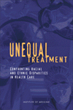
“A large body of published research reveals that racial and ethnic minorities experience a lower quality of health services and are less likely to receive even routine medical procedures than are white Americans.”
Smedley et. al. National Academy Press, 2002
Courtesy of the National Academy Press, Wash., D.C.

Slide 10
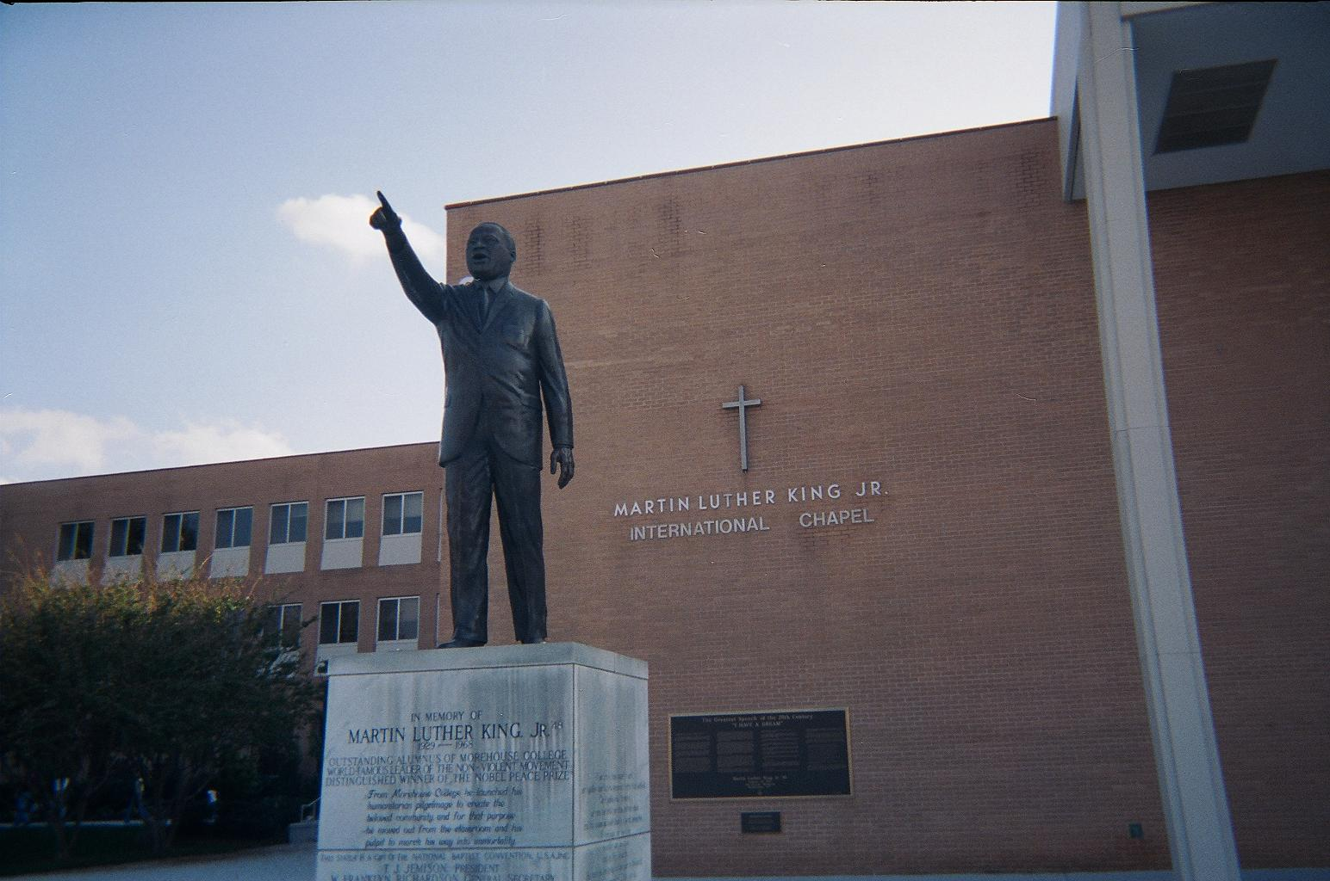
As Dr. King points over Morehouse College, he challenges the students with statements that are written in stone: “ Justice is indivisible, and injustice anywhere is a threat to justice everywhere.” (MLK)

Slide 11
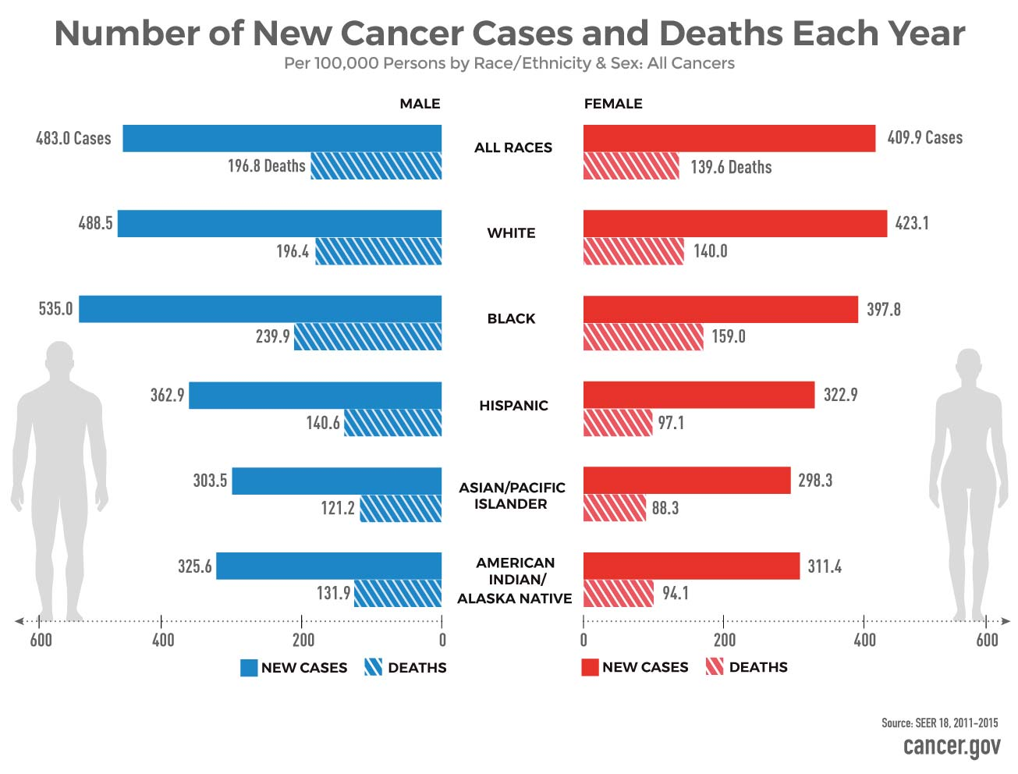
UNITED STATES CANCER HEALTH DISPARITIES

Slide 14
IF BLACK MEN ARE DIAGNOSED WITH A SLIGHTLY HIGHER RATE OF LOCALIZED AND LOWER RATE OF REGIONAL DISEASE, WHY ARE THEY DYING AT A SIGNIFICANTLY HIGHER RATE
Racial-Stage at diagnosis
Racial-5-year survival

Slide 15
American Cancer Society-CANCER FACTS & FIGURES FOR AFRICAN AMERICANS 2019-2021
Diagnosis |  | Ratio
Black | white
1 in 7 | 1 in 9
179.2 (per 100,000) | 101.7 (per 100,000) | 1.76
Death
1 in 25 | 1 in 45
39.8 (per 100,000) | 18.1 (per 100,000) | 2.20

Slide 16
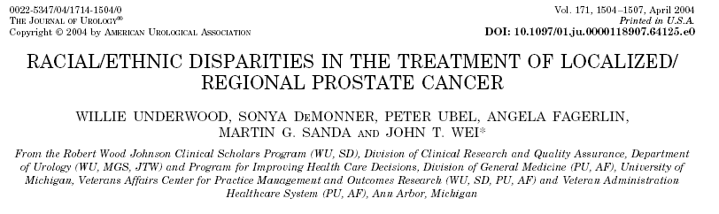
Observational study using a population-based tumor registry (SEER)
142,340 men diagnosed with localized/regional prostate cancer from 1992 through 1999 were identified.
We evaluated 3 primary racial/ethnic groups
  whites(116,132), Hispanic(9,121) & Blacks(17,087)
Notes:
Therefore, we added to the literature by performing an
Observational study using a population-based tumor registry (SEER)
142,340 men diagnosed with localized/regional prostate cancer from 1992 through 1999 were identified.
We evaluated 3 primary racial/ethnic groups
Caucasian (116,132), Hispanic (9,121) & African American (17,087)

Slide 17
DEFINITIONS
Definitive therapy:
  radical prostatectomy
  external beam radiation therapy
  brachytherapy
  combination therapy
Androgen deprivation therapy /expectant management (ADT/EM):
  not receiving definitive therapy
  receiving ADT alone.
Notes:
In this study we defined:
Definitive therapy as receiving either a
radical prostatectomy
external beam radiation therapy
brachytherapy
or combination therapy
Androgen deprivation therapy /expectant management (ADT/EM):
not receiving definitive therapy or
receiving ADT alone.

Slide 18
DEFINITIONS
Tumor Grade
    Well
      Gleason sum 2-4 (4-7% mortality risk /15 yrs)
    Moderate
      Gleason sum 5-7 (6 to 70% mortality risk/15 yrs)
    Poor
      Gleason sum 8-10(60 to 87% mortality risk /15 yrs)
    Albertsen et al JAMA, 1998
Notes:
We defined tumor grade as
Well
Gleason sum 2-4 (4-7% mortality risk /15 yrs)
Moderate
Gleason sum 5-7 (6 to 70% mortality risk/15 yrs)
Poor
Gleason sum 8-10(60 to 87% mortality risk /15 yrs)

Slide 19
Distribution of Race, Grade, and Marital Status
 | Total Sample (142,340) | white (116,132) | Hispanic (9,121) | Black (17,087) | P value
Mean age | 68 (8.8) | 68 (8.7) | 68 (8.5) | 66 (8.9) | <.001
Marital status(%) | 73.5 | 75.7 | 72.7 | 59.7 | <.001
Grade(%)
Well diff. | 13.0 | 13.3 | 15.0 | 11.0 | <.001
Mod. diff. | 68.0 | 68.2 | 64.8 | 68.2
Poorly diff. | 19.0 | 18.5 | 20.2 | 20.8

Slide 20
ADJUSTED ODDS(95% CI) OF RECEIVING DEFINITIVE THERAPY
Grade | white | Hispanic | Black
Well | 0.3 (0.3 to 0.3) | 0.2 (0.2 to 0.3) | 0.3 (0.3 to 0.3)
Moderate | 1 (Referent) | 0.8 (0.7 to 0.8) | 0.7 (0.7 to 0.7)
Poor | 1.0 (0.9 to 1.0) | 0.7 (0.6 to 0.8) | 0.5 (0.5 to 0.6)
The odds of receiving definitive therapy adjusting for age, marital status, grade, SEER site (geographic region) and the interaction between race and grade.

Slide 21
Things have not changed
 | white | Black | Hispanic | Asian/other
2000-2002
Well | Referent | 0.64 (0.49-0.83) | 0.78 (0.61-1.00) | 0.84 (0.59-1.19)
Moderate | Referent | 0.75 (0.70-0.80) | 0.85 (0.80-0.91) | 0.88 (0.0.81-0.97)
Poor GS 8-10 | Referent | 0.70 (0.62-0.79) | 0.75 (0.67-0.85) | 0.73 (0.63-0.85)
2003-2006
Well | Referent | 1.05 (0.72-1.53) | 1.01 (0.73-1.40 | 1.15 (0.72-1.83)
Moderate | Referent | 0.83 (0.78-0.88) | 0.91 (0.86-0.97) | 1.01 (0.93-1.10)
Poor GS 7-10 | Referent | 0.69 (0.64-0.75) | 0.77 (0.71-0.83) | 0.99 (0.90-1.09)

Slide 22
Men Diagnosed 2004-2011

Slide 23
Distribution of Race, Grade, and Marital Status 2004-2011
Urology Gold Journal September 22, 2016
Racial/Ethnic Disparity in Treatment for Prostate Cancer: Does Cancer Severity Matter?
 | Total Sample (327,652) | white (238,641) | Hispanic (26,905) | Black (45,865) | Asian (16,241) | P value
Mean age | 65 (8.9) | 65 (8.9) | 65 (9.0) | 63 (8.9) | 67(8.7) | <.001
Marital status(%) | 70.6 | 72.0 | 69.6 | 56.9 | 77.5 | <.001
Grade(%)
< 6 | 1.4 | 1.3 | 1.8 | 1.4 | 1.3 | <.001
6 | 46.6 | 47.1 | 48.9 | 44.2 | 42.3
7 | 39.4 | 39.1 | 36.8 | 42.1 | 39.0
8-10 | 12.6 | 12.5 | 12.5 | 12.3 | 17.4
K.Moses, H. Orom, A Brasel, J.Gaddy, W. Underwood, III

Slide 24




Men Diagnosed 2004-2011

Slide 25
ADJUSTED ODDS(95% CI) OF RECEIVING DEFINITIVE THERAPY
Risk | white | Hispanic | Black | Asian
D’Amico Low risk | 1 (Referent) | 1.1 (1.02 to 1.14) | 0.83 (0.8 to 0.9) | 0.98 (0.91-1.07)
D’Amico Intermed. risk | 1 (Referent) | 0.74 (0.71 to 0.77) | 0.89 (0.84 to 0.93) | 0.98 (0.9-1.05)
D’Amico High risk | 1 (Referent) | 0.79 (0.73 to 0.85) | 0.59 (0.56 to 0.63) | 0.9 (0.82-0.99)
The odds of receiving definitive therapy adjusting for age, marital status, SEER site (geographic region) and the interaction between race and grade.

Slide 27
They used the VHA Corporate Data to perform a retrospective cohort study of veterans diagnosed with low-or intermediate-risk CaP between 2011 and 2017.
35, 427 (66% Non-Black and 34% Black men) They created three groups low, moderate and high curative treatment benefit men ( base upon 10-year life expectancy and CaP characteristics)

Slide 28




The significantly lower odds of definitive treatment for Black men with high treatment benefit versus non-Black men after adjustments for confounders (OR, 0.89; 95% CI, 0.83-0 .95) underscore the apparent racial inequity in CaP treatment.
These data indicate that although the VHA system has made significant progress in providing equitable access to care, racial disparities persist in the receipt of high-benefit, definitive treatment for CaP

Slide 29




Black are more likely to receive WW instead of AS

Slide 30
Conclusions: Among those not treated for low risk prostate cancer, Caucasian men were placed on active surveillance more frequently than African-American men, who often defaulted to de facto watchful waiting after an initial period of active surveillance. This discrepancy raises questions about the factors favoring watchful waiting over active surveillance. Moreover, given the lack of consensus regarding the most efficient active surveillance strategy, we anticipate that racial disparities in the use of active surveillance will persist, especially in African-American patients.

Slide 31
More than 25% of Black with Very low risk prostate cancer experienced upgrading.
AA men with very low–risk PCa had more adverse pathologic features at RP and poorer oncologic outcomes.
AA men were more likely to experience disease upgrading at prostatectomy (27.3% v 14.4%; P .001), positive surgical margins (9.8% v 5.9%; P .02), and higher Cancer of the Prostate Risk Assessment Post-Surgical scoring system (CAPRA-S) scores.
On multivariable analysis, AA race was an independent predictor of adverse pathologic features and pathologic upgrading.

Slide 32
Compared to White Men
Black men are more likely to die from prostate cancer.
Black men are equally as likely to be diagnosed with a localized prostate cancer
Black men are less likely to receive definitive (curative treatment) among every risk group when diagnosed with localized prostate cancer.
Among men not receiving treatment, Black men are less likely to be on a true active surveillance protocol.
Among men diagnosed with so called clinically very low risk disease, Black are more likely to have high risk disease.
Therefore, one must conclude that until the above healthcare inequities are eliminated, active surveillance for Black men must be look at with skepticism and major concerns for Black men lives.

Slide 33

Thank you!
I hope you found this presentation educational and enlightening.

