Slide 1
Is Gleason 6 Really Prostate Cancer?
Scott Eggener, M.D.
Professor of Surgery (Urologic Oncology) and Radiology
University of Chicago
Twitter: @uroegg
July 29th, 2021

Slide 2
No Relevant Disclosures
Insightec (advisory)
Francis Medical (advisory)
Profound Medical (advisory and investigator)
Steba (unpaid)
Janssen (speaker)

Slide 3
Outline
Origin of the problem
Outcomes of surveillance are superb
My (and others) utopian future of Gleason 6 (GG1)
Counterarguments

Slide 4
Origin of the Problem
Notes:
Four words tough to digest
4 other previously unimaginable words

Slide 5
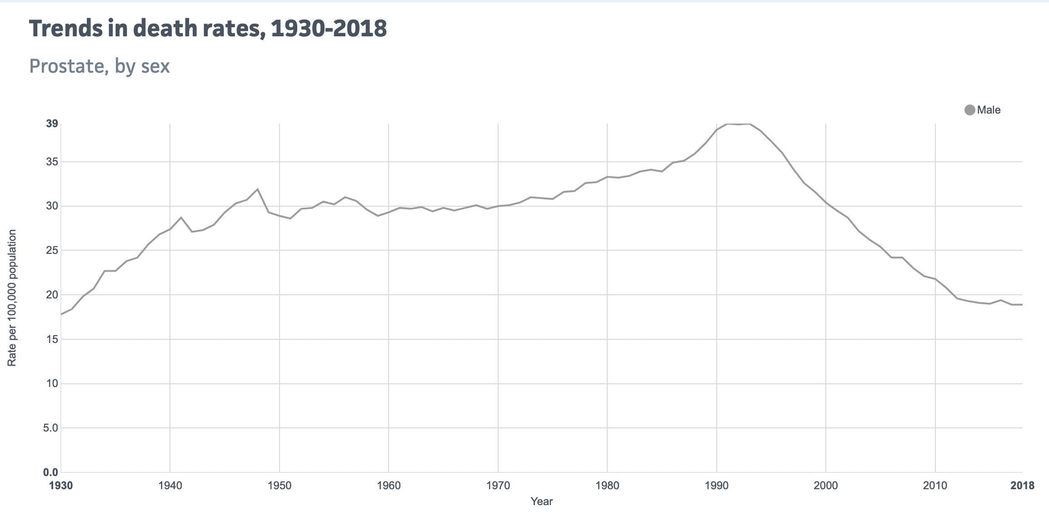
Prostate Cancer Mortality in U.S. Through 2018
Reference: National Center Health Statistics, CDC

Slide 6
Need to minimize overdetection and overtreatment
Prostate Cancer Screening Saves Lives But…..

Slide 7
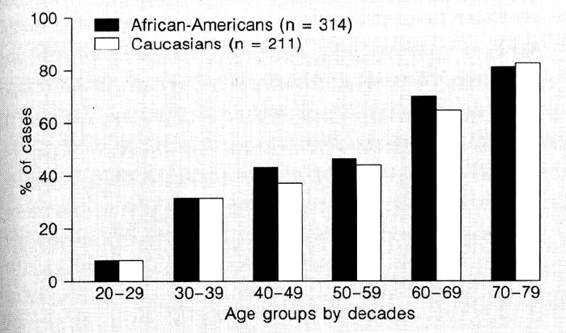
Prostate Cancer Is Common Among Men Dying of Other Causes
Reference: Sakr et al, In Vivo, 1994

Slide 8
Gleason 6 (Grade Group 1)
0.28% with extension beyond prostate capsule (n=2,500; Anderson, Eur Urol, 2017)
0% chance of seminal vesicle invasion (n=2,500; Anderson, Eur Urol 2017)
0% chance of metastasizing to lymph nodes (n=14,000; Ross, Am J Surg Path, 2014)
After surgery, likelihood of dying from prostate cancer in 15 year: 0.2% (Eggener, J Urol, 2011)
Not aware of anyone ever having a metastasis or dying from pure Gleason 6 (GG1)

Slide 9
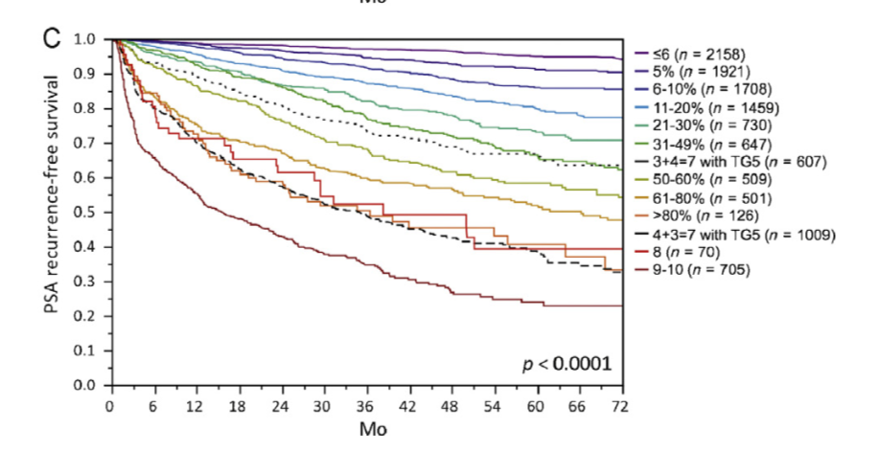
Increasing risk
Cure Rate for Gleason 6 Following Surgery Is Basically 100%
~9,600 men having surgery at Martini Klinik with pathologic Gleason 7
Reference: Sauter et al, Eur Urol, 2015

Slide 10
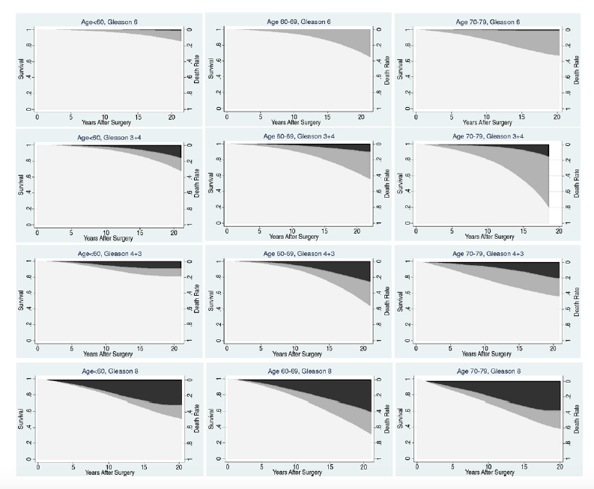
Impossible to Die from Gleason 6 Following Surgery
23,900 men had surgery from 1987-2005 at 4 large academic centers
Cancer-specific mortality (black)
Death from other causes (gray)
Reference: Eggener, J Urol, 2011
Notes:
Points:
initial gleason was small cohort, barely any Stage I-II
1978: Gleason beats out others

Slide 11
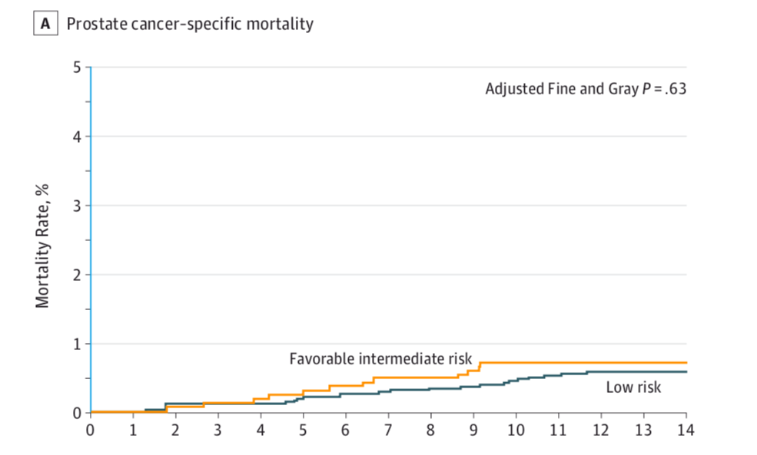
Death Rate Following Brachytherapy for Gleason 6 is < 1%
5,580 men undergoing brachytherapy from 1997 - 2013
Reference: Raldow, JAMA Oncology, 2015
Notes:
Points:
initial gleason was small cohort, barely any Stage I-II
1978: Gleason beats out others

Slide 12
Summary of Rationale
If cure rate following treatment for a ‘cancer’ approaches 100%............
……there is 100% need to rethink terminology and how we diagnose and manage it
Notes:
Points:
initial gleason was small cohort, barely any Stage I-II
1978: Gleason beats out others

Slide 13
Outcomes With Surveillance Are Superb
Notes:
Four words tough to digest
4 other previously unimaginable words

Slide 14
Swedish Active Surveillance: Expected vs Observed Mortality
76,000 Swedish men from 1991-2009 untreated
“managed without curative intent”
Low-Risk
Intermediate-Risk
High-Risk
Regional Mets
Reference: Rider et al, Eur Urol, 2013
Notes:
All G6 when matched to folks WITHOUT cancer, no difference in survival at 15 years

Slide 15
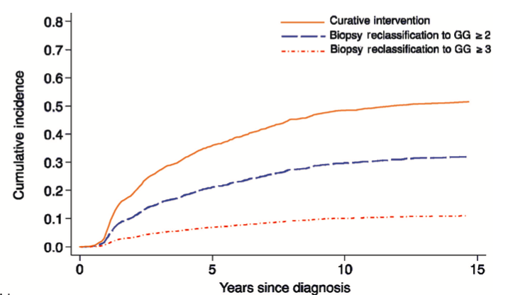
Johns Hopkins Active Surveillance: Strict Criteria
1800 men with very-low and low-risk prostate cancer
15-year likelihood of metastases/death: 0.1%
Reference: Tosoian, Eur Urol, 2020

Slide 16
University of Toronto: Loose Criteria
993 men with median age of 67
Inclusion criteria:
clinical stage T1-T2c with occasional T3
PSA< 10 ng/ml (up to 15 ng/ml until 2000)
Gleason 6 (up to Gleason 7 until 2000)
Method of surveillance:
PSA every 3 months for 2 years, then every 6 months
Re-biopsy (8-14 core) at 6-12 months, then every 3-4 years
Metastasis-free survival at 10 and 15 years: 95% and 91%
Metastasis-free survival among Gleason 6: 98%
Reference: Klotz, J Clin Oncol, 2015

Slide 17
Deaths from Prostate Cancer
Metastases Following Active Surveillance
*ALL DEATHS: POORLY STAGED BY CONTEMPORARY STANDARDS*
Patient #1: 69 year old with PSA=12.8 ng/ml and Gleason 7 in 1 of 6 cores
- bone mets at 3 years
Patient #2: 66 year old with PSA=7.1 ng/ml and Gleason 7 in 1 of 6 cores
non-compliant after 2 years
died 8 years after diagnosis
Patient #3: 67 year old with PSA=3.2 ng/ml with Gleason 6 in 2 of 6 cores
PSADT of 1.6 months led to RP at 13 months with positive nodes
died 5 years after diagnosis
Patient #4: 73 year old with PSA=10.9 ng/ml with Gleason 6 in 4 of 6 cores
died 3 years after diagnosis
Patient #5: 74 year old with PSA=9 ng/ml and Gleason 6 in 2 of 6 cores
biopsy 20 months after diagnosis showed Gleason 8
died 9 years after diagnosis
Reference: Krakowsy et al, J Urol, 2010

Slide 18
My Utopian Future of Gleason 6 (GG1)
Notes:
Four words tough to digest
4 other previously unimaginable words

Slide 19
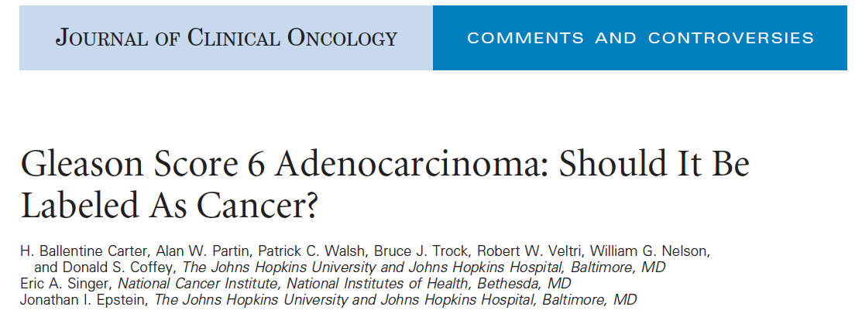
Ref: Carter et al, JCO, 2012; Ahmed et al, Lancet Oncology, 2012; Labbate, WJU, 2021
Notes:
Even at time published, unthinkable headline, particularly from Hopkins group

Slide 20
Merriam-Webster Dictionary Definition
Benign: of a mild type or character that does not threaten health or life
Malignant: a malignant tumor of potentially unlimited growth that expands locally by invasion and systemically by metastasis

Slide 21
Merriam-Webster Dictionary Definition
Gleason 6: of a mild type or character that does not threaten health or life
Gleason ≥ 7: a malignant tumor of potentially unlimited growth that expands locally by invasion and systemically by metastasis
Gleason 6 Is Not ‘Cancer’ and Should be Left Alone
(or lose it’s cancer label)
Notes:
Points:
initial gleason was small cohort, barely any Stage I-II
1978: Gleason beats out others

Slide 22
If We Rename Gleason 6…..
IDLE: Indolent lesion of epithelial origin
INeRRT: indolent neoplasm rarely requiring treatment
Notes:
IDLE: proposed in the literature
INeRRT: proposed by me

Slide 23
If Not Called Cancer……
New term can be ‘non-cancer’ or ‘pre-cancer’, but not ‘cancer’
Should be extremely rare to treat Gleason 6
Men with erstwhile Gleason 6 would undergo:
PSA (+/- other biomarkers such as PHI, 4K, Select MDx, etc)
DRE
+/- MRI
Goals of screening:
find Gleason ≥ 7 (GG ≥ 2)
don’t find Gleason 6 (GG1)
Notes:
IDLE: proposed in the literature
INeRRT: proposed by me

Slide 24
Biography of Gleason Scoring
By 1987: Gleason system widely adopted
Modified in 2005:
eliminate patterns 1 and 2 (Gleason 2 through 5)
more restrictive definition for pattern 3
Approximately one-third of prior Gleason 6 upgraded
Modified in 2014:
International Society of Urologic Pathology into 5 groups
further restrictions of Gleason 6 definition
Notes:
Long history of Gleason modifications

Slide 25
Past is Precedent
Gleason 2 through 5 prostate cancer
PUNLMP (bladder cancer)
Follicular subtype of papillary thyroid cancer
Corollaries in breast (DCIS), melanoma, and others…….
Notes:
IDLE: proposed in the literature
INeRRT: proposed by me

Slide 26
Most Common Counterarguments
Microscopically, it meets the definition of cancer
A significant number of these men unknowingly have Gleason ≥ 7
Genomically, some Gleason 6 have same profile as Gleason ≥ 7
”It’s better to know”
Notes:
IDLE: proposed in the literature
INeRRT: proposed by me

Slide 27
Conclusions
Gleason 6 (GG1) should be ‘benign’ or a ‘pre-cancer’
Individual men’s and public health would dramatically improve

Slide 28
Conclusions

