Slide 1
The future of liquid biopsies and active surveillance.

Slide 2
Outline of the talk
Current standard of care
Active Surveillance
Liquid Biopsies
The Sentinel®️PCC4 Test
The Sentinel ®️ Test and Active Surveillance

Slide 3
Current standard of care –diagnosis of prostate cancer
In the United States prostate cancer screening for men over the age of 45 occurs during their annual physical and usually consists of a digital rectal exam (DRE) and measurement of serum PSA levels.
  DRE fails to detect 80% of prostate cancers.
  PSA cut-off level >3 ng/mL misses between 20-25% of “low PSA-expressing” prostate cancers”. About 10% of these are high-risk cancers.
  If you have a PSA> 3 ng/mL
  Your primary care provider will probably recommend a core needle biopsy

Slide 4
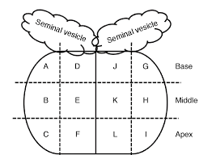
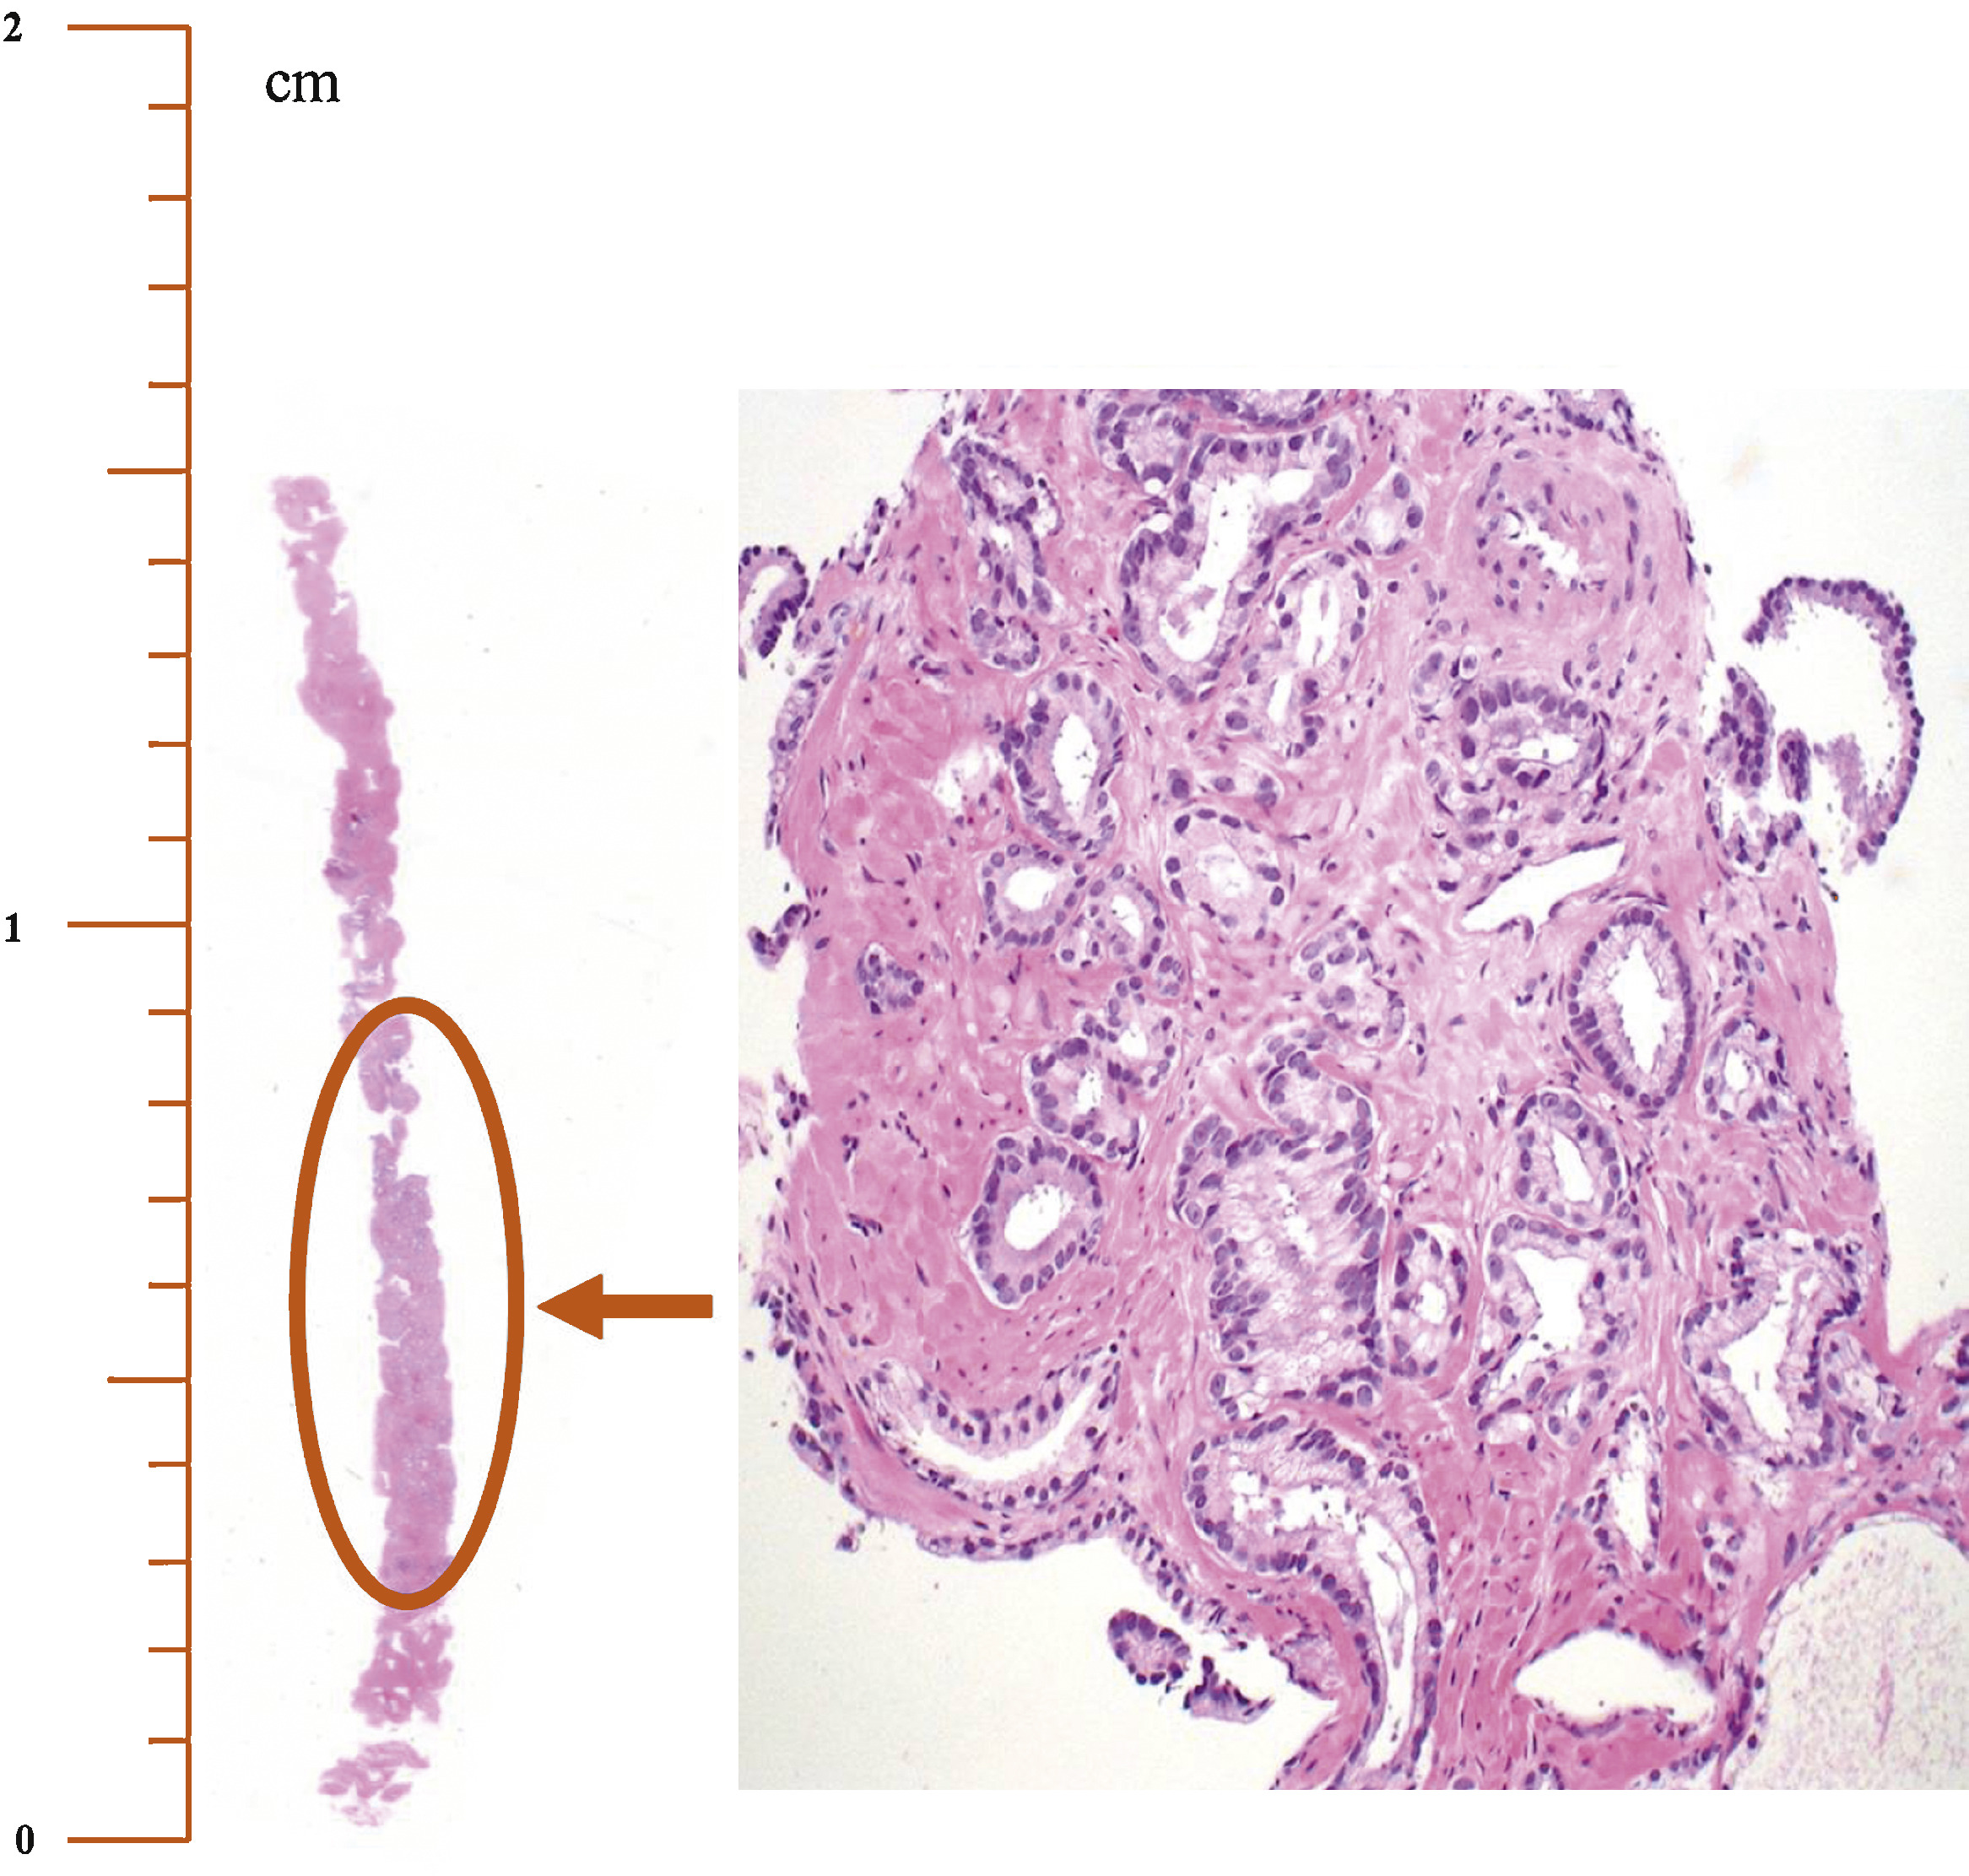
Basics of core needle biopsies
The primary goal of needle biopsy is to diagnose prostatic adenocarcinoma.
is a relatively straight forward process- if the pathologist can see tumor in the core needle biopsy, then you have prostate cancer
core needle biopsies miss a lot tumors- % of missed biopsies hovers around 45-50%.
The secondary goal of needle biopsy is to assess the likelihood that the tumor is advanced/aggressive/clinically significant or indolent/benign/ clinically insignificant
much more difficult subjective process because the tools used to determine “risk of progression” are not well developed (a polite way of saying imprecise)
sampling error many not capture the most important regions of the tumor

Slide 5
Watchful waiting or active surveillance ?
Watchful Waiting: an approach to a medical problem in which time is allowed to pass before medical intervention or therapy is used.
relying on changes in a man’s symptoms to decide if treatment is needed.
treatment is most often meant to control symptoms from the cancer, but not to cure it.
first symptom that is noted is often bone pain from metastatic disease, by which time palliative therapy is the only real option.
usually reserved for older men diagnosed with advanced prostate cancer in poorer general health who are not strong enough for surgery or chemotherapy.
Active surveillance
monitoring the cancer closely.
usually includes a visit with a prostate-specific antigen (PSA) blood test every 6 months
and a digital rectal exam (DRE) at least once a year.
prostate biopsies and imaging tests (mpMRI, microUS) may also be done every 1 to 3 years
If your test results change, your treating physician would then talk to you about treatment options

Slide 6
“After the first PSA test, regardless of the result, we are all on one form of active surveillance or another”

Slide 7
Common Standard of Care for Active Surveillance
Exclusion Criteria:
patients diagnosed with intermediate to high-risk cancer (Gleason Score 4+3 (GG3), serum PSA levels > 15 ng/mL, > 3 cores involved),
the usual approach is to proceed to definitive therapy (predominantly prostatectomy or radiation therapy).
Entry Criteria:
restricted enrollment (Hopkins)
  individuals who have Gleason Score 3+3 (GG1), clinical stage T1c,
  serum PSA levels ≤ 10 ng/mL, PSAD (PSA density) ≤ 0.2 mg/mL/cm³
  with less than 2 cores involved
inclusive criteria (Sunnybrook and Marsden)
  individuals with (Gleason Score 3+4 (GG2),
  Serum PSA ≤ 10-15 ng/mL, no maximum PSA density
  no fixed number of positive cores,

Slide 8
What are Liquid Biopsies?
any test that detect molecules or cells in bodily fluids derived from a tumor.
    blood, seminal fluid, menstrual fluid, tears, cerebrospinal fluid, saliva or urine.
use the fluid as a surrogate for the tumor tissue itself
    brain cancer, (glioblastoma multiforme) kidney cancer, pancreatic cancer (which are very difficult to biopsy).
What do we measure?
analytes: the things we measure molecules- DNA, RNA, proteins
free floating nucleic acids
in CTC- circulating tumor cells
in exosomes

Slide 9
Basis of the Sentinel®️ PCC4 test
Sentinel®️ Prostate Disease Management Platform
  based on analysis of urine exosomal sncRNAs (miRNAs and snoRNAs)
  provides a molecular assessment of the health of the whole prostate
  molecular characterization of tumor status throughout the prostat
  includes contribution of small potentially aggressive tumors that can be missed by TRUS or MRI-guided biopsies and/or not recorded on pathology
  does not distinguish between monofocal and multifocal disease
Small membrane bound vesicles released from into the extracellular milieu from all cells in. the prostate and can be isolated from the blood, seminal fluid and urine
Pre-miRNA
miRNA
C/D Box snoRNA
H/ACA Box snoRNA
mRNA stability and translation
mRNA translation and primary transcript splicing

Slide 10
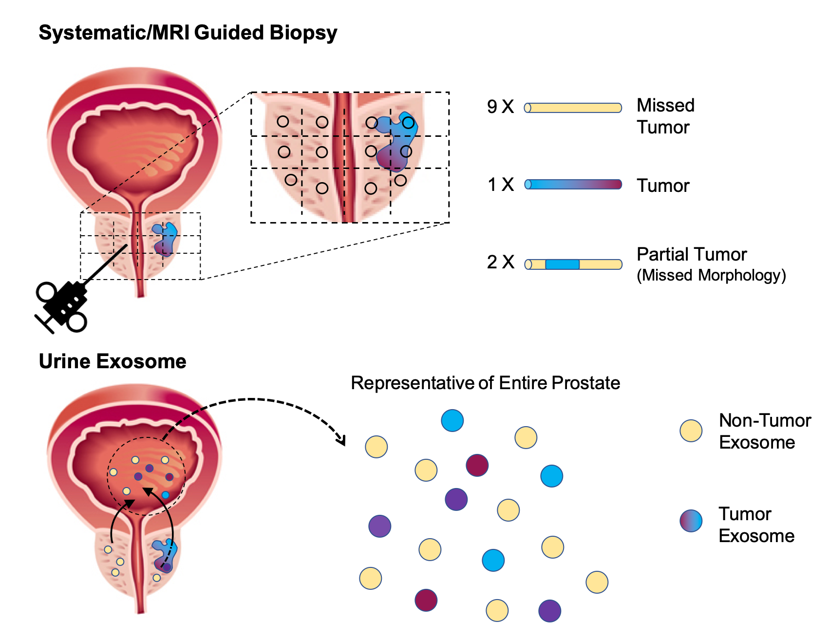
Comparison of pathological and molecular assessment of prostate cancer
Pathological assessment dependent on ability to “find” the tumor(s).
Small monofocal tumors can be missed; multifocal tumors are problematic.
Molecular assessment dependent on ability to distinguish the signals generated from the expression of sncRNAs from tumor(s).

Slide 11
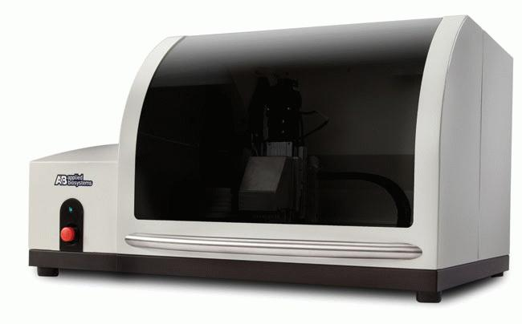

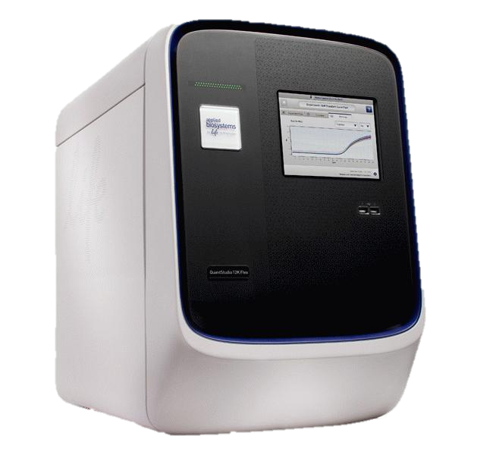
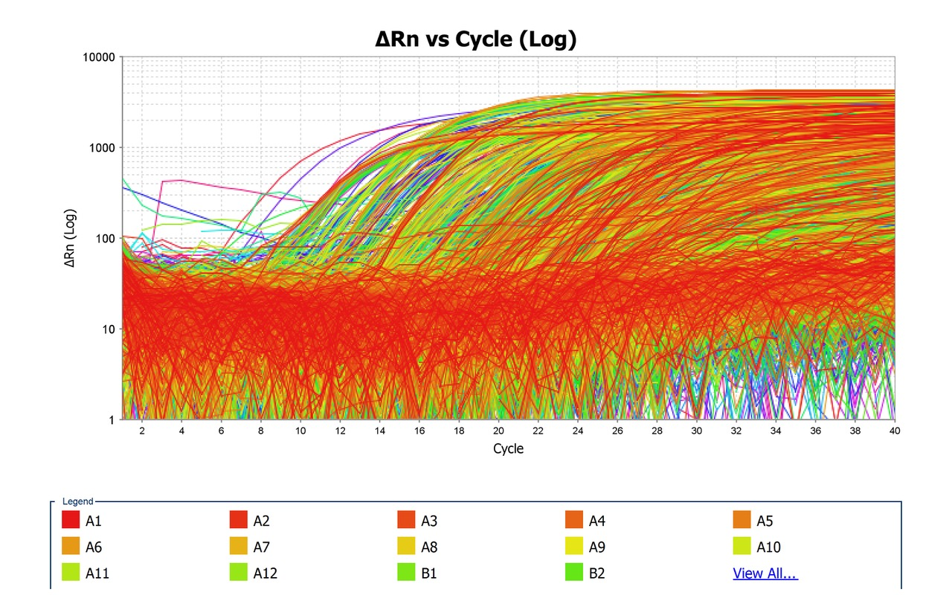
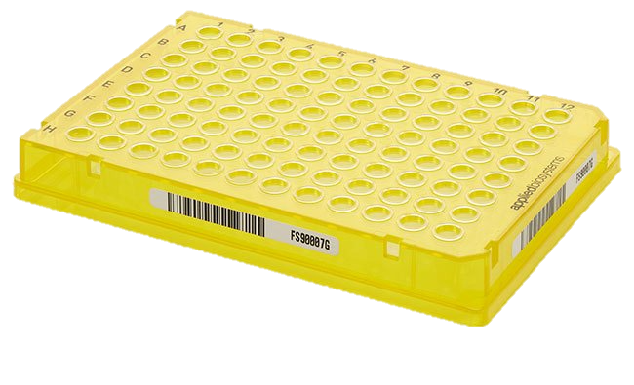
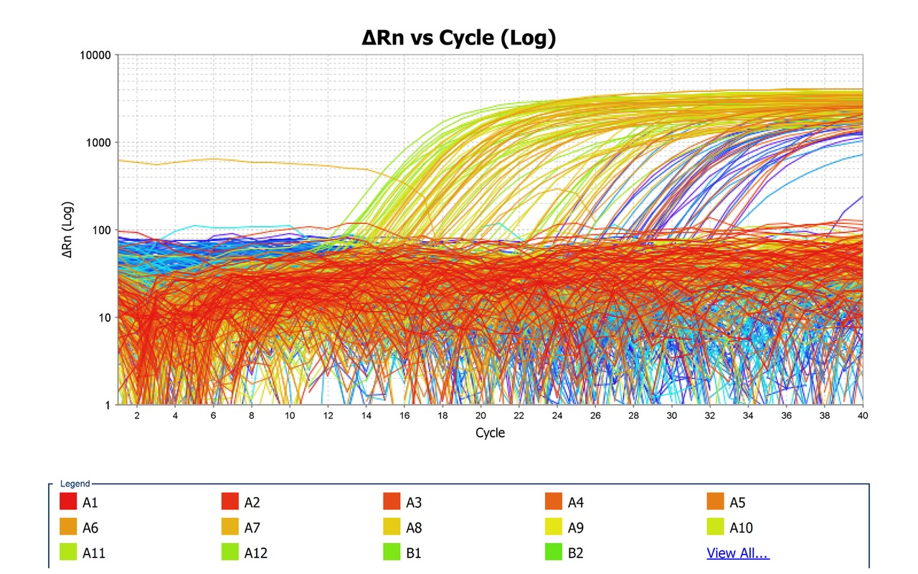
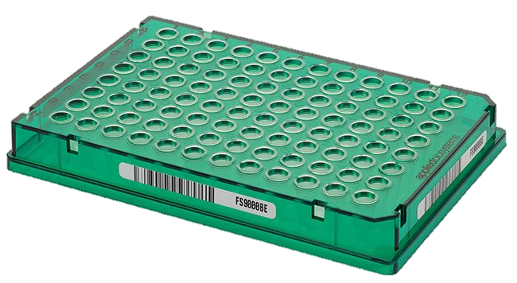
Overview of the Sentinel®️ PCC4 Platform
224 miRNA OA Prep
AccuFill™️ System
Assisted OpenArray
Sample Loading
QuantStudio 12K
RT-PCR Signal Detection
224 snoRNA OA Prep
Each QuantStudio run simultaneously analyzes 4 OpenArray Plates, 442 snc RNA entities for 23 patients (1,720,320 data points)
Sentinel®️ PCC4
Risk Classification
Open Array Results into miR Sentinel®️ algorithm
It’s complex but

Slide 12
Summary of the processes with the Sentinel®️ Test
Extract RNA from urinary exosomes
Measure the expression levels of 442 small non-coding RNAs
RT-PCR on a high throughput instrument –Thermo Fisher QuantStudio 12K Flex
Analyze the expression data using the in the Sentinel®️ PCC4 algorithm
Classify patients into risk groups independent of serum PSA levels, prior to a core needle biopsy.
Use statistical approaches to assess status of prostate health

Slide 13
Schematic of the Sentinel®️ PCC4 Test
The Sentinel®️ Algorithm compares the expression of 442 sncRNAs
To the expression profiles of over 1000 patient samples with known pathology to determine
the risk classification of the new patient
Four different risk groups based on Grade Group:
NPEP C
GG1 Low
GG2 Intermediate
GG3-GG5 High

Slide 14
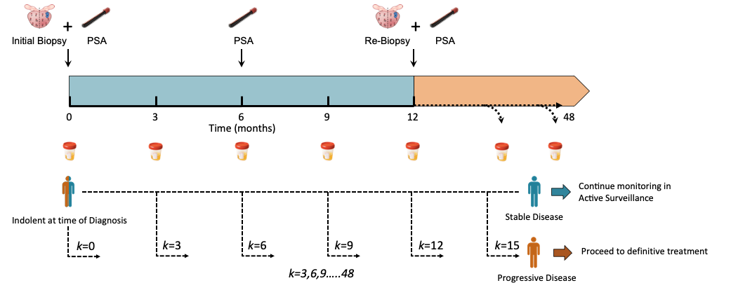
How the Sentinel Test integrates into active surveillance standard of care

Slide 15
Report Form

