Slide 1
How do you know when to enter Active Surveillance and when to leave?
Kirsten Greene, MD, MS, FACS
Paul Mellon Professor and Chair
UVA Department of Urology
Associate CMO UVA Health

Slide 2
Active Surveillance is not Watchful Waiting
Active surveillance involves close PSA follow up, serial biopsies, MRI and maybe genomic testing
The goal of active surveillance is to safely delay treatment but preserve your option to treat for cure.
Watchful waiting is a hands off, approach. PSA periodically with no biopsies, no imaging.
The goal of Watchful waiting is to allow the prostate cancer to take its natural course(which means maybe spread) and to treat symptoms when they arise. No plan for curative treatment ever.
Active surveillance is about timing of treatment

Slide 3
Recommendation #1
Both you and your physician should know if you are on watchful waiting or active surveillance and it should be the one YOU WANT. Know your destination.

Slide 4
Active Surveillance - Goals
Avoid or Delay the costs (functional, monetary) of treatment without compromising cancer cure
Compliant with screening guidelines
Based on the rationale that
Initial assessment is reasonably accurate
Monitoring is accurate and identifies sub – clinical progression at a time that initial treatment options are still available and curative
Active surveillance is about timing of treatment

Slide 5
Active Surveillance – Why?
Low and very low risk prostate cancer is not life threatening at the time of diagnosis
Preserve urinary function
Preserve sexual function
Preserve bowel function
Preserve fertility
Allow for treatment for cure with equivalent outcomes when surveillance is ended
Active surveillance is about prioritizing quality of life

Slide 6
Active Surveillance
PSA testing at 6 month intervals(q3months if indicated)
Repeat biopsy at 12 to 24 months
DRE 12 months
mpMRI/genomic profiling for initial risk assessment and to allow for targeted biopsy
Treatment considered for change in grade, volume or both

Slide 7
PSA density versus PSA
PSAD is a better predictor of treatment and reclassification than PSA
 | Outcome
 | Delayed Treatment | Biopsy Progression
Independent Variable | HR (95% CI) | HR (95% CI)
Met strict criteria | 1.12 (0.82-1.53) | * 0.67 (0.50-1.04)
PSA diagnosis | 1.01 (0.97-1.05) | 0.97 (0.91-1.02)
Biopsy Density^ | 1.21 (0.66-2.22) | 1.31 (0.66-2.57)
PSAD strata <0.1 | Ref | Ref
0.1-0.15 | * 1.64 (1.09-2.47) | ** 2.06 (1.30-3.29)
>0.15 | ** 1.89 (1.25-2.87) | ** 2.83 (1.73-4.62)
Adjusted for biopsy frequency, year of diagnosis, age, race, marital status, and smoking history
J Urol. 2015 Mar;193(3):807-11.
Notes:
UPDATED 9/4/14 – CW (SUBMITTED FOR PUBLICATION)

Slide 8
NCCN guidelines

Slide 9
NCCN

Slide 10
Very low risk-AS preferred

Slide 12
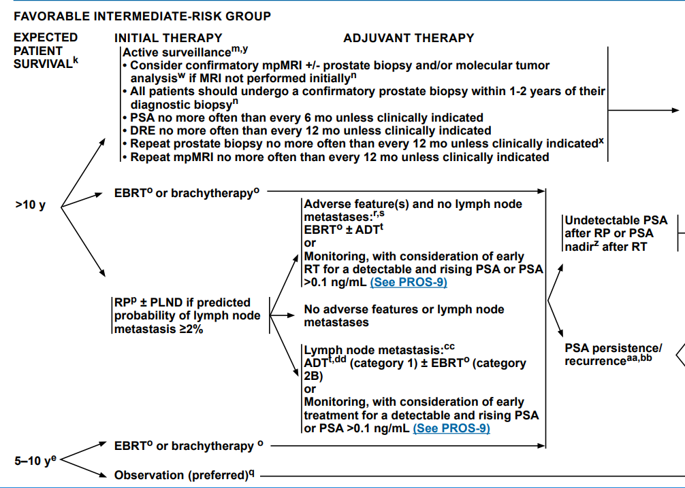

Slide 13
AUA Prostate cancer guidelines

Slide 14
CARE OPTION SUMMARY Very low and low risk
Evidence Level/ Recommendation Strength | Prostate Cancer Severity/Aggressiveness
 | Very Low Risk | Low Risk
A / Strong | Active Surveillance | NA
B / Moderate | NA | Active Surveillance
B / Conditional | NA | Radical Prostatectomy OR Radiotherapy
C / Conditional | NA | Cryosurgery (whole gland)
No evidence / clinical principle or expert opinion | NA | Focal Ablative Therapy OR HIFU

Slide 15
Intermediate risk
Evidence Level/ Recommendation Strength | Care Option Advisability Based on Prostate Cancer Severity Subgroup
 | Favorable Intermediate Risk | Unfavorable Intermediate Risk
A / Strong | Radical Prostatectomy OR Radiotherapy with ADT | Radical Prostatectomy OR Radiotherapy with ADT
B / Moderate | Radiotherapy* without ADT | NA
C / Conditional | Active Surveillance OR Cryosurgery (whole gland) | Cryosurgery (whole gland)
No evidence / clinical principle or expert opinion | Focal Ablative Therapy OR HIFU | Focal Ablative Therapy OR HIFU
* Radiotherapy includes external 3-D conformal or IMRT, alone or combined with LDR or HDR radiotherapy

Slide 16
RISK STRATIFICATION
High Risk: | PSA >20 ng/ml OR Grade Group 4-5 (i.e., Gleason score > 8) AND T1-T2 (stage>T3 is beyond the scope of these guidelines)
Clinicians should stage high-risk localized prostate cancer patients with cross sectional imaging (CT or MRI) and bone scan
Clinicians should recommend radical prostatectomy or radiotherapy plus ADT as standard treatment options for patients with high-risk localized prostate cancer
Do not recommend AS, focal therapy, primary ADT

Slide 17
Recommendation #2
You should know your risk category by NCCN and AUA(or at least one)

Slide 18
Who Are Candidates for Active Surveillance?
NCCN very low
NCCN low
NCCN intermediate
Low – volume, secondary pattern 4
No cribiform or intraductal pattern

Slide 19
Active Surveillance - Goals
Avoid or Delay the costs (functional, monetary) of treatment without compromising cancer cure
Based on the rationale that
Initial assessment is reasonably accurate
Monitoring is accurate and identifies sub – clinical progression at a time that initial treatment options are still available and curative
Active surveillance is about timing of treatment

Slide 20
AS: Triggers for Intervention
Consistent change in PSA kinetics
Progression on follow-up biopsy
Patient anxiety
Clinical or radiographic evidence of local/distant progression
Identification of more concerning pathologic variants(cribiform or intraductal)

Slide 21
Active Surveillance Current Controversies
What risk categories are appropriate?
Very low risk, low risk, favorable intermediate risk
Those with GS ¾ disease
Is it safe in African American men?
Are younger men appropriate candidates?

Slide 22
Is Active Surveillance Safe in Younger Men?
3 and 5- year upgrade-free survival rates: 73 and 55% versus 64 and 48% (p<0.01)
Younger patients more likely to receive subsequent treatment with RP (26%) versus RT (7%)
On Cox multivariable regression age ≤60 associated with freedom from biopsy upgrade (HR 1.48, 95% CI 1.21-1.82) and biopsy progression (HR 1.32, 95% CI 1.11-1.57)
No significant association between younger age and time to treatment or BCR following delayed RP
Younger Patients Have
Slower Rates of Progression
JCO 2017 10:35 (17): 1898

Slide 23
African American Men Are Not at Higher Risk for Adverse Pathology
Data from 2 large registries– CaPSURE/UCSF and SEARCH
AA race not associated with upgrade or upstage:
Upgrade (OR 1.44, 95% CI 0.96-2.16, p=0.13)
Upstage (OR 1.15, 95% CI 0.67-2.00, p=0.64)
No significant association with AA status and pathologic upgrade, upstage or positive surgical margins
Remained upon restriction to JHU/UCSF strict AS criteria
AA race not associated with risk of BCR after RP
UCSF / CaPSURE (n=4,231)
Few African American Men
in Current Cohorts
SEARCH (n=895)
J Urol. 2016 Nov;196(5):1408-1414. doi: 10.1016/j.juro.2016.06.086.
Jalloh M et al. Eur Urol 67(2015): 451-457

Slide 24
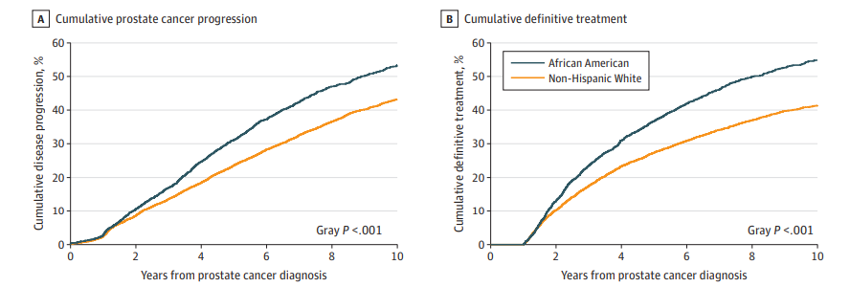
African American Men are at higher risk of progression and treatment(but remember AS is about timing of treatment)
PSA>10ng/ml
GG2 or higher(Gleason 3+4)
Deka et al. JAMA 2020

Slide 25
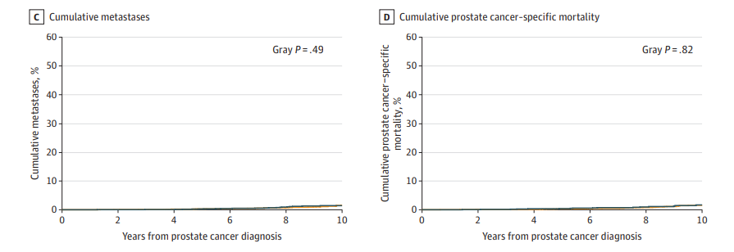
African American Men are at higher risk of progression and treatment(but remember AS is about timing of treatment)
NO Difference!
Deka et al. JAMA 2020

Slide 26
Active surveillance is safe in African American men and should not be withheld as an option
In the JAMA article, 40% of African American men avoided unnecessary treatment by 10 years.
Closer follow up may be needed: PSA, MRI, biopsy
The time on active surveillance may be shorter than men of other races, but even in the JAMA article it was the same for the first two years.
Race should not exclude a man who has very low or low risk prostate cancer and is interested in active surveillance.

Slide 27
Active Surveillance: Five-Year Outcomes
 | UCSF 2017 | JHH 2015 | Toronto 2015 | Canary 2016 | PRIAS
Cohort | 1549 | 1298 | 945 | 905 | 2494
Biopsy reclassification (grade+volume) | 49% | 35% | - | 30% | 28%
Treatment | 37% | 37% | - | 30% | 35%
Journal of Urology. 2016; 195(2)

Slide 28
Upgrading/Treatment – 4 Cohorts JHH, PASS, UT, UCSF
Results from one cohort may not be applicable to another
Biennial biopsies, compared to annual biopsies, delayed timing of progression @ 6 months
Ann Intern Med. 2018 Jan 2;168(1):1-9

Slide 29
What predicts reclassification?
Tosoian et al. Eur Urol 2020

Slide 30
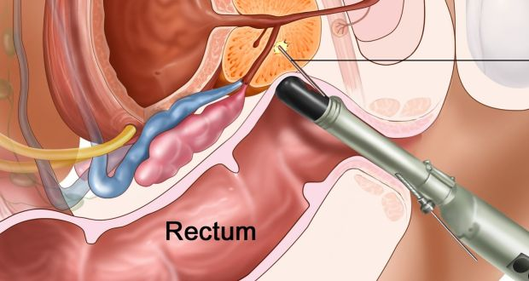
A few words about prostate biopsy
This is the most powerful tool in active surveillance. It determines risk category, can be used for genomics, tells volume and grade
Yes, you must have repeat biopsies
My opinion is that you should have anterior cores sampled as well.
20% of men with newly diagnosed prostate cancer have disease in the anterior zone

Slide 31
So who should consider active surveillance?

Slide 32
Absolute requirements
You must understand what you are getting into, why you are doing this, and the risks
Someone to follow up regularly with you(don’t go it alone)
Willingness to follow the protocol(this means biopsy, imaging, PSA testing)
Understanding that this is about DELAYING TREATMENT
Know your risk tolerance

Slide 33
Serial imaging during surveillance

Slide 34
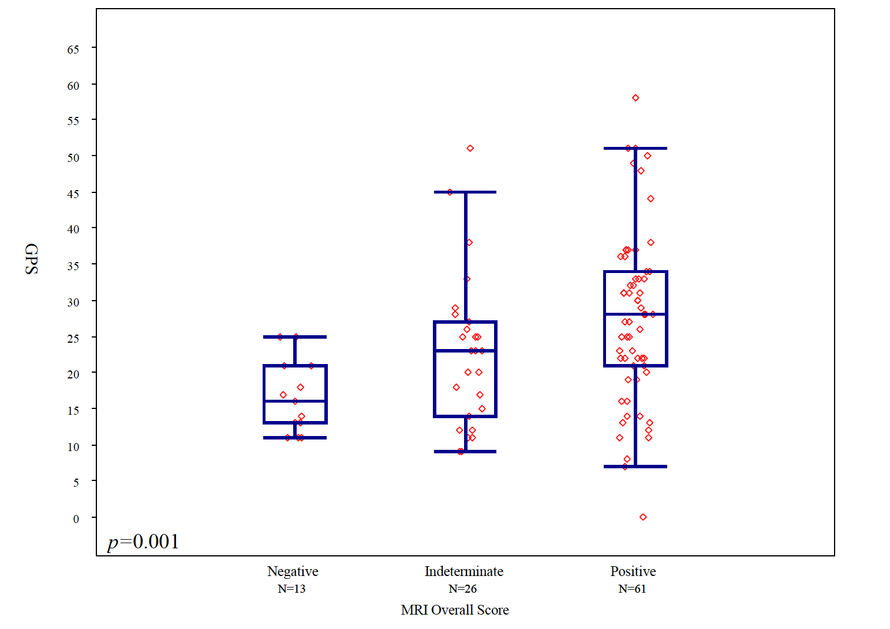
Where do these new tools intersect? Tissue Markers vs. MRI
PIRADS 4/5 a predictor of progression and adverse pathology
PIRADS 5
PLoS One. 2017 Oct 10;12(10):e0185535
Notes:
So while variability appears to exist in genomic profiles among favorable risk men with high suspicion score lesions.
It is very likely that similar comparative effectiveness work will be of value in a climate increasingly mindful of the economic toll of cancer care.

Slide 35
MRI during the first year of diagnosis
NCCN guidelines recommends
Helps to evaluate what is not well seen on transrectal ultrasound
Good for evaluating anterior tumors
Remember active surveillance relies upon initial diagnosis being accurate

Slide 36
mpMRI - Concerns
Costs
Insurance may not cover (in US, differs by state and biopsy status)
Variability of interpretation
Access
Can miss some cancers
Combine with other markers – PSAD, PHI, 4K

Slide 37
PI-RADS score and upgrade on surveillance
Characteristic | HR | 95% CI | P-Value
PI-RADs 1-2 (reference) | 1.00 |  | <.01
PI-RADS 3 | 1.55 | (0.68, 3.51) | 0.29*
PI-RADS 4 | 2.62 | (1.45, 4.76) | <.01*
PI-RADS 5 | 4.38 | (2.36, 8.16) | <.01*
Age at diagnosis (years) | 1.01 | (0.98, 1.04) | 0.40
PSA density at diagnosis (log) | 1.47 | (0.98, 2.20) | 0.06
Biopsy cores % positive at Diagnosis | 1.01 | (0.99, 1.02) | 0.24
Diagnostic Biopsy performed at UCSF | 0.57 | (0.36, 0.90) | 0.02
Harrell’s C-index-0.847 *Parameter P-Value
Cox regression for risk of upgrade to Gleason ≥3+4 on subsequent biopsy for AS cohort of men diagnosed with Gleason 3+3
Kornberg et al, J Urol
Notes:
MV model adjusted for marital status, race

Slide 38
GPS score and upgrade on surveillance
Characteristic | HR | 95% CI | P-Value
GPS (per 5-units) | 1.28 | (1.19, 1.39) | <.01
Age at diagnosis (years) | 1.00 | (0.97, 1.02) | 0.81
PSA density at diagnosis (log) | 1.38 | (0.94, 2.01) | 0.10
Biopsy cores % positive at Diagnosis | 1.01 | (1.00, 1.02) | 0.28
Diagnostic Biopsy performed at UCSF | 0.98 | (0.68, 1.40) | 0.90
Harrell’s C-index-0.680 *Parameter P-Value
Cox regression for risk of upgrade to Gleason ≥3+4 on subsequent biopsy for AS cohort of men diagnosed with Gleason 3+3
Kornberg et al, J Urol
Notes:
MV model adjusted for marital status, race

Slide 39
Predictive Values of PI-RADSv2 and GPS for Biopsy Upgrade
 | PPV |  |  | NPV
Cut-off Values | 1 Year | 3 Years | 5 Years | 1 Year | 3 Years | 5 Years
GPS>16 vs. ≤16 | 15% | 43% | 55% | 95% | 74% | 64%
GPS>22 vs. ≤22 | 19% | 51% | 64% | 93% | 73% | 63%
GPS>29 vs. ≤29 | 19% | 63% | 73% | 90% | 70% | 58%
PI-RADSv2 1-2 vs. 3-5 | 13% | 33% | 46% | 94% | 85% | 82%
PI-RADSv2 1-3 vs. 4-5 | 14% | 35% | 49% | 95% | 81% | 78%
PI-RADSv2 1-4 vs. 5 | 21% | 41% | 67% | 92% | 74% | 68%
Kornberg et al, J Urol, in press
Notes:
Of note, the median time from PI-RADS to subsequent biopsy was about a year, and median time from PI-RADS to biopsy upgrade was about 24 months.
Looking at the positive and negative predictive values of PI-RADS, we see that at 3 years following mpMRI, PI-RADS scores of 1-2 show a reasonable but not extraordinary negative predictive value of 87%.
Looking at the positive predictive values, PI-RADS 5 lesions only had a 3yr PPV of 33% which I would argue is surprisingly low

Slide 40
GPS score/PI-RADS and upgrade on surveillance
Cox regression for risk of upgrade to Gleason ≥3+4 on subsequent biopsy for AS cohort of men diagnosed with Gleason 3+3 with both PI-RADS and GPS scores
Characteristic | HR | 95% CI | Global P | Param. p
Age at diagnosis (years) | 1.03 | 0.99-1.07 |  | 0.17
PSA density at diagnosis (log) | 1.62 | 0.88-3.00 |  | 0.12
Biopsy cores % positive at GPS | 1.02 | 1.00-1.03 |  | 0.05
GPS score (<16 [25th percentile] vs. >29 [75th percentile]) | 3.09 | 1.40-6.80 |  | <.01
PI-RADS (4-5 vs. 1-3) | 1.58 | 0.85-2.93 |  | 0.15
Notes:
MV model adjusted for marital status, race

Slide 41
What about gleason 3 + 4?
Active Surveillance

Slide 42
Contemporary Risk Profiling
Old
Grade (3/4)
Volume (0.5 cc)
New
Volume
PSAD
MpMRI – PIRADS
MRI:TRUS fusion Biopsy
Genomics/Histology
Multivariable risk models

Slide 43
Treatment-free survival 3+3 vs 3+4
Notes:
tx-free survival 3/3 64%
tx-free survival ¾ 48%

Slide 44
Biochemical Recurrence After Delayed Radical Prostatectomy
PCS Survival 100%
Metastases - Free Survival 99%/98% (p = 0.21)
Masic et al, AUA 2018

Slide 45
Preoperative Predictors
Table 4. Multivariate Cox proportional hazards regression of pre-prostatectomy clinical variables with outcome of disease recurrence
 |  | HR (95% CI) | P
Age at diagnosis | Years | 1.02 (0.98-1.06) | 0.40
PSA density at diagnosis | Log | 1.50 (0.98-2.30) | 0.06
Gleason score and volume of high grade cores at diagnosis | GS 3+4 and 2+ HG cores vs GS 3+3 | 2.65 (1.23-5.69) | 0.01
 | GS 3+4 and 1 HG core vs GS 3+3 | 1.45 (0.52-4.07) | 0.47
Abbreviations: CI, confidence interval; GS, Gleason score; HG, high grade; HR, hazard ratio; PSA, prostate specific antigen.

Slide 46
AS - Caution
High PSAD
PIRADS 4/5 on mpMRI
Adverse genomics (GPS)
Cribriform histology
Intraductal histology
Larger number of biopsy cores 3/4 positive at diagnosis (volume)
Kweldam et al. Mod Pathol 2015; 28:457, Nat Rev Urol 2018 Apr 30. doi: 10.1038/s41585-018-0013-1

Slide 47
What to choose?
Candidates
For Active Surveillance
Immediate
Treatment
Standard
Watchful Waiting
Less Intense
3/4 , high volume
High genomics
ECE, SVI
Cribriform
Poor health
Low PSAD
Neg. biopsy
Favorable MRI/Genomics

Slide 48
PSA density versus PSA
PSAD is a better predictor of treatment and reclassification than PSA
 | Outcome
 | Delayed Treatment | Biopsy Progression
Independent Variable | HR (95% CI) | HR (95% CI)
Met strict criteria | 1.12 (0.82-1.53) | * 0.67 (0.50-1.04)
PSA diagnosis | 1.01 (0.97-1.05) | 0.97 (0.91-1.02)
Biopsy Density^ | 1.21 (0.66-2.22) | 1.31 (0.66-2.57)
PSAD strata <0.1 | Ref | Ref
0.1-0.15 | * 1.64 (1.09-2.47) | ** 2.06 (1.30-3.29)
>0.15 | ** 1.89 (1.25-2.87) | ** 2.83 (1.73-4.62)
Adjusted for biopsy frequency, year of diagnosis, age, race, marital status, and smoking history
Notes:
UPDATED 9/4/14 – CW (SUBMITTED FOR PUBLICATION)

Slide 49
Detection Paradigms are Changing
Detect all, Treat All
Heavy and repeated screening, no deferred treatment
Detect All, Treat Some
Heavy and repeated screening and biopsy, offer surveillance to those with lower risk disease
Detect Some, Treat Some
Avoid detection of low risk disease, offer surveillance to those with lower risk disease

Slide 50
Active Surveillance – you don’t have to stop
Because you think you are healthier now so can tolerate treatment better
Because you are young
Because you are
African American

Slide 51
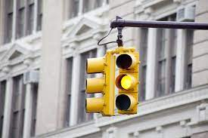
Active Surveillance – you may want to stop
Your urinary symptoms are so bothersome that you
will need surgical treatment for this.
You can’t have an MRI due to a pacemaker or other device
You can’t or won’t have another prostate biopsy(for any reason)
You are being evaluated for organ transplantation

Slide 52
Active Surveillance – you should stop
Increase in volume of disease
Rising PSA which is not explained
Upgrading
Increase in stage on imaging(T2 to T3)
Cribiform
Intraductal
Psychological stress is worsening your quality of life

Slide 53
Active Surveillance - Summary
Active surveillance is safe in well - selected patients but it is a commitment!!!
Active surveillance is safe in very low risk patients-long term data
Selected patients with GS ¾ disease are candidates for AS
Low PSAD, Favorable MRI, low risk genomics, low volume
This is delaying treatment for a few years, not forever
It is not about avoiding treatment, it is about safely delaying treatment.
Improving overall health while on active surveillance may improve long term survival
Weight loss
Smoking cessation
Diet and exercise

Slide 54
Active Surveillance – Questions to ask
Is my MRI changing?
Is my PSA consistently and rapidly rising?
Is my volume of disease changing?
Is my grade of cancer changing?
Do I have any pattern 4?
Of the pattern 4, is any cribiform or intraductal?
Am I following up as closely as I need to?
Is active surveillance making my life WORSE due to stress?

Slide 55
Thank you! kirsten.greene@virginia.edu

