Slide 1
Optimizing Sleep, Exercise and Nutrition in Prostate Cancer
Stacy Loeb, MD MSc PhD (Hon)
@LoebStacy
Professor of Urology and Population Health,
New York University and Manhattan Veterans Affairs
www.stacyloeb.com

Slide 2

Sleep Health
Lisa Fotios, Pexels

Slide 3
How is your sleep?
Do you have trouble falling asleep or staying asleep?
Do you wake up more than once in the middle of the night?
Do you snore, or wake up choking or gasping?
Do you feel fatigued during the daytime?
Are you likely to doze off in a meeting, a public place or while driving?
Do you have any of these risk factors?
  Are you overweight?
  Is your shirt collar larger than 17 inches?
  Do you have high blood pressure?

Slide 4
Types of Sleep Problems
Insomnia
  Difficulty falling asleep, staying asleep, or waking earlier than you would like and cannot get back to sleep
Sleep Apnea
  Potentially serious condition where breathing repeatedly stops and starts
Others (e.g., narcolepsy, restless leg syndrome)- less common

Slide 5
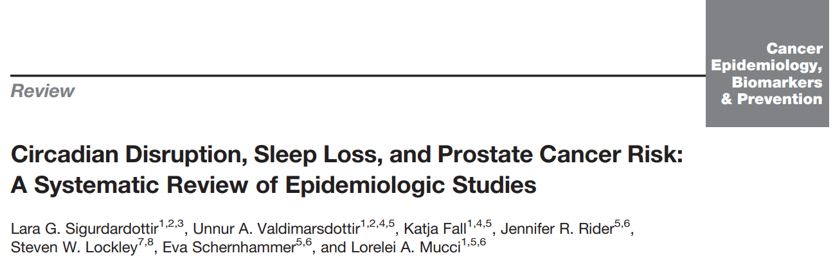



15 of 16 showed positive association (10 statistically significant)
Ecological data: countries with more light at night → more CaP
Inverse association of sleep duration and CaP risk
Pilots and other occupations with Circadian disruption → higher CaP risk
Shift work → higher CaP risk in multiple studies

Slide 6
Mechanisms Linking Sleep Disturbances to Cancer
Circadian system as potential tumor suppressor (e.g., inhibition of cellular proliferation, anti-angiogenesis)
Melatonin is secreted by pineal gland, with peak at night
  Suppressed by many factors including light at night
  Inhibits prostate cancer growth in experimental studies
Obstructive sleep apnea → hypoxia → accelerated tumor progression

Slide 7
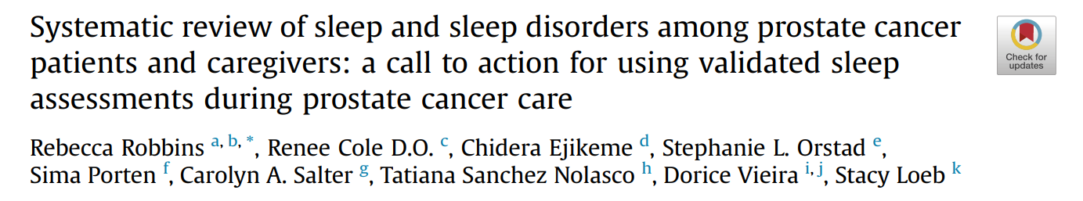
83 studies
3 including caregivers
Prostate cancer has a substantial impact on sleep
Linked with other issues:
  Night sweats
  Urination
  Pain
  Stress
  Anxiety
Sleep Medicine 2022; 94: 38

Slide 8
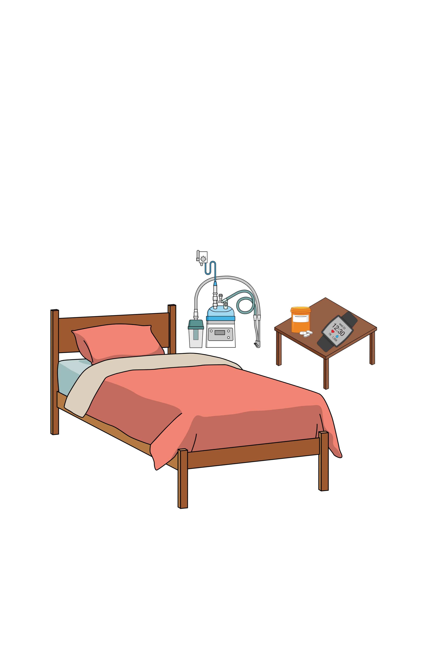
Survey of Patients with Prostate Cancer
45% were at high-risk for sleep apnea
48% used sleeping medicine and 31% had poor sleep habits
22% met the criteria for clinical insomnia
67% of respondents met the cutoff for poor sleep quality
Loeb et al. (Unpublished Data)

Slide 9
Ironman Registry: Advanced PCa
Baseline Data on Sleep
Courtesy of Dr. Lorelei Mucci
Manuscript in Progress

Slide 10
Survey of Caregivers of Patients with Prostate Cancer
26% are at “high risk” for OSA
43% used medications to help them sleep
37% met the cutoff for clinical insomnia
88% met PSQI criteria for “poor sleep”
Thakker et al. BJUI Compass (in press)

Slide 11



Sleep Disturbances are Morbid!
Mental health consequences:
↑ Depression, ↓ QOL/well-being
Increased risk of chronic disease:
Hypertension, diabetes, obesity, depression, heart attack, and stroke
↑ Accidents and injuries
↑ Healthcare Utilization

Slide 12
What to do if you are experiencing sleep problems
Improve sleep hygiene
Mindfulness meditation
Cognitive behavioral therapy for insomnia
Caution with sleep medications
See a sleep specialist (especially if snoring/gasping for air)

Slide 13




Sleep Hygiene Tips
Regular bedtime & wake time
Avoid looking at clock if awaken
Bright light in morning
Avoid bright light at night
Turn off electronics at night
Enhance the sleep environment (e.g., temperature, comfort)
Regular physical activity in morning/afternoon
Limit caffeine consumption
Avoid big meals & limit fluid within 3h of bedtime

Slide 14

Cognitive behavioral therapy for insomnia (CBT-I): recommended initial treatment
Shared-decision-making about adding pharmacologic therapy when CBT-I alone is unsuccessful (ideally only for <=5 weeks)
Consider treatable secondary causes of insomnia (e.g., depression, pain, urinary problems, and other sleep disorders like OSA)

Slide 15
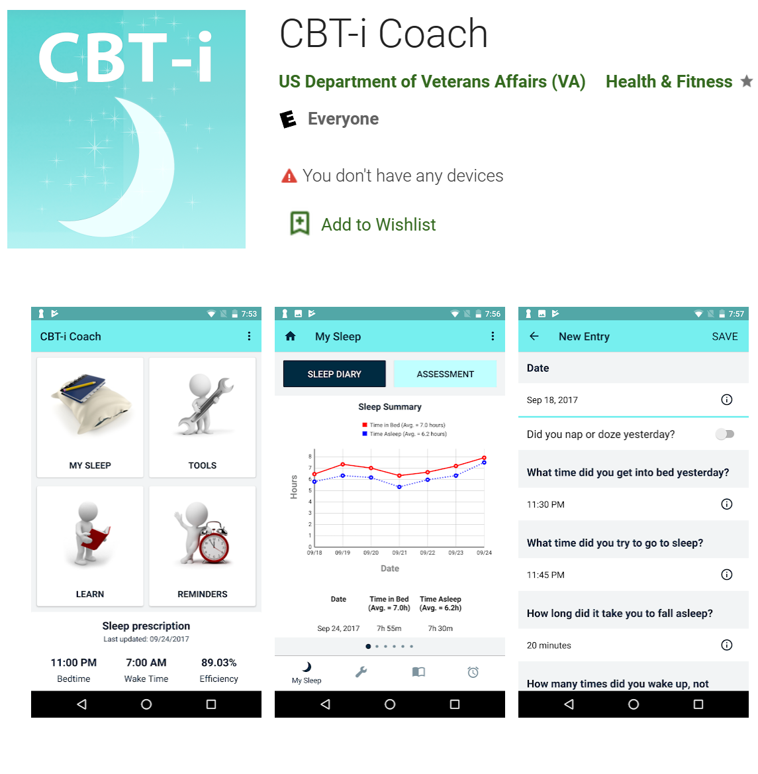
Cognitive Behavioral Therapy for Insomnia (CBT-I)
Individual or group therapy
Web-based modules/apps
Self-help books

Slide 16
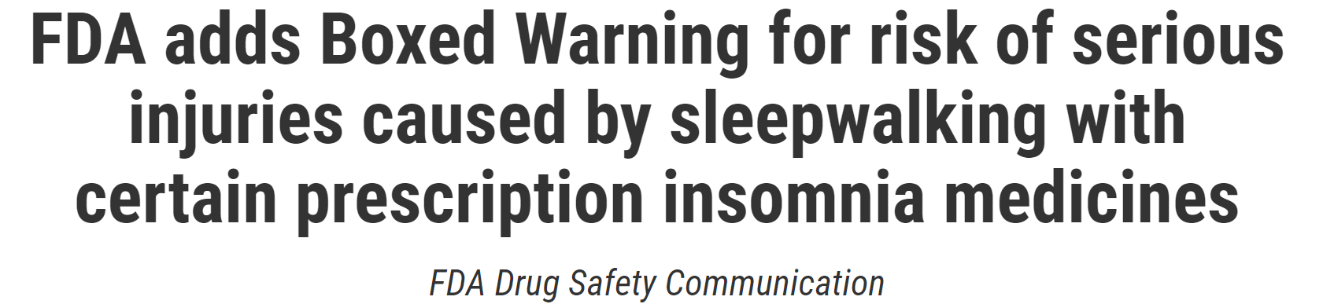
Dangers of Sleep Medication

Slide 17
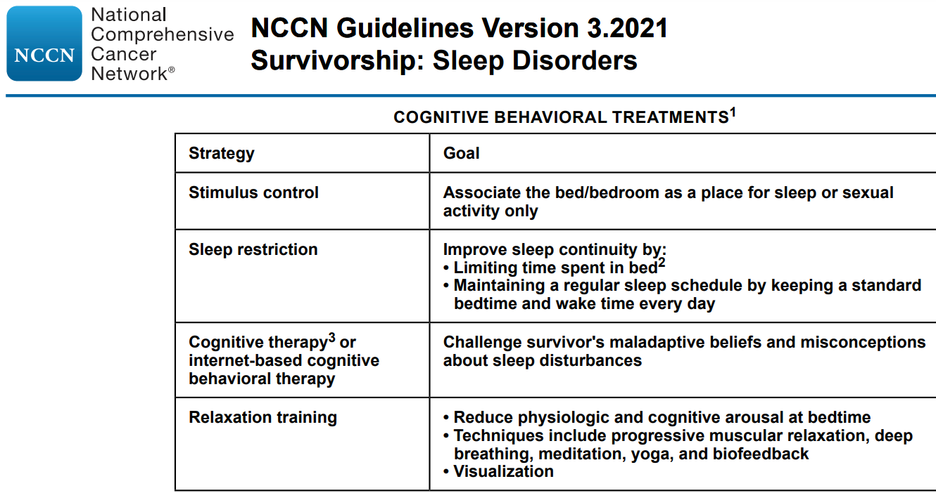

Slide 18

Lifestyle Modification:
Physical Activity + Nutrition
Barbara Olsen, Pexels

Slide 19
Why Healthy Lifestyle is Important for People with Prostate Cancer
Low-risk prostate cancer → >9x more likely to die from cardiovascular disease than prostate cancer
Metastatic prostate cancer → 17% die from noncancer causes (e.g., cardiovascular disease)
Klotz et al. JCO 2014; 33: 272 Yamamoto et al J Urol 2016; 195: 1409.
Elmehrath et al. JAMA Network Open 2021

Slide 20
American Cancer Society Survivorship Guidelines
American Cancer Society Prostate Cancer Survivorship Care Guidelines
Maintain a healthy weight
Engage in at least 150 mins/week of physical activity
Eat a diet high in fruits, vegetables and whole grains
Avoid smoking

Slide 21

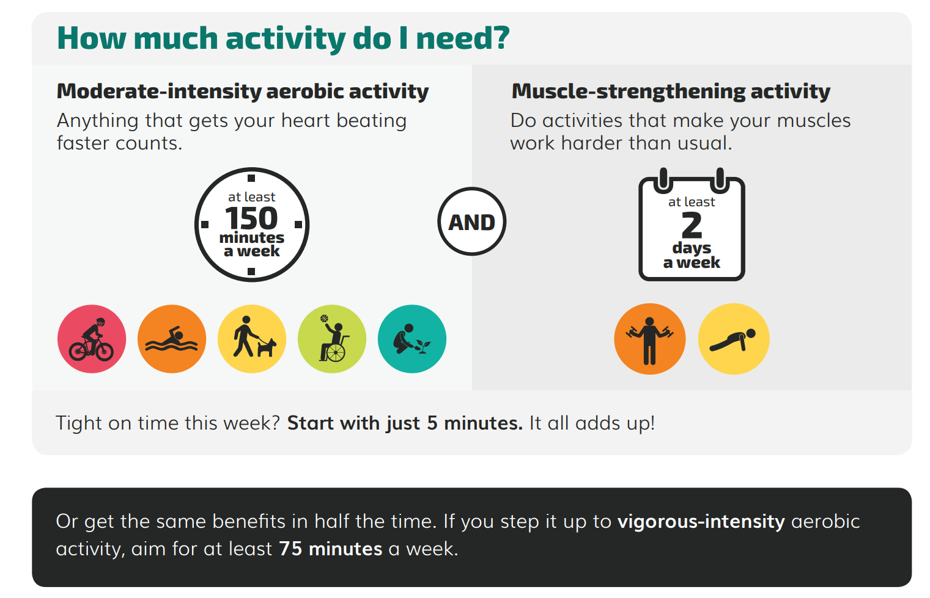

Slide 22
Look for activities that you enjoy!
Moderate - intensity aerobic activity
  Brisk walking, dancing, gardening, light cycling, doubles tennis
Vigorous – intensity aerobic activity
  Jumping rope, running, vigorous cycling, singles tennis, swimming
Strength training
  Resistance bands, weights
Flexibility and Mind/Body
  Yoga, mindfulness meditation

Slide 23
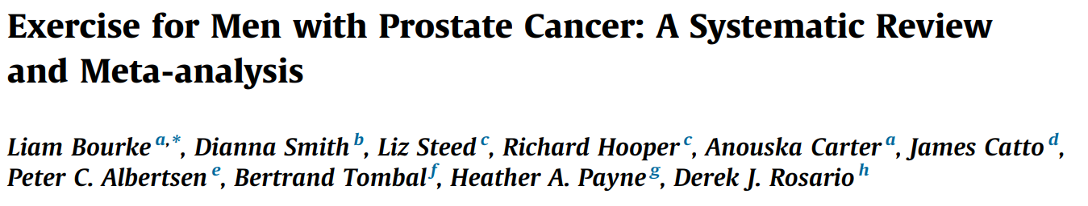



16 randomised controlled trials (RCTs) , 1574 men with prostate cancer, Follow-up varied from 8 wk to 12 mo
No difference in disease progression/ PSA
Moderate improvement in cancer-specific quality of life in the high-quality studies
Improvement in cancer-related fatigue
Borderline increase in sexual activity, but no difference in sexual function
Improvement in lower body strength
No difference in blood pressure
Improvement in lower body strength
Improvement in aerobic fitness

Slide 24
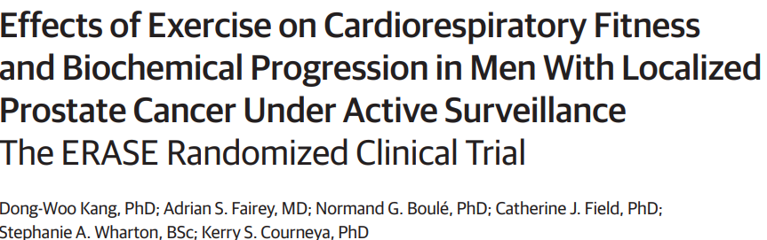


High intensity interval training 3x/wk x 12 weeks
Intervention arm:
Improved cardiopulmonary fitness
Decreased PSA
Versus
Usual care

Slide 25
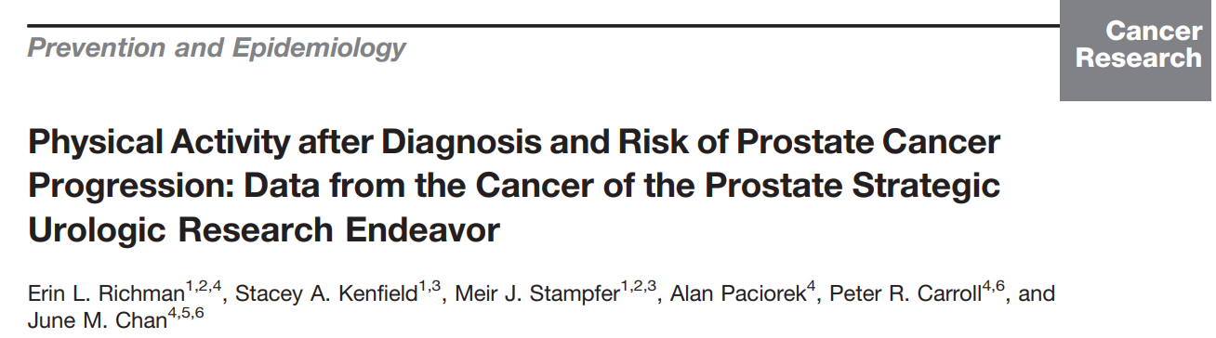
Men who walked briskly for ≥3 h/wk had a 57% lower rate of progression than men who walked at an easy pace for less than 3 h/wk
More brisk walking pace was associated with decreased risk of progression independent of duration

Slide 26
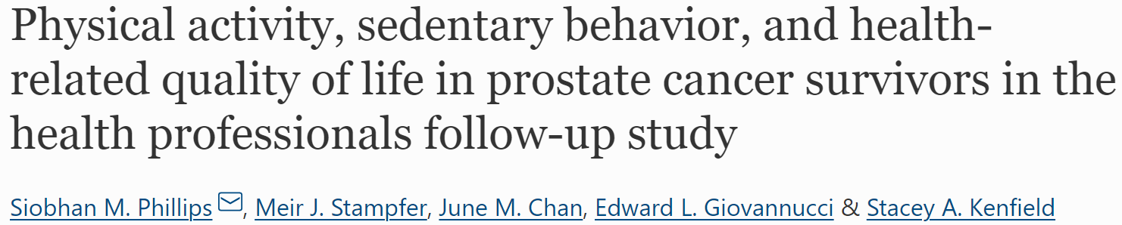
Examined physical activity after prostate cancer diagnosis and quality of life
Higher duration of total, non-vigorous, and walking activity was associated with higher vitality/hormonal functioning scores (p-trends, <0.0001)

Slide 27

Nutrition
Ella Olsson, Pexels

Slide 28
Global Variation in Prostate Cancer Incidence

Slide 29

Migration Studies
Japanese in Japan < Japanese migrants to Hawaii < Caucasians in Hawaii
JAPAN:
LOW RISK
USA:
HIGH RISK
Kolonel et al. Nat Rev Cancer 2004; 4: 519

Slide 30
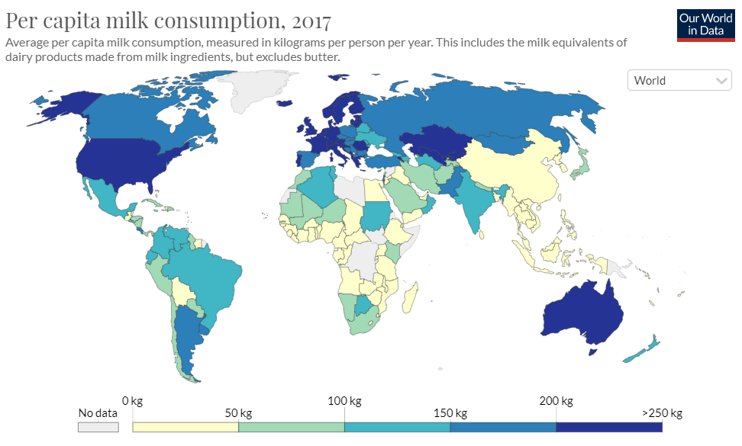
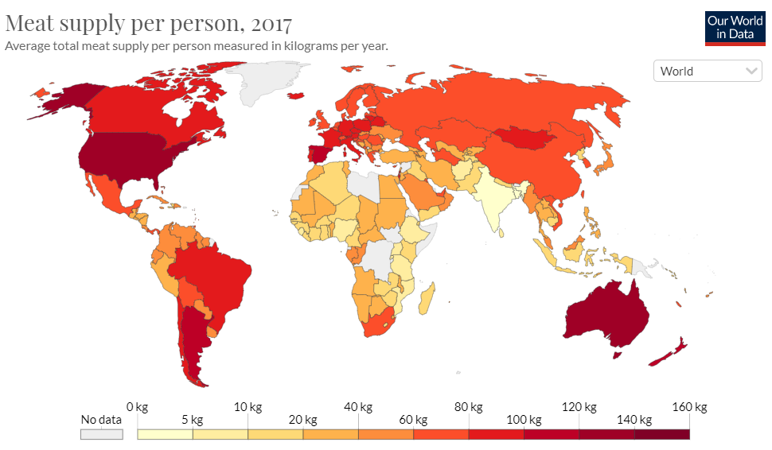
Prostate Cancer Risk & Dietary Maps
Prostate Cancer Incidence

Slide 31



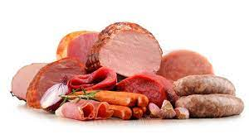
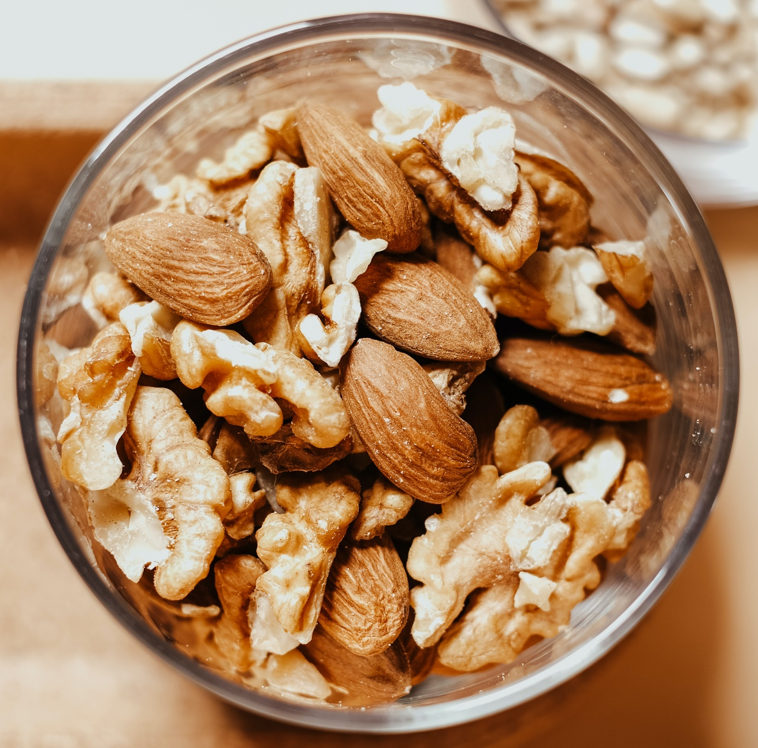
Specific Foods Linked With Risk of Clinically Significant Prostate Cancer
Beneficial
Harmful
Notes:
For prostate cancer, many prior studies have linked individual plant-based foods like tomatoes with a lower risk of prostate cancer. Meanwhile, animal-based foods like dairy and processed meat have been linked with a higher risk of prostate cancer. However, most studies have focused on individual foods and less on full dietary patterns

Slide 32
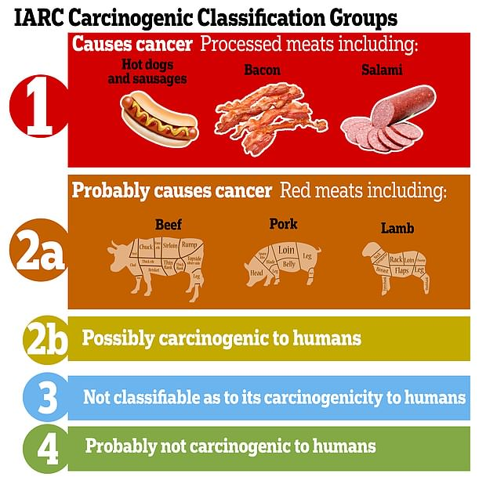
WHO Classifies Meat as a Carcinogen
Same category as arsenic and asbestos
Same category as DDT, lead and mustard gas
Notes:
Focusing specifically on cancer, the World Health Organization considers processed meats such as hot dogs, bacon and salami as a Group 1 carcinogen (causes cancer), the same group as asbestos and smoking. Red meats such as beef, pork and lamb are classified as Group 2a, probably causes cancer. These ratings were primarily based on the relationship with colorectal cancer.

Slide 33
Why Meat is Carcinogenic
Formation of heterocyclic amines during high-temperature cooking
Hormonal effects
Nutrient composition
  Lower levels of anti-carcinogenic compounds (e.g., fiber, antioxidants) in meats vs plants

Slide 34


Slide 35
Specific Foods Linked With Risk of Clinically Significant Prostate Cancer
Beneficial
Harmful
Mediterranean or plant-based dietary patterns
Notes:
For prostate cancer, many prior studies have linked individual plant-based foods like tomatoes with a lower risk of prostate cancer. Meanwhile, animal-based foods like dairy and processed meat have been linked with a higher risk of prostate cancer. However, most studies have focused on individual foods and less on full dietary patterns

Slide 36

Whole Foods Plant-Based Diet (“WFPB”)
Emphasizes whole, minimally processed foods
Limits or avoids animal products (e.g., meat, dairy, eggs)
Avoids highly processed/refined foods (e.g., sweeteners, white rice, bleached flowers)
Staples are legumes, fruits, vegetables and whole grains

Slide 37
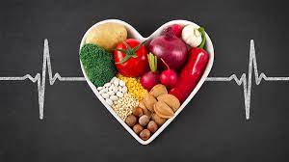


Benefits of Plant-Based Diets
Plant-based diets reduce risk of numerous health conditions, including ischemic heart disease, diabetes, hypertension, certain types of cancer, and obesity
Plant-based diets are more environmentally sustainable (less greenhouse gas emissions, land and water use, biodiversity loss) and environmental/social justice
72 billion land animals and >1.2 trillion aquatic animals are killed for food around the world every year.
Notes:
Plant-based diets have many well-established benefits for overall health, including a reduction in heart disease, diabetes, hypertension, multiple types of cancer and obesity. Other advantages of plant-based diets are that they are more environmentally sustainable, resulting in less emissions, land and water use, less biodiversity loss. Of course, there are also benefits for the more than 1 trillion animals killed for food every year.

Slide 38

Appropriately planned vegetarian, including vegan, diets are healthful, nutritionally adequate, and may provide health benefits for the prevention and treatment of certain diseases.
These diets are appropriate for all stages of the life cycle, including pregnancy, lactation, infancy, childhood, adolescence, older adulthood, and for athletes.
Plant-based diets are more environmentally sustainable because they use fewer natural resources and are associated with much less environmental damage.
Vegetarians and vegans are at reduced risk of certain health conditions, including ischemic heart disease, type 2 diabetes, hypertension, certain types of cancer, and obesity.

Slide 39
Plant-Based Dietary Patterns & Prostate Cancer
Benefits Across the Spectrum of Disease
Lower risk of elevated PSA
Lower risk of diagnosis with aggressive prostate cancer
Lower risk of progression among men on active surveillance
Lower risk of progression among men with recurrent/advanced disease

Slide 40
Plant-Based Diet → Lower Risk of Elevated PSA
N=1399 men in National Health and Nutrition Examination Survey
Higher consumption of healthy plant-based diet associated with lower probability of having elevated PSA (0.47, 95% CI 0.24-0.95, p=0.034)
Mouzannar et al. Urology 2021; 156: 205-210.

Slide 41

Higher Plant-Based Diet Index → Lower Risk of Fatal Prostate Cancer
Prospective cohort study, n=47,239 men in the Health Professionals Follow-up Study (1986-2014)
Greater overall plant-based consumption was associated with a significantly lower risk of fatal prostate cancer (p-trend = 0.04)
Loeb et al. American Journal of Clinical Nutrition

Slide 42
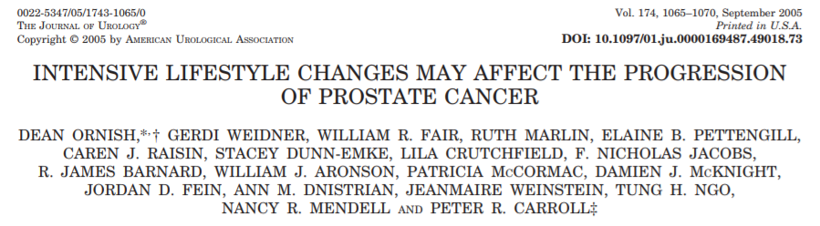
Men on active surveillance for favorable-risk localized prostate cancer
Group 1: Intensive Lifestyle Program
Vegan diet with supplements, moderate aerobic exercise and stress management
Fewer progressed to treatment
↓PSA
↓Cholesterol
95% adherence
More had treatment due to progression
↑PSA
↑Cholesterol
Group 2: Control group
No intensive lifestyle program
* No difference in testosterone between the groups *

Slide 43
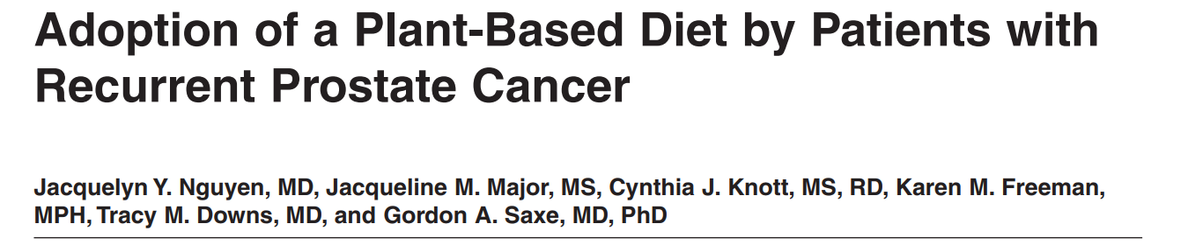
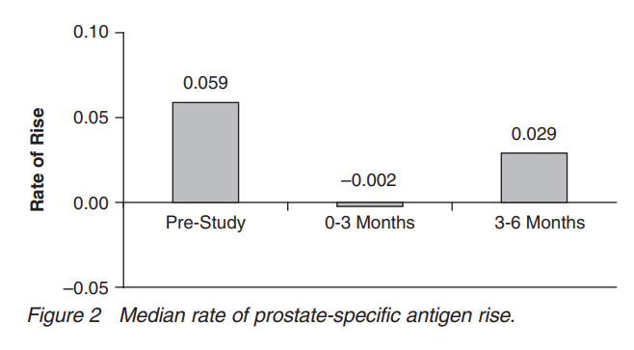
University of California, San Diego (UCSD) Healthy Men Study
Men with rising PSA after prostatectomy or radiation
Clinical trial of individual and group-based support to increase plant-based dietary consumption + stress reduction
PSA actually significantly declined for several months when plant-based consumption was highest

Slide 44
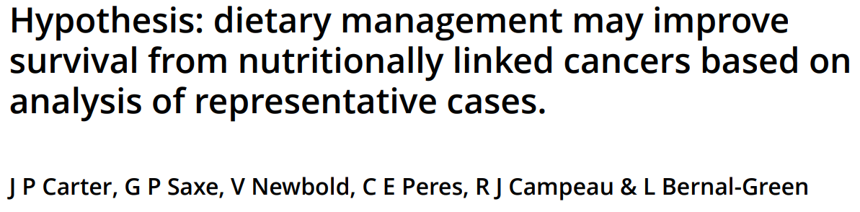
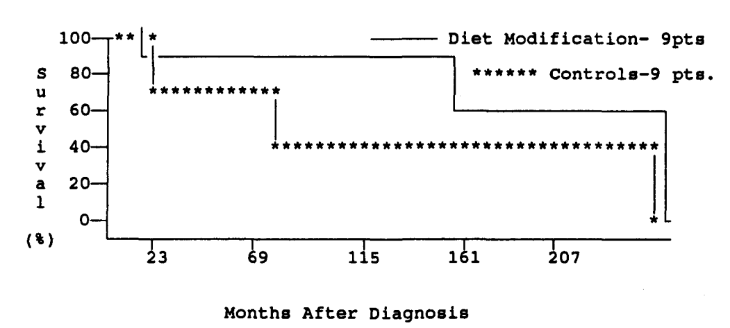
Patients with metastatic prostate cancer
  N=9 adopted macrobiotic plant-based low-fat diet vs. N=9 controls on Standard American Diet (“SAD” ☹)
Dietary modification group: 3 had healing of bone lesions and 100% progression-free prior to deviation from the diet
Longer median survival compared to “SAD” controls
Journal of the American College of Nutrition 1993; 12:3; 209-226.

Slide 45

Downsides to Plant-Based Diets

Slide 46



Added Perk to Plant-Based Diet: Better Erections!

Slide 47

More Added Perks to Plant-Based Diet: Improve Diabetes
New consensus statement from American College of Lifestyle Medicine, endorsed by several other societies:
Diet as a primary intervention for Type 2 diabetes is most effective in achieving remission when emphasizing whole, plant-based foods with minimal consumption of meat and other animal products.
A low-fat, whole food, plant-based diet can often sustain remission of Type 2 diabetes.
A very low-carbohydrate diet can be associated with significant adverse events and cardiovascular risk that make this diet inadvisable for long-term remission of type 2 diabetes
Rosenfeld et al. Am J Lifestyle Medicine 2021

Slide 48
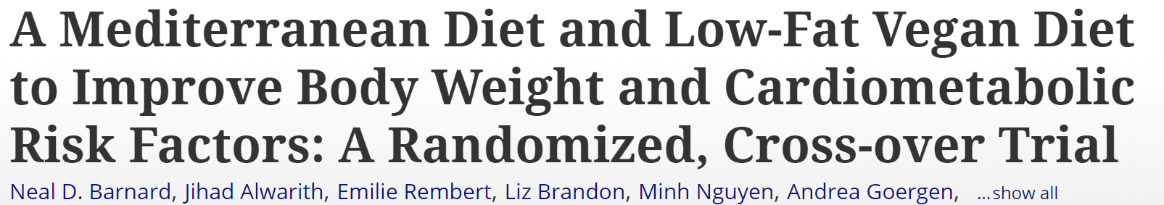
Added Perk to Plant-Based Diet: Weight Loss
62 overweight adults assigned to Mediterranean or vegan diet for 16 weeks → 1 month break → switch to the other diet
Vegan diet: significantly more weight loss compared to Mediterranean diet (net effect: -6 kg, p<0.001) and significant decrease in cholesterol

Slide 49

Resources for Plant-Based Diet
Documentaries
  Game Changers
  Forks Over Knives
  What the Health
Books
  How Not To Die (by Dr Greger)
  The China Study (by Dr Campbell)
  Healthy at Last (by NYC Mayor Eric Adams)
Website for Information & Recipes from MD’s/RD’s:
  Physicians Committee for Responsible Medicine (pcrm.org)
  Nutrition Facts (nutritionfacts.org)
Meal Service
  Purple Carrot
App/Website
  Happy Cow

Slide 50
Conclusion
Eat more plants!
  Plant-based diets are associated with a lower risk of prostate cancer progression
  Also better for cardiovascular health, sexual health, the environment, animals…..
  A win-win with no downside
  Emphasis on whole, minimally processed foods
Get active!
  ≥150 mins/wk of moderate intensity aerobic activity + strength & flexibility exercises
  Improves quality of life in prostate cancer + cardiovascular health
Healthy sleep is important!
  Improve sleep hygiene
  Cognitive behavioral therapy for insomnia
  See sleep specialist for symptoms of sleep apnea

Slide 51

Acknowledgements
Prostate Cancer Foundation
New York State Department of Health
NYU Perlmutter Cancer Center Support Grant
Special thanks to all of the patients, caregivers and healthcare providers who have participated in our studies!
@benevolente82 (Shutterstock)

Slide 52
Open to enrollment- patients, partners & family members!
Pilot of Sleep & Health Improvement Program (SHIP)
Baseline
Questionnaires + Sleep Monitor
3 Months
Website with sleep & lifestyle tips
Post-Intervention
Questionnaires + Sleep Monitor
Call with health coach
Supported by NYU Perlmutter Cancer Center and New York State Department of Health
Participation involves visiting a website designed by the study team with recommendations about sleep, nutrition and exercise, completing online surveys, wearing a wrist watch to measure activity for a total of two weeks, visiting a website, and two telephone calls with the study team. Gift cards will be provided as reimbursement for study completion.
For more information or to schedule an interview, please contact:
Nataliya Byrne: 646-501-2681 / Nataliya.Byrne@nyulangone.org
or Tatiana Sanchez Nolasco: 646-501-2550 / Tatiana.Sancheznolasco@nyulangone.org

