Slide 1
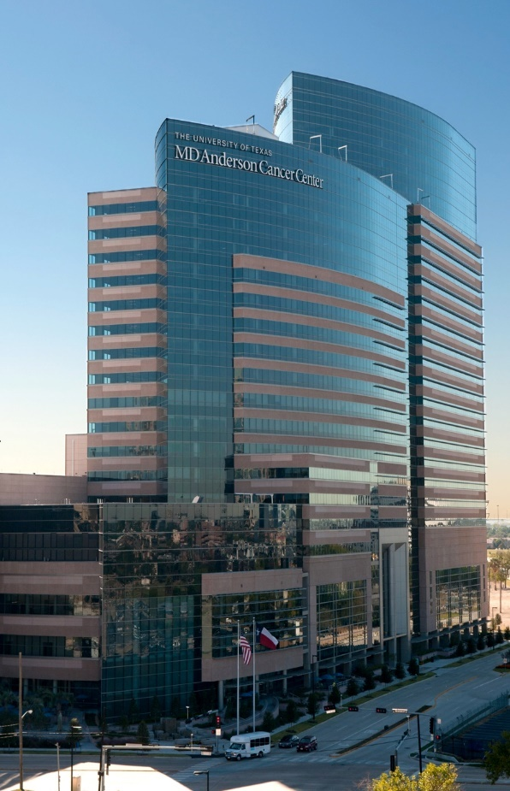

Prostate Cancer Prevention and Early Disease Non-Progression: Update and Diet, Exercise, Supplements
Justin R. Gregg, MD
Assistant Professor of Urology and Health Disparities Research
UT MD Anderson Cancer Center
International Prostate Forum
5/15/22
Notes:
Talk about here is work I have done with collaborators at MD Anderson and is a lot of the reason I chose to go there for my fellowship

Slide 2
Disclosures
Bayer HealthCare – Steering Committee
Notes:
“this perked our interest, as my lab mentor Tim Thompson has years of expertise on cav-1 – this is a transmembrane cholesterol binding protein involved in lipid trafficking and previously shown to be associated with aggressive prostate cancer. Furthermore, prior work showed that increased serum Cav-1 was associated with disease reclassification in patients enrolled on active surveillance.

Slide 3
Objective
Primary: To describe current evidence for modifiable risk factors associated with prostate cancer development and disease progression
Contents
  Prostate cancer risk
  Progression on active surveillance
  Advanced disease progression

Slide 4
Prostate cancer risk

Slide 5
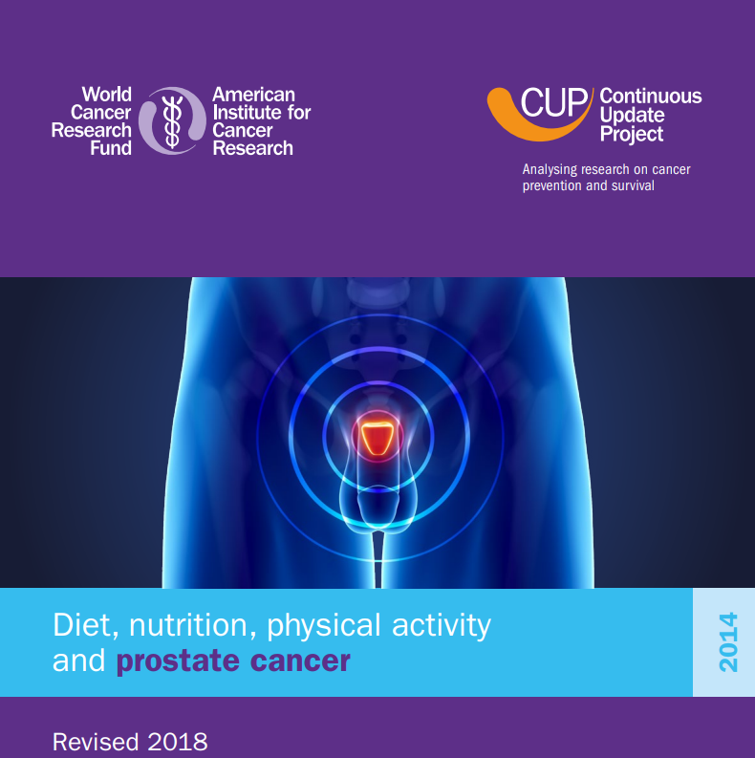

Slide 6
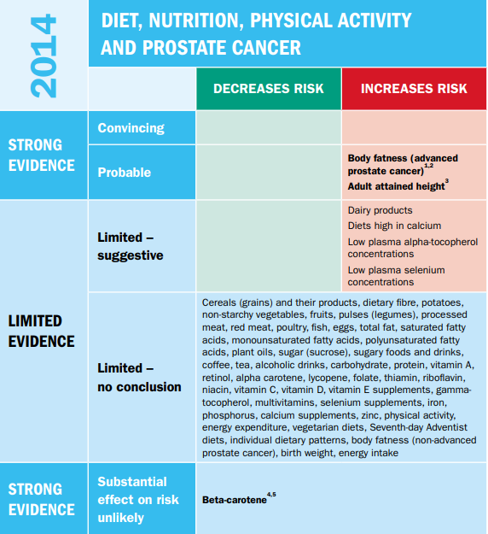
Increased risk of “aggressive” disease:
Probable
  Body fat
  Adult height
Limited
  Dairy; high calcium diet
  Low alpha-tocopherol
  Low plasma selenium

Slide 7
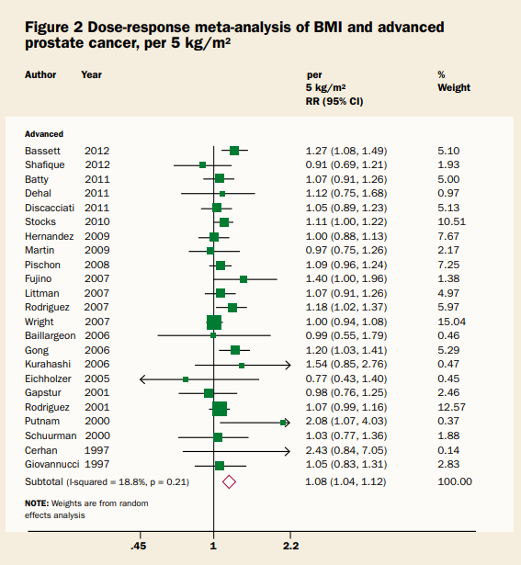
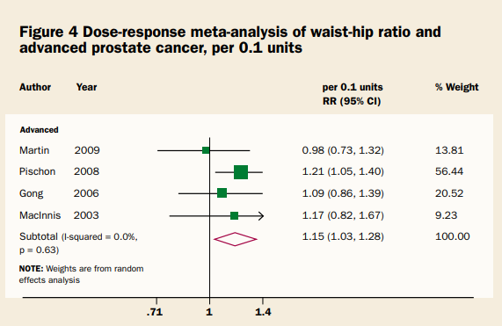
BMI and “advanced” prostate cancer
Waist to hip ratio
Overall: HR 1.15, 95% CI 1.03-1.28
Overall: HR 1.08, 95% CI 1.04-1.12
Notes:
Notes here: similar findings with waist to hip ratio for waist circumference

Slide 8
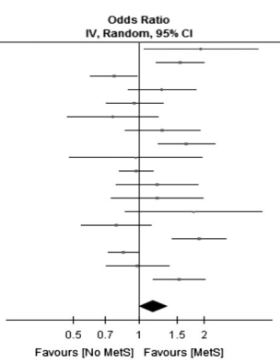
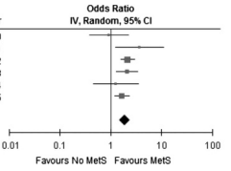
Metabolic syndrome
Abdominal obesity
Elevated triglycerides
Low HDL
Elevated blood pressure
Elevated fasting glucose
GG4 or higher disease
OR 1.89; 95% CI 1.50-2.38
Any prostate cancer
OR 1.17; 95% CI 1.00-1.36
Gacci et al. PCAN 2017
Notes:
Start with 34% of patietns with prostate cancer have at least one factor
Nice metaanalysis that included 24 cohort studies

Slide 9
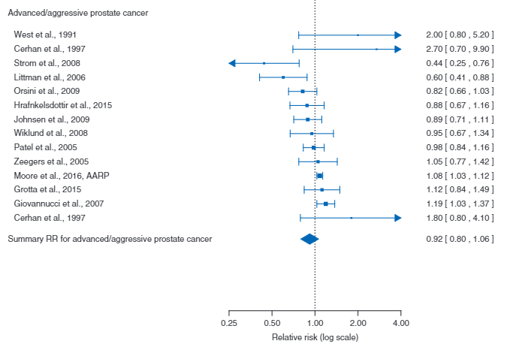
Physical activity
HR 0.92; 95%CI 0.80-1.06
Benke et al. Annals Oncol 2018
Brookman-May et al. Eur Urol Focus 2018
Notes:
Data are surprisingly lacking in this area
Metaanalysis limited but does not suggest beneft
THIS METAANALYSIS LOOKS AT GG2 or higher disease

Slide 10
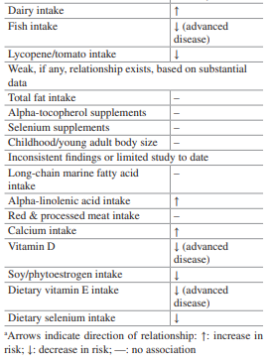
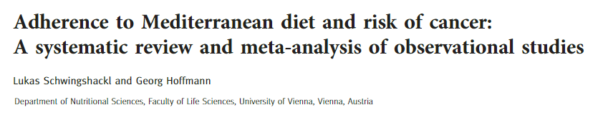
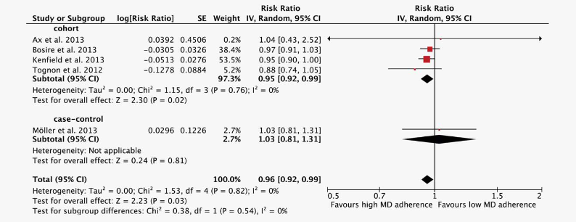
Diet
Weak
Adapted from Wilson and Mucci. Diet and Lifestyle in Prostate Cancer. Prostate Cancer 2nd ed. 2019
Schwingshackl and Hoffmann. Int J Cancer 2014

Slide 11

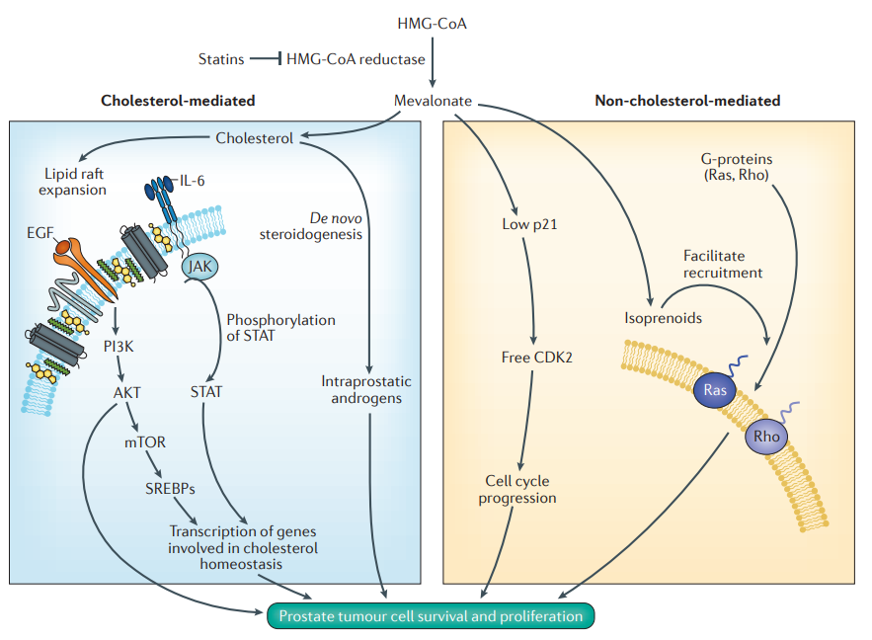
Evidence summary
Cholesterol mediated and non-cholesterol mediated
Setting | Risk | Notes
Pre-diagnosis | Lower risk advanced disease | Bias regarding PSA screening and use
Post-diagnosis | Lengthened PCSS
Lipid rafts vs. Ras-mediated
Alfaquih…Freedland Nat Rev Urol 2017

Slide 12
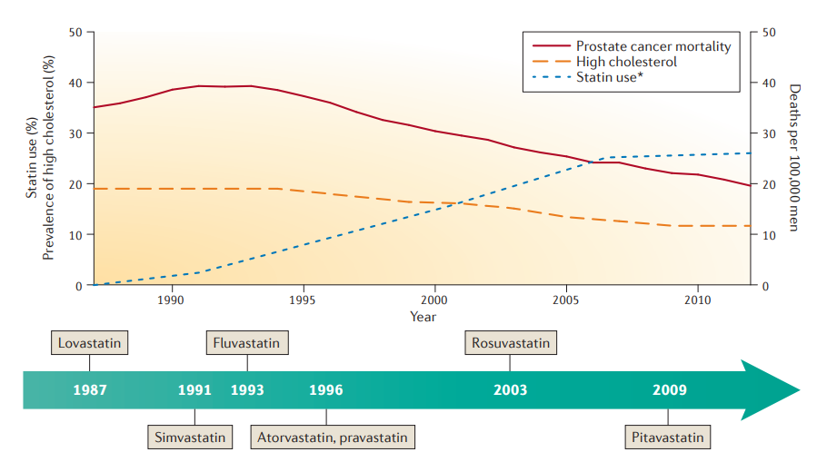
Statin use, cholesterol level and PCSM

Slide 13
Modifiable risk factors NOT discussed
Prevention using 5 alpha reductase inhibitors
Smoking
Ejaculatory frequency

Slide 14
Prostate cancer progression

Slide 15

2020
Review of diet and lifestyle considerations for men diagnosed with prostate cancer
Focused on RCTs
“Supplemented” with observational studies

Slide 16
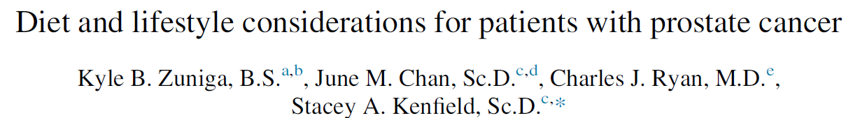
Dietary Factor | Localized prostate cancer | Advanced prostate cancer
Lycopene/tomato | RCT leans towards benefit, significant effect | RCT leans towards benefit, significant effect
Green Tea | RCT leans towards benefit, moderate
Avoid vitamin/mineral substance (ex. Selenium) | RCT no benefit
Coffee | *Potential benefit
Cruciferous Vegetables | *Potential benefit
Fish | *Potential benefit
Mushrooms | *Potential benefit
Avoid dairy | *Potential benefit
Avoid eggs | *Potential benefit
Avoid poultry | *Potential benefit
Avoid processed red meat | *Potential benefit
Avoid saturated fat | *Potential benefit
Milk thistle | RCT no benefit
Pomegranate | RCT no benefit | RCT no benefit
Soy | RCT no benefit | RCT no benefit
Omega 3 | RCT no benefit
2020
* = observational study
Zuniga et al. Urol Oncol 2020

Slide 17
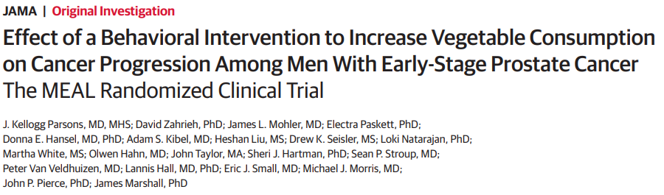
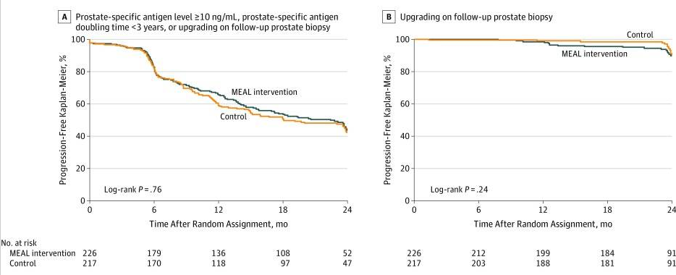
2020
Phase III RCT testing high vegetable intake
  Randomized to telephone counseling
  Time to progression (PSA, PSADT, grade)
478 randomized
  Vegetable intake improved
  No change in other diet factors
Notes:
NEED THE BETTER SLIDE HERE

Slide 18
Diet quality and progression on AS
Hypothesis: overall diet quality is associated with improved progression-free survival in a surveillance population
Mediterranean diet
Fruit | Meat*
Vegetables | Dairy*
Legumes | Monounsaturate/saturated FA
Whole grain | Alcohol**
Fish
MD Anderson prospective AS cohort
  Enrollment 2005-2014
  Confirmatory + yearly biopsy
  N=410
  Time to Gleason GG progression
“Detrimental” components
**Moderate alcohol considered beneficial
Notes:
Diet stuff diet stuff, but what is it about diet that may be associated with aggressive prostate cancer? In fact there are data in this space that interventions for diet may not be effective.

Slide 19
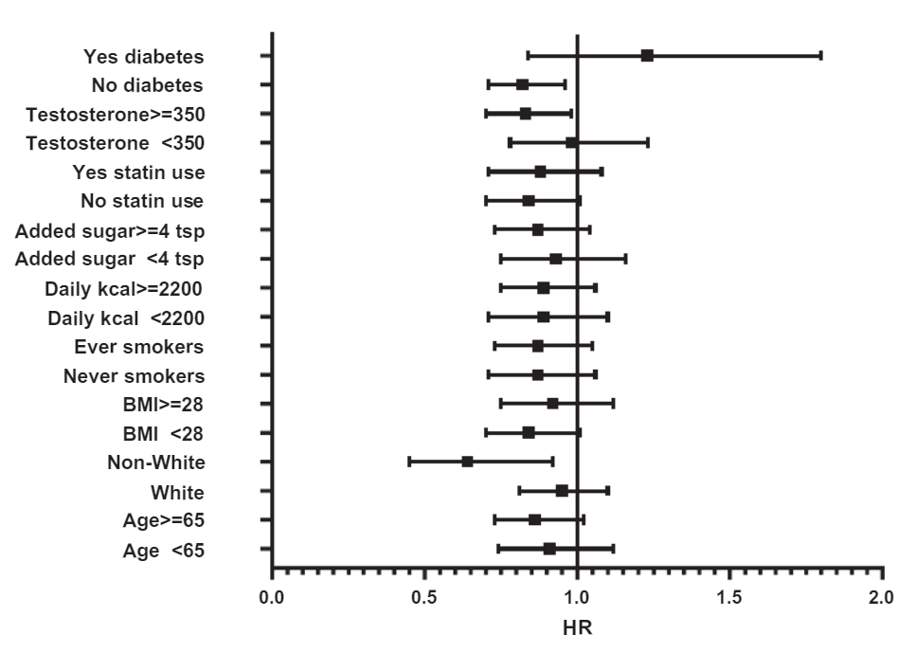
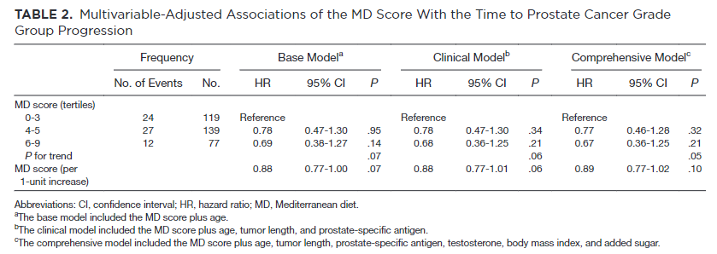
Mediterranean diet and progression risk on AS
Gregg et al. Cancer 2021

Slide 20
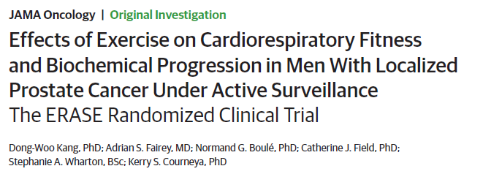
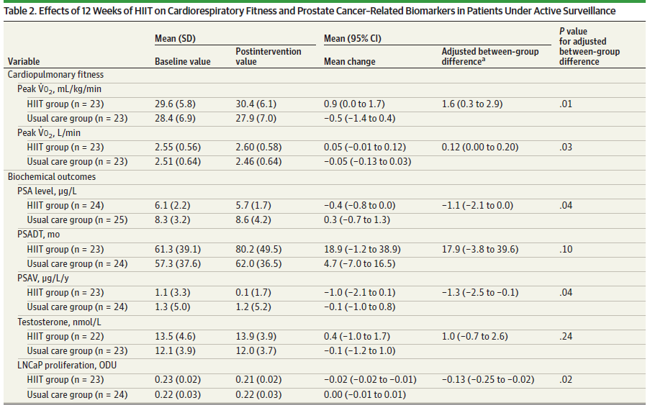
2021
2021
52 randomized
26 HIIT
26 usual care
Primary: Peak V₀₂
Secondary
  PSA and kinetics
  PCa cell line growth

Slide 21
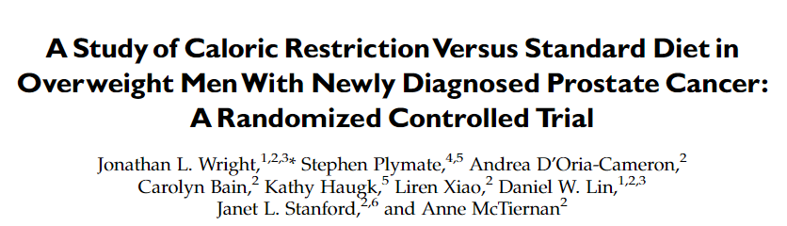
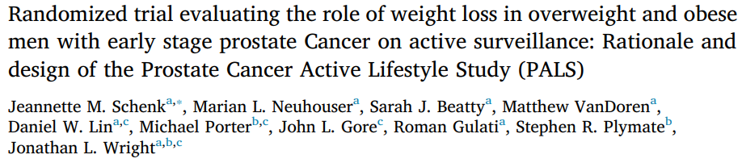
Weight loss
19 patient pilot
6 week calorie restriction
3.7 vs. 2lb weight loss
Biomarker change
6 mo pre-bx diet and exercise intervention
Primary outcomes
  Glucose regulation markers
  Weight loss
Prostate 2013
Contemp Clin Trials 2019

Slide 22
Advanced prostate cancer progression

Slide 23
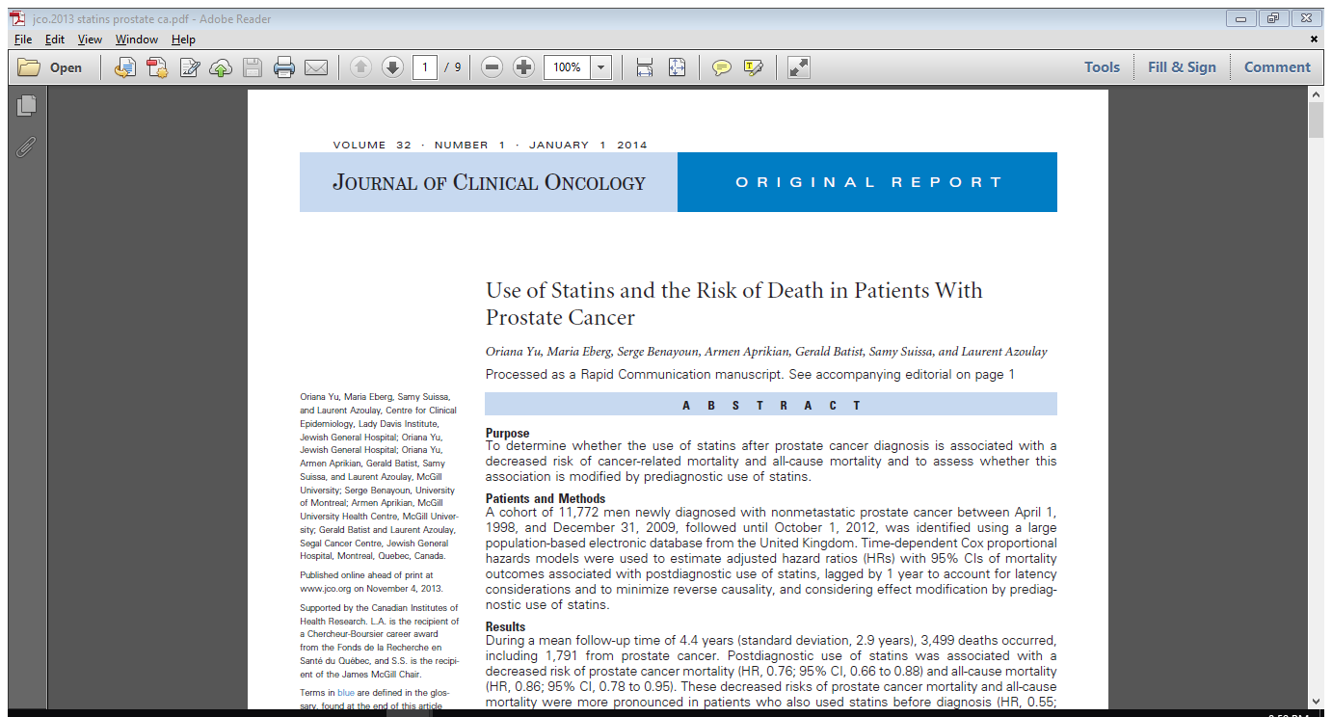
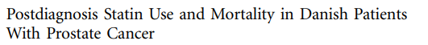
Statin use
Adjusted HR Prostate Cancer Mortality
Yu et al., 2013
0.83 (95% CI 0.77-0.89)
0.76 (95% CI 0.66-0.88)
Larsen et al., 2017

Slide 24
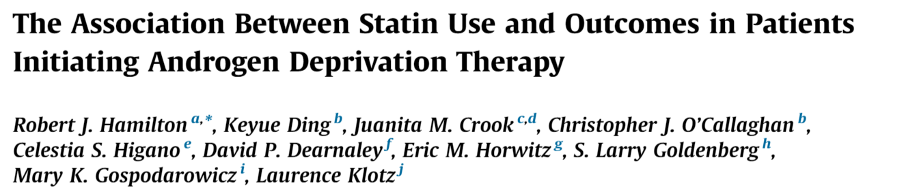

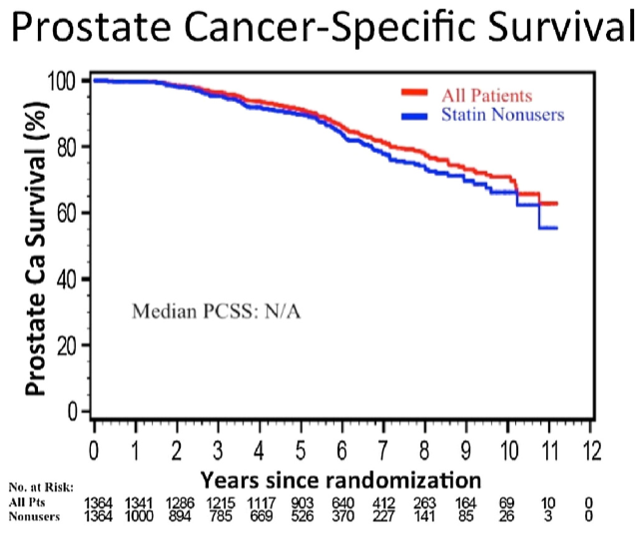
2021
Secondary analysis of RCT
  Prior radiation (>1yr) with PSA >3
  Intermittent vs. continuous ADT
  N=1,364
Results – statin use associated with:
  Improve OS: HR 0.64 (95% CI 0.53-0.78)
  Improved PCSS: HR 0.65 (95% CI 0.48-0.87)

Slide 25
Hormone Signaling
Metabolic Function
Chronic Inflammation
Friedenreich et al. Mol Oncol 2021

Slide 26
Bonus content: development of modifiable, risk factor-based intervention

Slide 27

75% of Americans drink coffee (50% daily)
Numerous health benefits
Loftfield et al. J Nutr 2016
Notes:
MAYBE NEED TO REPRESENT THIS GRAPHICALLY
Look at that carrie paper…

Slide 28

Coffee and Cancer
Coffee decreases risk of diagnosis of a wide range of cancers
Prostate cancer and coffee associations
  Lower risk of diagnosis
  Less aggressive disease at diagnosis
Associated with decreased progression in colon cancer
Not studied in an active surveillance population
Grosso. Annu Rev Nutr 2017; Liu Nutr Cancer 2015
Wilson JNCI 2011; Guercio J Clin Oncol 2015
Notes:
“slide 38” – this is where I left off on the plane 12/12/18 going over Carrie’s edits

Slide 29
Coffee consumption and surveillance
Hypothesis: Increased coffee consumption association with improved progression free survival in men on active surveillance
Cups/day | N (%)
0 | 74 (18.0)
<1 | 85 (20.7)
1-1.9 | 87 (21.2)
2-3.9 | 106 (25.8)
≥4 | 59 (14.4)
Total | 411
Gregg et al. J Urol 2018
Notes:
MAYBE NEED TO REPRESENT THIS GRAPHICALLY
Look at that carrie paper…

Slide 30
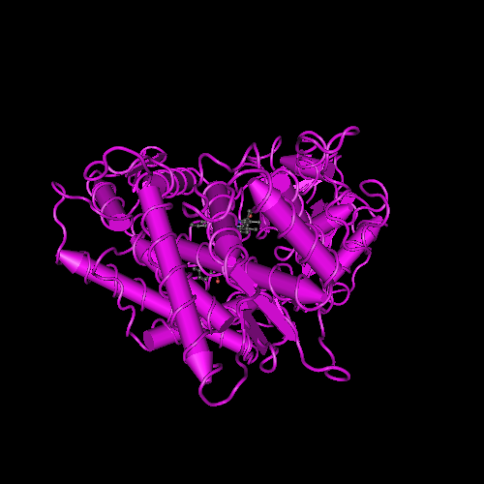


Caffeine metabolism
Fast metabolizers consume coffee
Fast (AA)
Intermediate (AC)
CYP1A2 NCBI
Slow (CC)
Guest Med Sci Sports Exerc 2018
El-Sohemy Genes Nutr 2007
Notes:
Maybe make this slide way better. Maybe show the enzyme, then arrows to a cyclist animation and a heart.
Or, arrows to the different genotypes, and an arrow with fast metabolism + caffeine led to increased performance

Slide 31
rs762551 genotype and progression
AA
“fast metabolizer”
AC/CC
“moderate/slow metabolizer”
Gregg et al. J Urol 2018
Notes:
This of course requires further validation, which we are currently working on, though offers another example

Slide 32
Conclusions
Risk of prostate cancer
  Obesity
  Physical activity
  Diet
Risk of active surveillance progression
  Diet? Exercise?
Risk of advanced progression
  Statins

